Slide 4
Climate Change and the Energy Transition: Our Energy Infrastructure at a Crossroads
PNWER Annual Summit Plenary Session: Overview of our Regional Infrastructure and Policy Landscape
August 17, 2021
Arne Olson, Senior Partner

Slide 5
Themes
2
 A changing climate is posing PROFOUND CHALLENGES to our ability to deliver reliable and affordable energy
 Responding to the physical and policy imperatives of climate change will require significant investment in our ENERGY INFRASTRUCTURE
 Ensuring an ORDERLY, EQUITABLE TRANSITION toward clean energy systems will require proactive planning and regulation to preserve the public benefits provided by networked energy systems
5

Slide 6
The climate is transforming: key findings about possible climate futures from the 2021 IPCC report
3
Global surface temperature will continue to increase until at least the mid-century under all emissions scenarios considered. Global warming of 1.5°C and 2°C will be exceeded during the 21st century unless deep reductions in carbon dioxide (CO2) and other greenhouse gas emissions occur in the coming decades.
Many changes in the climate system become larger in direct relation to increasing global warming. They include increases in the frequency and intensity of hot extremes, marine heatwaves, and heavy precipitation, agricultural and ecological droughts in some regions, and proportion of intense tropical cyclones, as well as reductions in Arctic sea ice, snow cover and permafrost.
Continued global warming is projected to further intensify the global water cycle, including its variability, global monsoon precipitation and the severity of wet and dry events.
Under scenarios with increasing CO2 emissions, the ocean and land carbon sinks are projected to be
less effective at slowing the accumulation of CO2 in the atmosphere.
Many changes due to past and future greenhouse gas emissions are irreversible for centuries to millennia, especially changes in the ocean, ice sheets and global sea level.
Intergovernmental Panel on Climate Change, Climate Change 2021: The Physical Science Basis https://www.ipcc.ch/report/ar6/wg1/downloads/report/IPCC_AR6_WGI_SPM.pdf
6

Slide 7
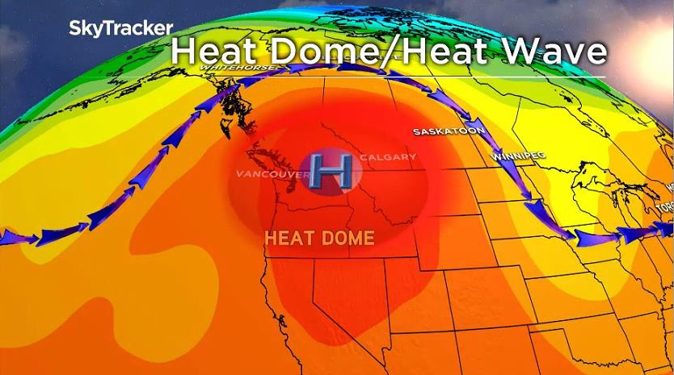
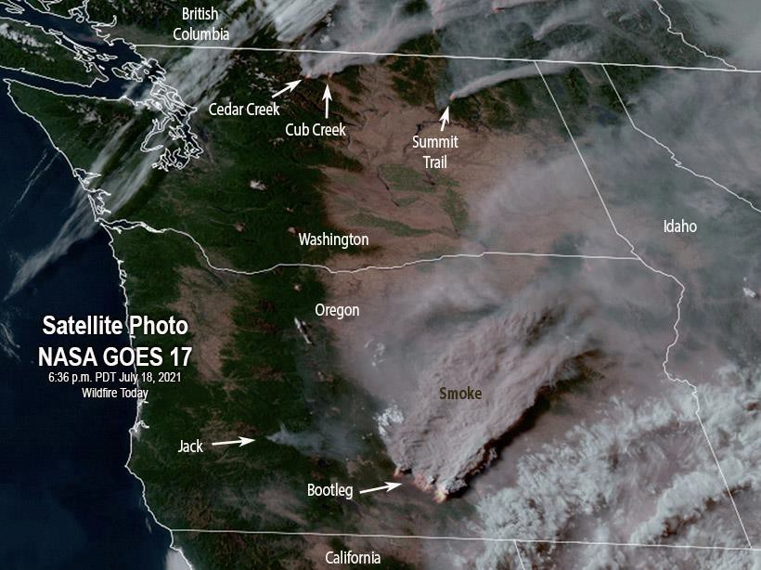
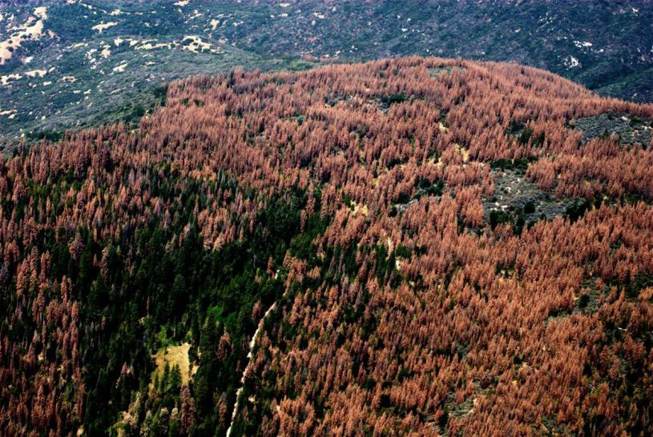
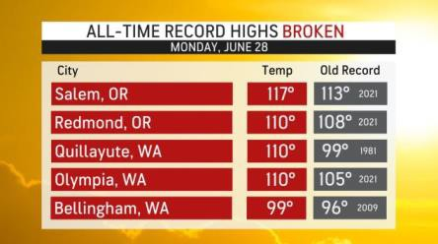
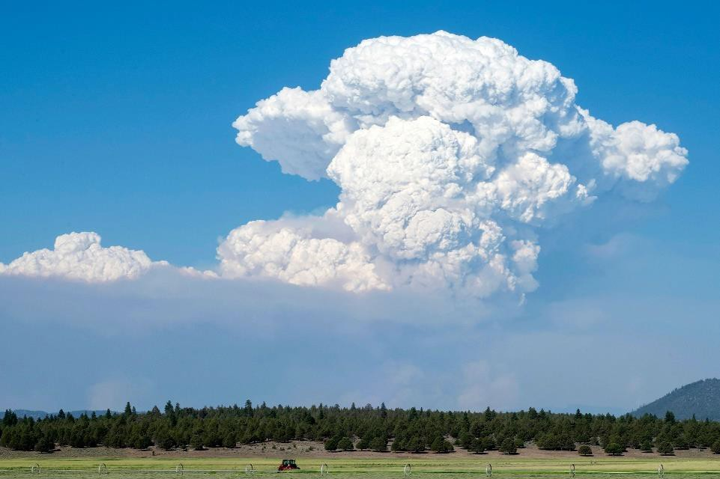
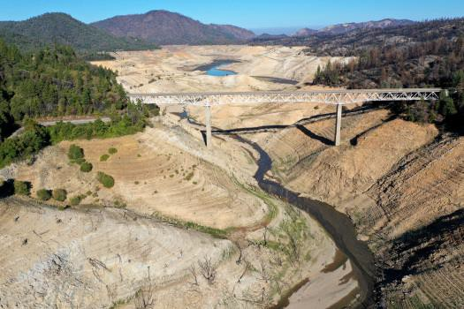
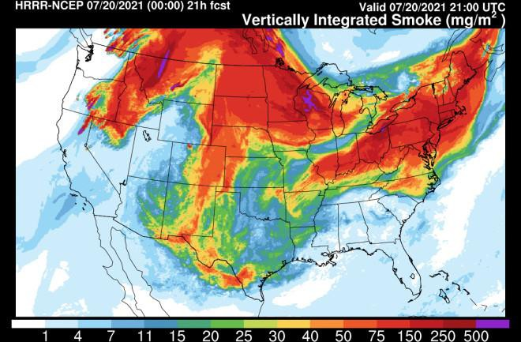
Climate impacts are happening close to home: extreme heat, drought, fires
4
7

Slide 8
The policy landscape is transforming: clean energy goals are multiplying
5
Most of the Pacific Northwest Region is now covered by some type of clean energy goal
Entity | Description
British Columbia | Climate Change Accountability Act (2007): Economy-wide, 40% reduction by 2030, 60% by 2040, 80% by 2050
Washington | Clean Energy Transformation Act (2019): Electricity only, no coal by 2025, carbon-neutral by 2030, 100% clean by 2045
Oregon | 100% Clean Energy Bill (2021): Electricity only, 80% carbon reduction by 2030, 90% by 2045, 100% by 2040
Idaho Power | 100% clean energy by 2045
Avista | Carbon neutral electricity by 2027, 100% clean energy by 2045
Puget Sound Energy | Beyond net-zero by 2045, which includes: a carbon neutral electric system by 2030 and 100% clean electricity by 2045.
NorthWestern | 90% carbon reductions by 2045
Portland General Electric | 80% carbon reduction by 2030, net zero carbon by 2040
8

Slide 9
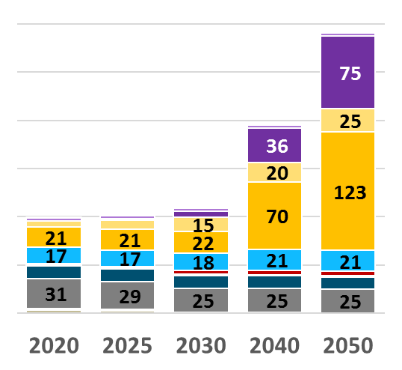
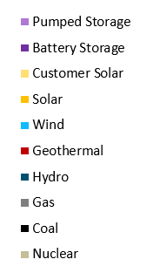
Meeting our energy and climate challenges will require a transition of our energy systems across four “pillars”
Energy efficiency & conservation
Low carbon fuels
Electrification
Low carbon electricity
California Electric Loads under Deep Carbon Reductions
California Electric Resources under Deep Carbon Reductions
+60%
Transportation
Other
Electrification
Existing loads
Electricity sector plays a key role in meeting societal carbon goals in all scenarios!
9

Slide 10
Climate change is posing multiple challenges to our Energy Infrastructure
7
 Keeping our communities and consumers SAFE is increasingly difficult with more extreme temperatures, storms and fires
 Providing RELIABLE energy service is complicated by both extreme weather and the transition to weather-dependent energy resources
 Keeping energy AFFORDABLE will be important to maintain our economic well-being and to facilitate the transition to electrified technologies
 A shift to more SUSTAINABLE energy sources is vital to limit future climate damage
 Ensuring EQUITABLE access to energy services will need to be a key priority as our energy systems transition
7

Slide 11
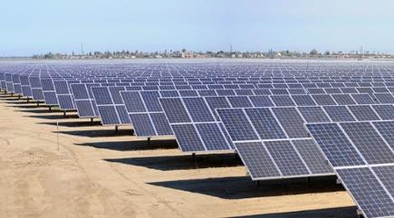
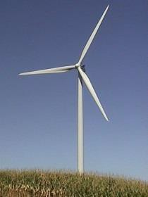
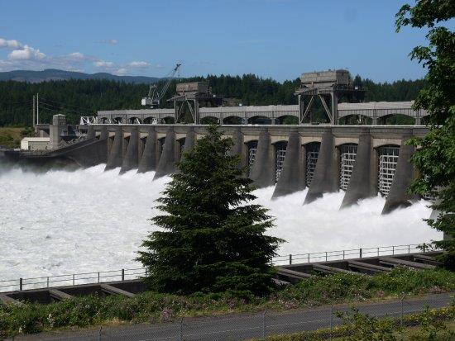
Electric sector “low-hanging fruit” is to rapidly scale up
clean generating resources
 Invest in new and existing CLEAN
ELECTRICITY generation
Wind and solar power are low-cost and abundant in most places
Coal replaced with renewables and gas
Retain existing NUCLEAR and HYDRO
Requires significant buildout of
TRANSMISSION
Significant GHG reductions can be achieved at relatively low cost in the Pacific Northwest
Image source: Resource Adequacy in the Pacific Northwest (Various utilities, 2019)

Slide 12
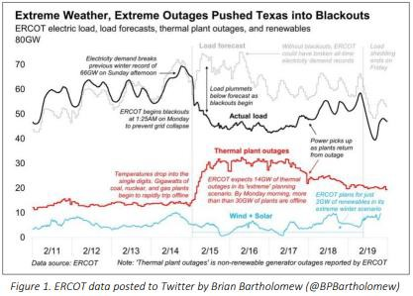
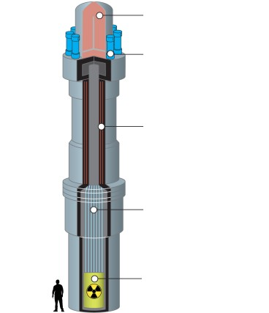
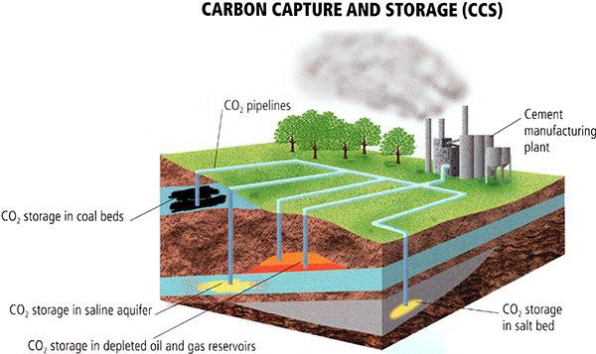
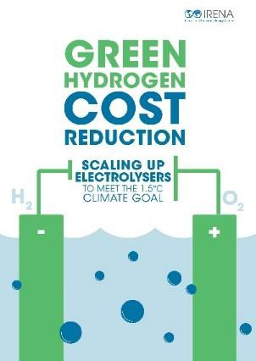
Maintaining reliable and affordable electricity will require continuing to invest in fossil fuel infrastructure
9
 RESOURCE ADEQUACY will be a significant challenge as coal is retired and more wind and solar are added
Firm capacity resources are needed for periods when wind and solar energy are not available
Today there is no substitute for NATURAL GAS GENERATION
A changing climate will amplify the challenge of maintaining reliable power supplies
 Invest in R&D for “CLEAN FIRM” resources to eventually replace gas:
New nuclear (e.g., Small Modular Reactors)
Fossil generation with carbon capture and sequestration
Very long-duration energy storage
Hydrogen or renewable natural gas

Slide 13
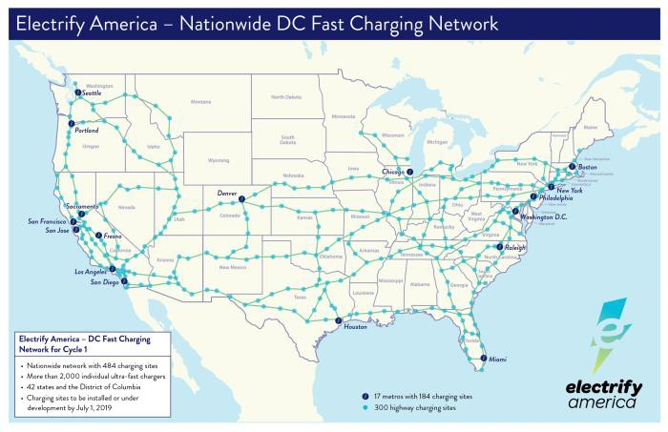
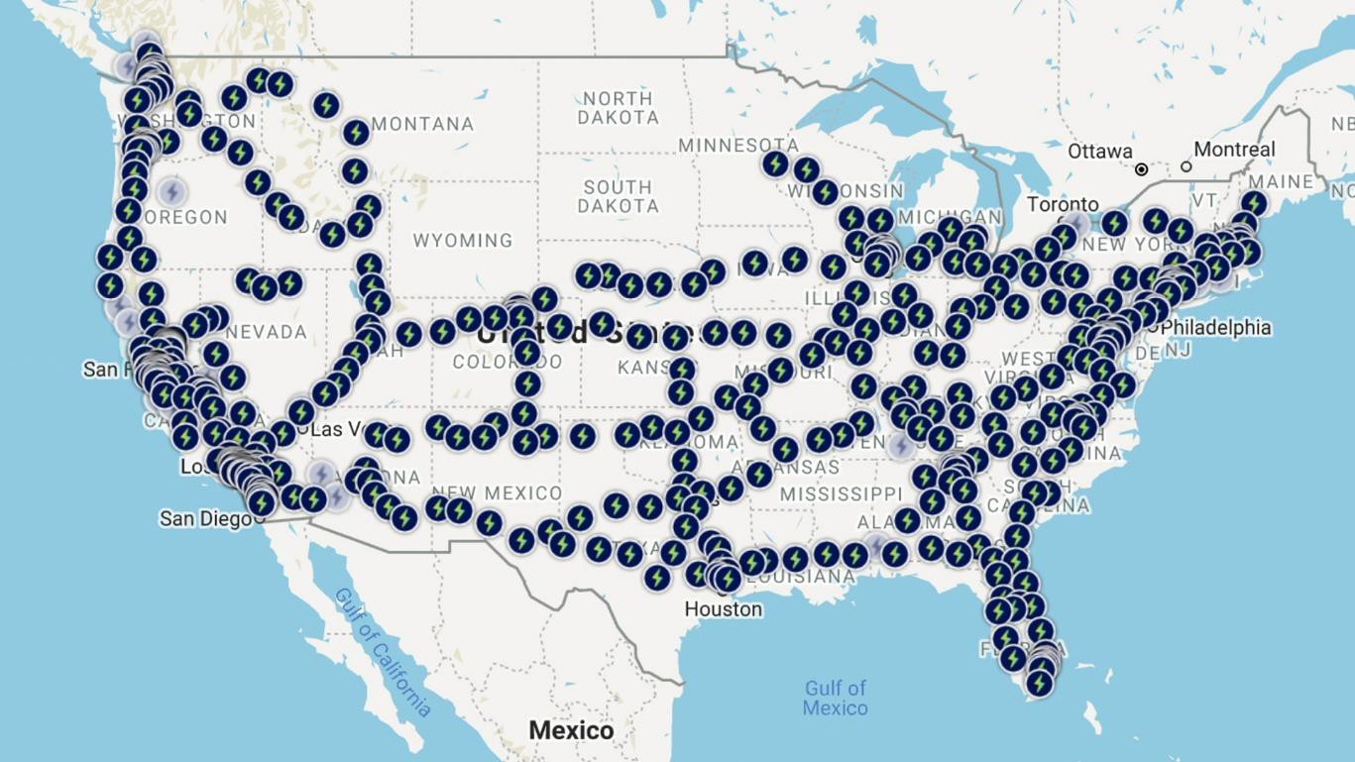
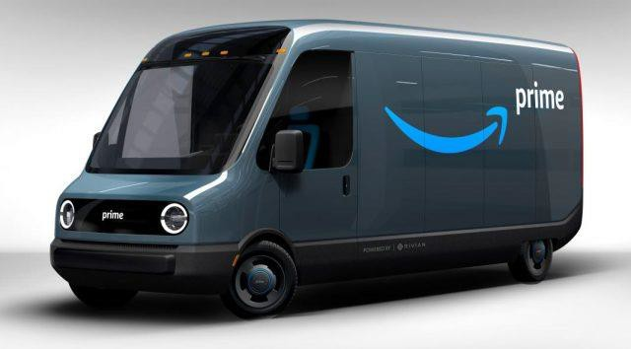
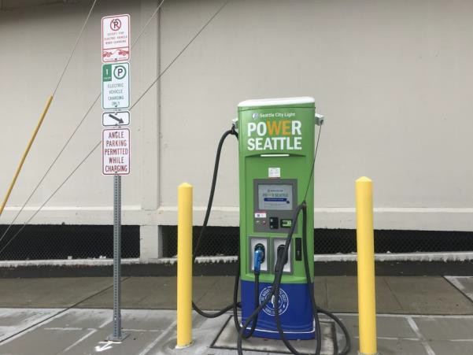
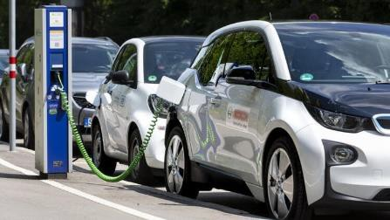
Transportation sector “low-hanging fruit” is electrification of light- and medium-duty vehicles
 Accelerate adoption of light duty consumer
ELECTRIC VEHICLES and short-haul truck fleets
 Significant investment required to build out local and regional CHARGING NETWORKS
 Ensuring EQUITABLE ACCESS TO MOBILITY will require thoughtful and proactive regulation

Slide 14
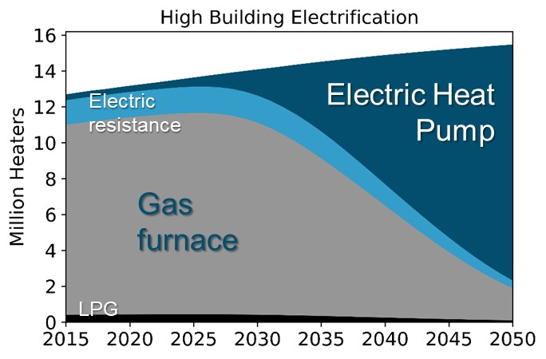
Building sector: managed transition toward electrification and lower-carbon fuels
 Encourage adoption of electric HEAT PUMP technologies for residential and small commercial buildings
 Invest in clean alternatives to fossil gas such as HYDROGEN and BIOMETHANE
 Use proactive planning and regulation to manage an ORDERLY AND EQUITABLE
TRANSITION of the natural gas business model
Building electrification can have a significant impact on electricity system peak loads
Ensure equitable recovery of existing fixed costs during the transition
“S-shaped” adoption curves with stock rollover of long-lived equipment means policy action must start early

Slide 15
Themes
12
 A changing climate is posing PROFOUND CHALLENGES to our ability to deliver reliable and affordable energy
 Responding to the physical and policy imperatives of climate change will require significant investment in our ENERGY INFRASTRUCTURE
 Ensuring an ORDERLY, EQUITABLE TRANSITION toward clean energy systems will require proactive planning and regulation to preserve the public benefits provided by networked energy systems

Slide 16
Thank You!
Energy and Environmental Economics, Inc. (E3)
44 Montgomery Street, Suite 1500 San Francisco, CA 94104
Tel 415-391-5100
http://www.ethree.com
Arne Olson, Senior Partner (arne@ethree.com)

Slide 17
PNWER Annual Summit
Nicole Kivisto
President & CEO, MDU Utilities Group

Slide 18
Company overview
A strong infrastructure is the heart of the American economy. It is the natural gas and electricity that power business, industry and our daily lives. It is the pipes and wires that connect our homes, factories, offices and stores to bring them to life. It is the transportation network of roads, highways and airports that keeps our economy moving. Infrastructure is our business, and we are Building a Strong America®.

Slide 19
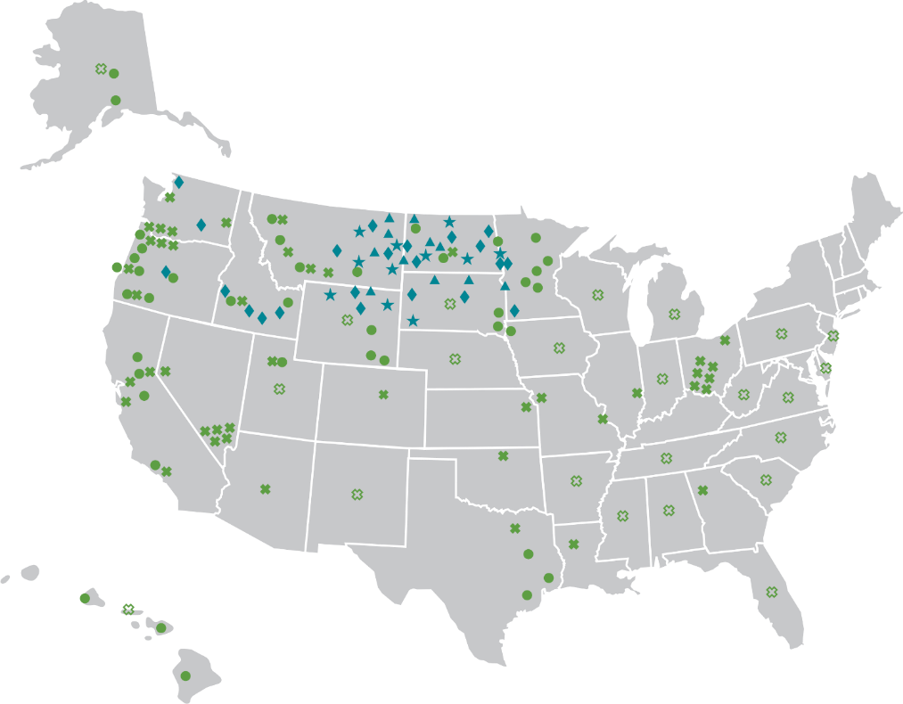
MDU Resources Group

Slide 20
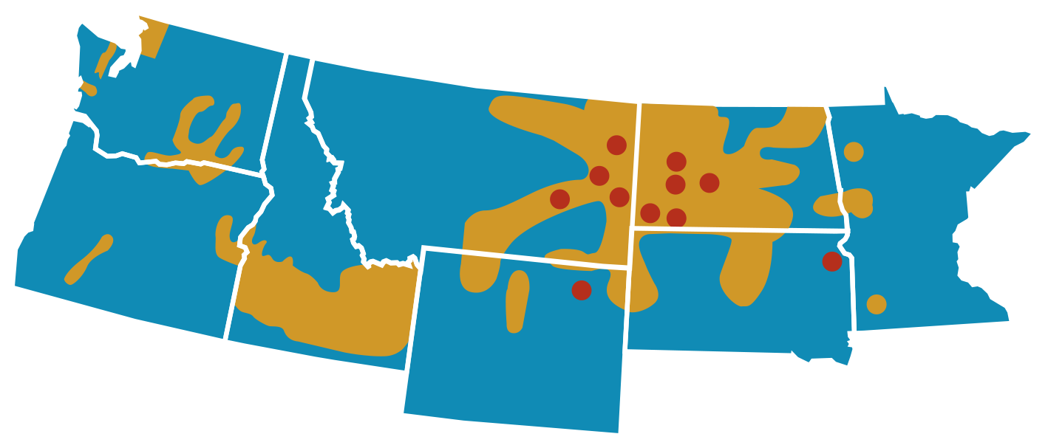
Customers by State
Washington
225,000 Customers
North Dakota
207,400 Customers
Montana
112,100 Customers
Minnesota
22,300 Customers
Oregon
79,200 Customers
Idaho
388,100 Customers
South Dakota
71,100 Customers
Wyoming
35,700 Customers
Notes:
Customers – ID, WA and ND
Rate Base – ND, WA, ID

Slide 21
Electric Generation Fleet

Slide 22
PNWER
David Anderson, President & CEO

Slide 23
Role of Our System Today
Serves 2.5 million people in Oregon and Southwest Washington
Delivers more energy than any other utility in Oregon
Heats 74% of residential square footage in the areas we serve
Meets 90% of energy needs for our residential space and water heat customers on the coldest winter days
One of the tightest, newest systems in the country
Our customers’ emissions account for just 6% of Oregon’s total GHG emissions

Slide 24
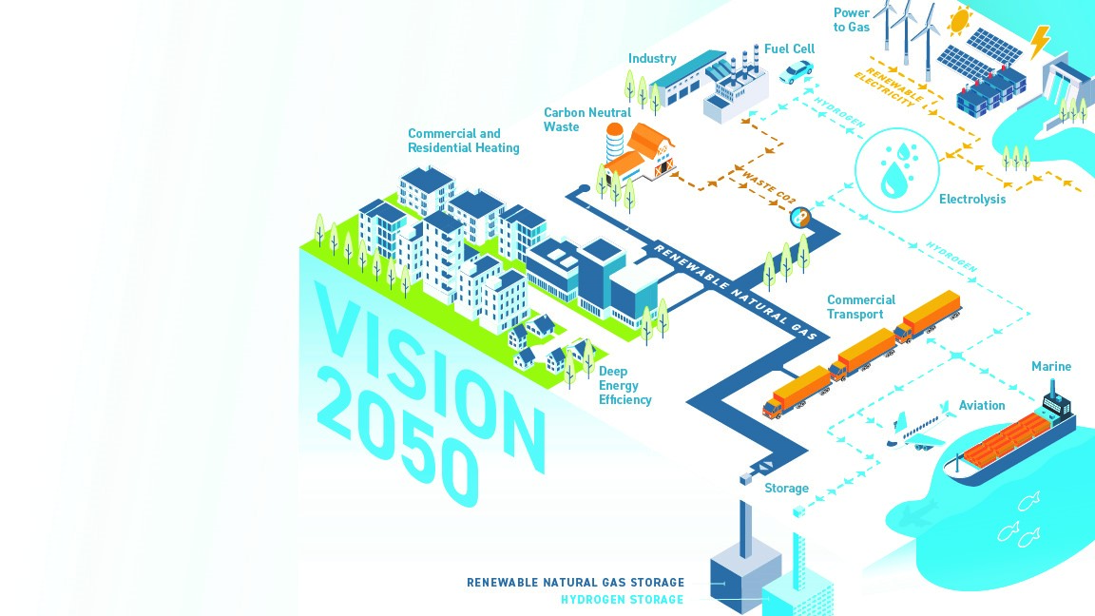
The Future of the Gas System
A decarbonizing network:
Deep energy efficiency
Renewable natural gas
Clean hydrogen
Blended
Methanated
100% H2

Slide 25
Gas System: Flexible, Long-Duration Renewable Storage
2019 U.S. Energy Output by Facility Type (MWh)
Gas system has 2.5 times the energy of hydro facilities and about 1,500 times the energy delivered from current large-scale utility batteries
Existing facilities can be used to store renewable natural gas and methanated hydrogen
NWN’s Mist storage can hold 6 million MWh of energy that can be delivered whenever needed
To replicate that with a Li-ion battery, that’s $2 trillion at today’s prices⁵
Source: EIA Weekly Natural Gas Storage Report - Withdrawals are calculated and aggregated from a weekly regional report. This understates the total volumes withdrawals if data was available for daily withdrawals from individual storage facility.
To convert natural gas volumes to MWh for comparison, this figures uses a national average heat content of 1036 btu/cf and a direct energy conversion of 0.29307 MWh/MMBtu.
Source: EIA 923 Form – Hydroelectric and battery generation are pulled from generator level data identified with prime movers “HY” and “BA”, respectively. Net generation is aggregated for hydroelectric generators and gross generation is aggregated for batteries.
The figure for hydroelectric generation is the total net generation from hydroelectric facilities and does not distinguish between what can and cannot be stored.
https://www.nrel.gov/docs/fy19osti/73222.pdf

Slide 26
Thank you.

