Slide 1
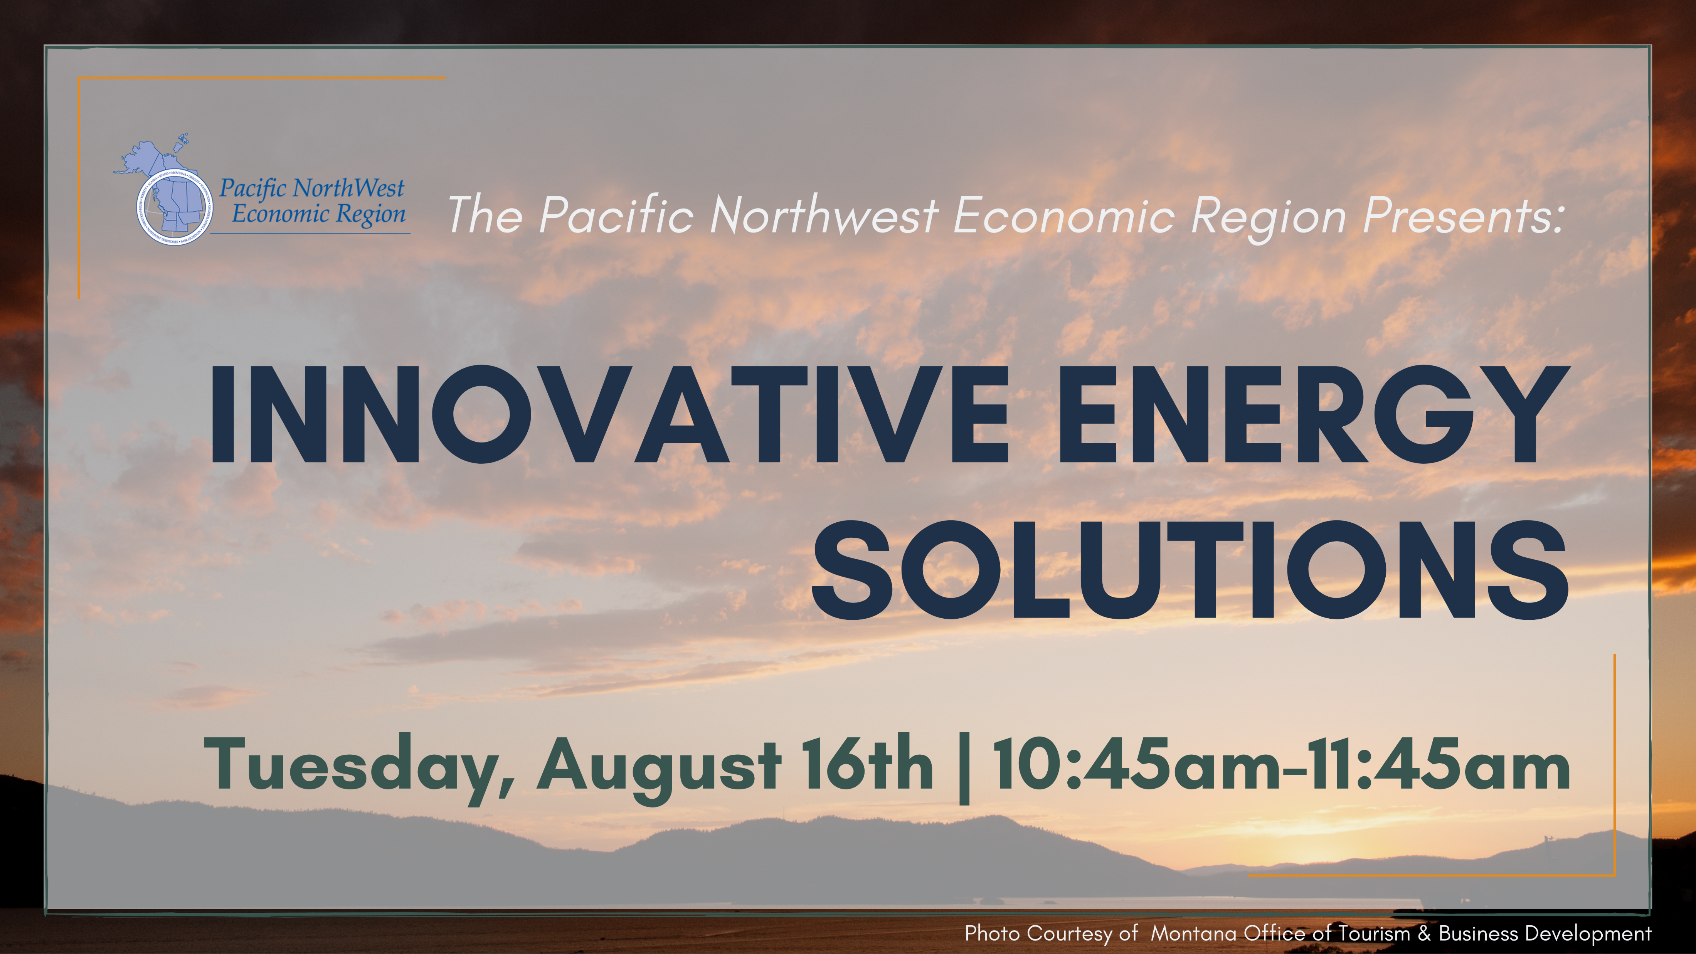

Slide 2
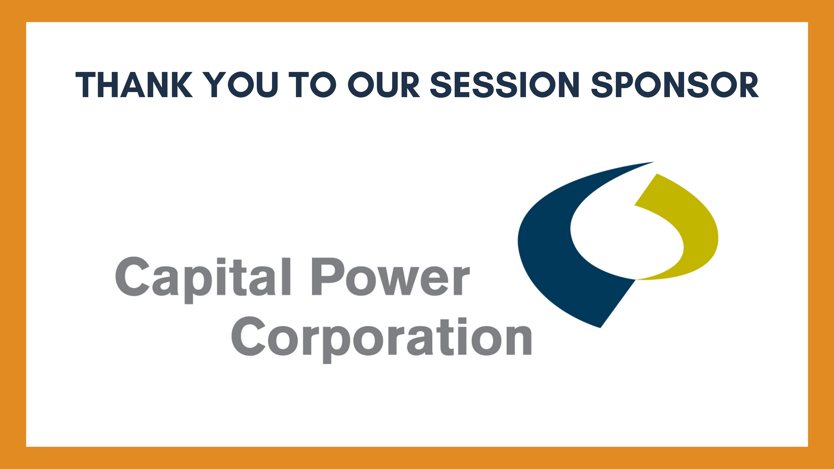

Slide 3
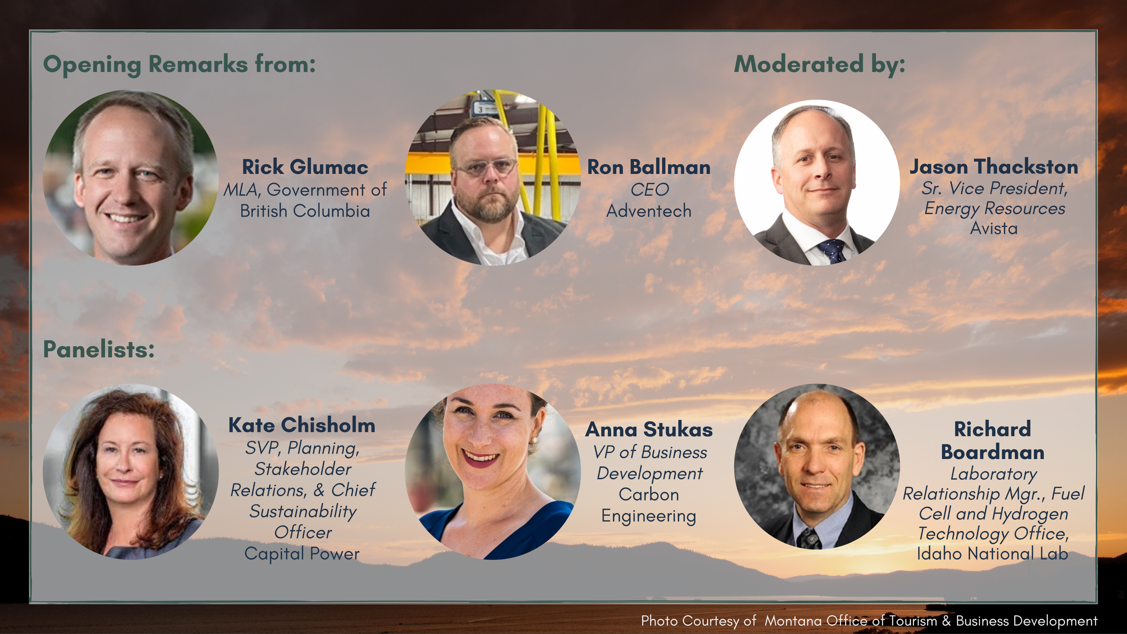

Slide 4
Avista’s Cleaner Energy Future:
Solutions Beyond Wind and Solar
Jason Thackston, Senior Vice President, Energy Resources
August 17, 2021

Slide 5
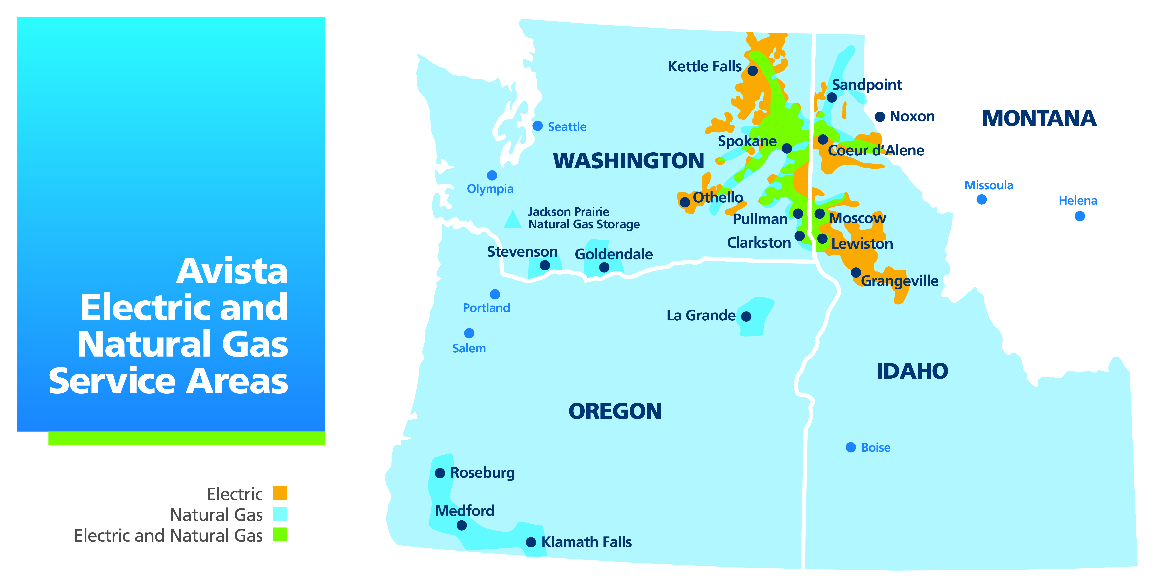
About Avista

Slide 6
Our Current Generation Mix

Slide 7
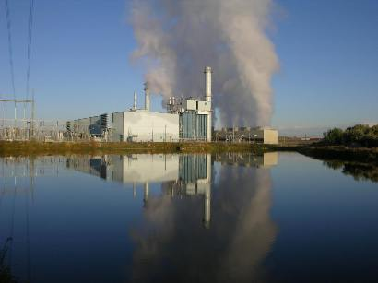
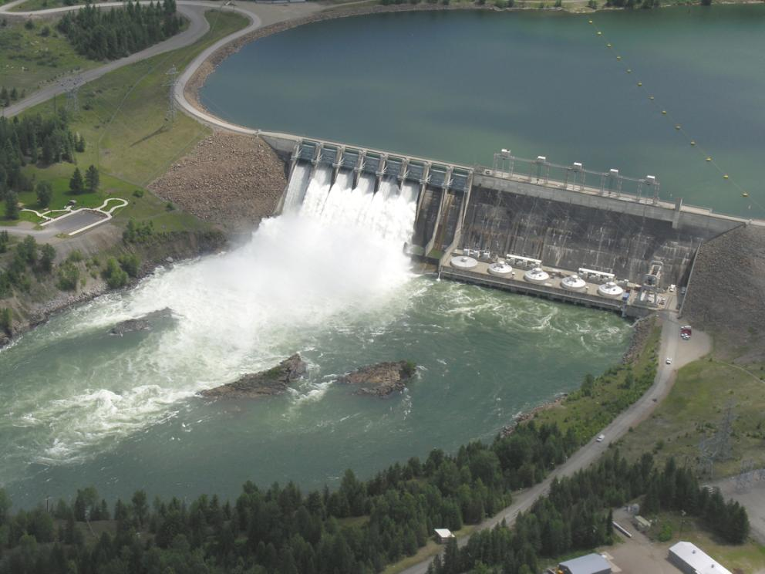
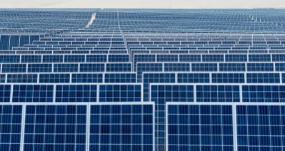
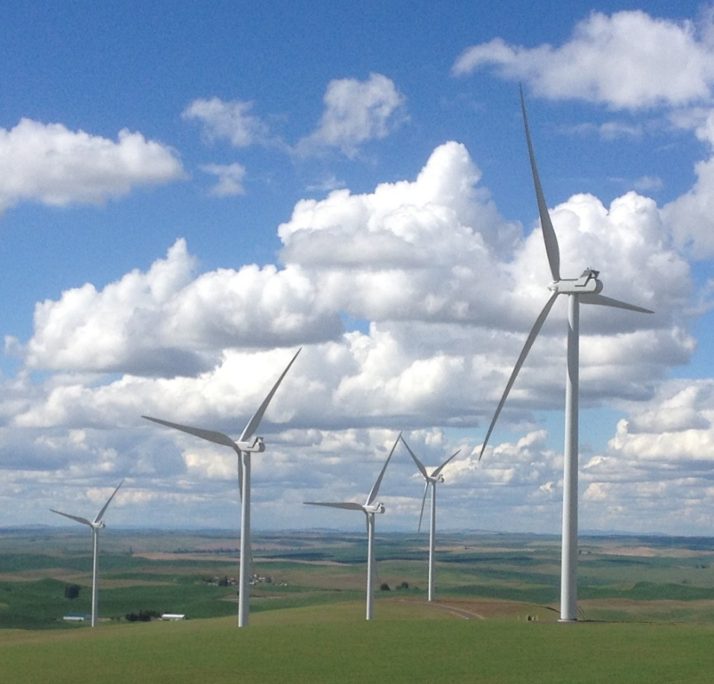
Avista’s Clean Electric Goals
Avista’s goal is to serve our customers with 100 percent clean electricity by 2045 and to have a carbon-neutral supply of electricity by the end of 2027
We will maintain focus on reliability and affordability
Natural gas is an important part of a clean energy future
Technologies and associated costs need to emerge and mature in order for us to achieve our stated goals
It’s not just about generation

Slide 8
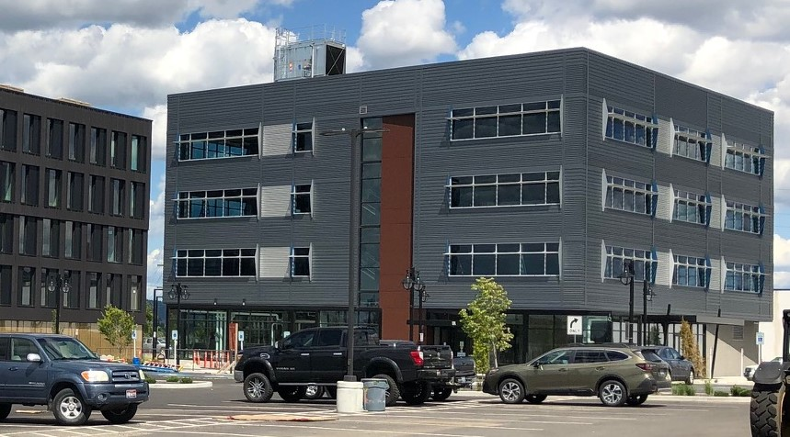
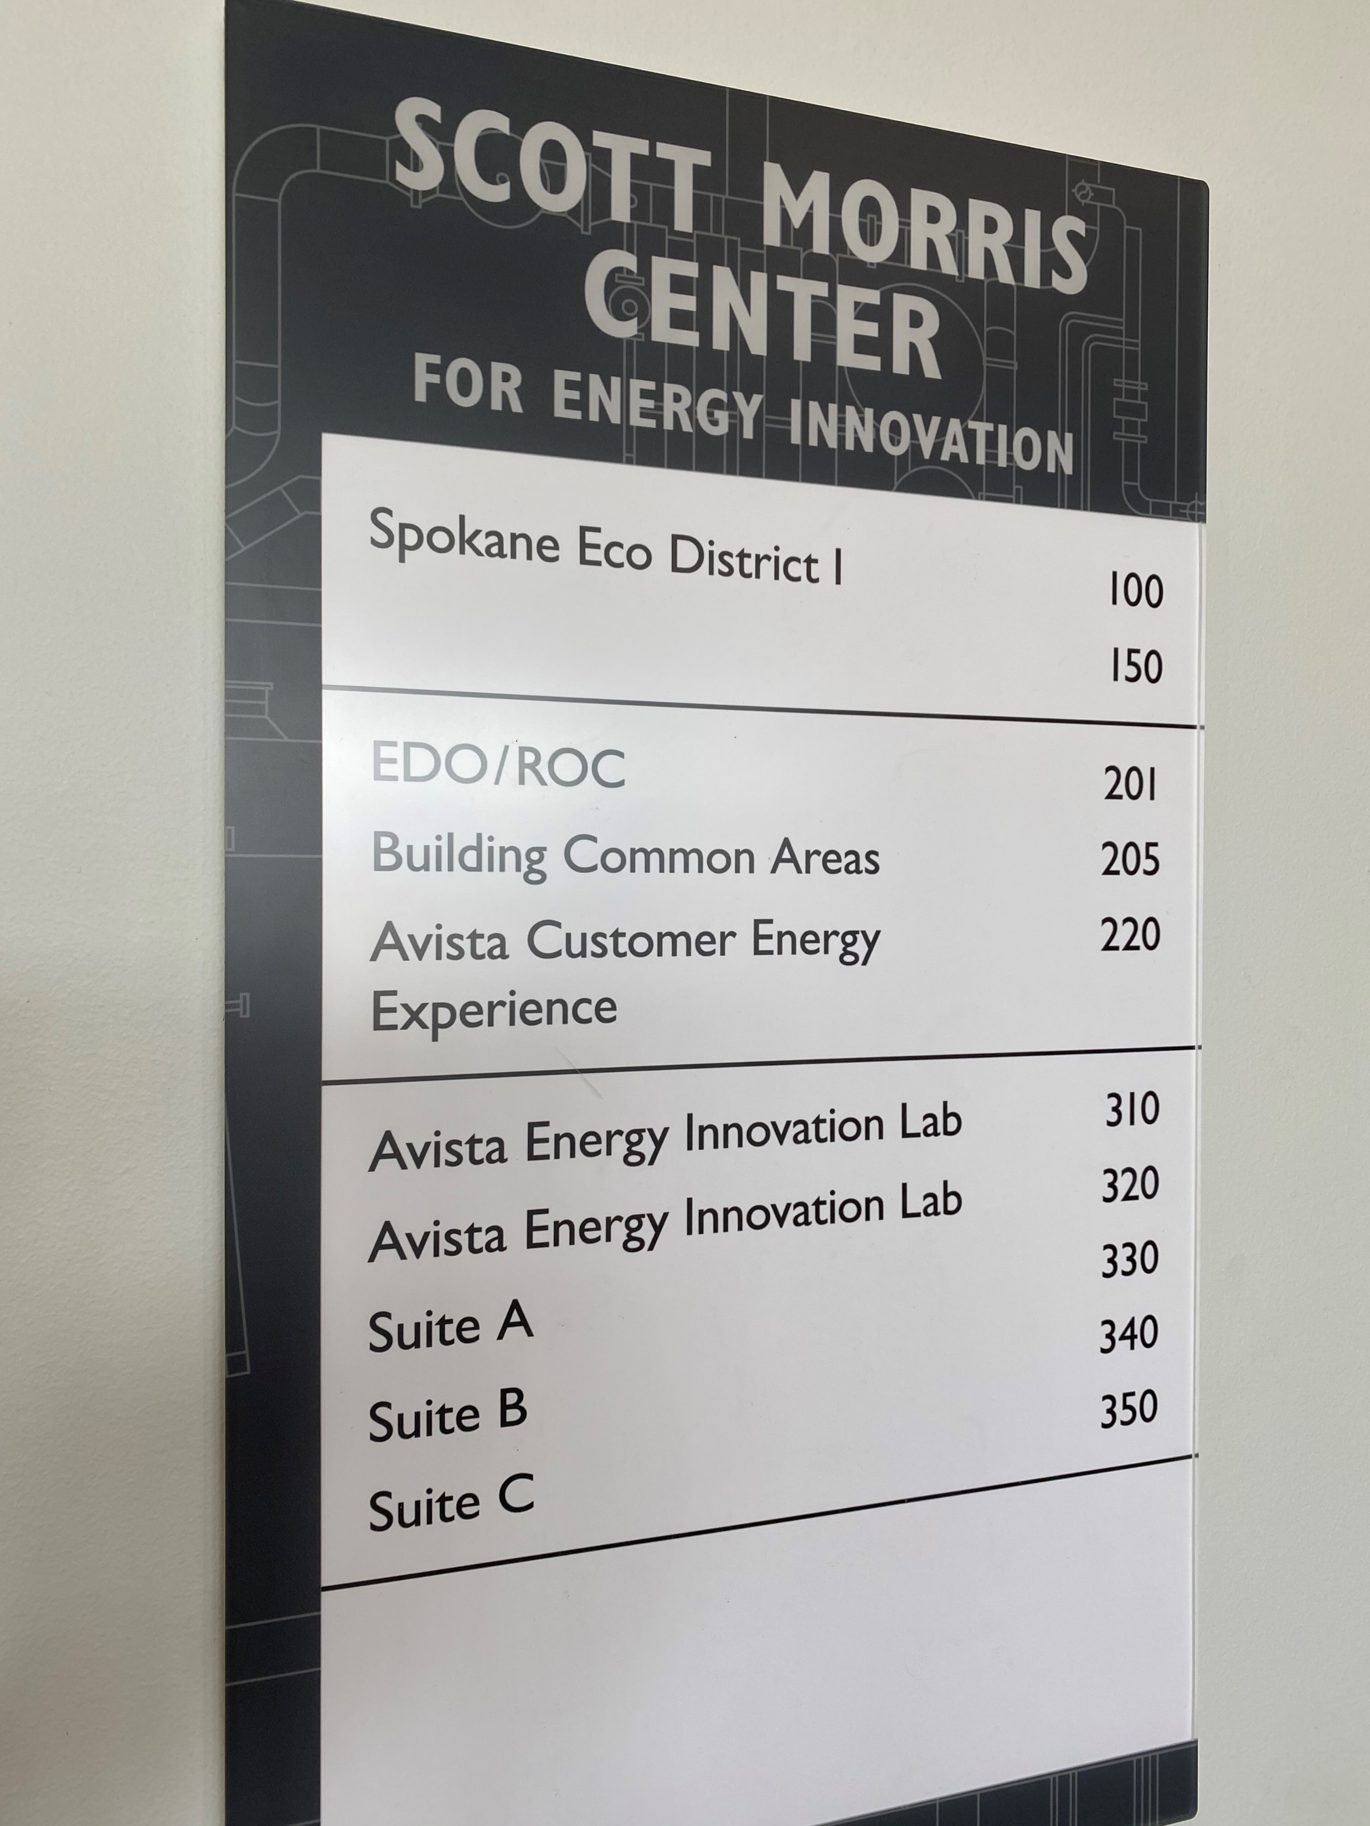
Avista’s Morris Center

Slide 9
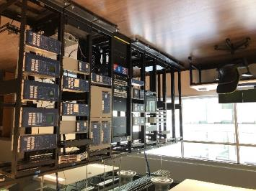
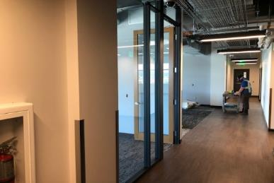
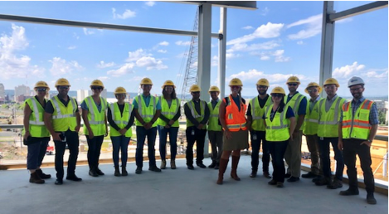
Avista’s Morris Center
Power & Control Hardware in the Loop
Partner Space for Innovation
Data Platform for Operational Platform

Slide 10
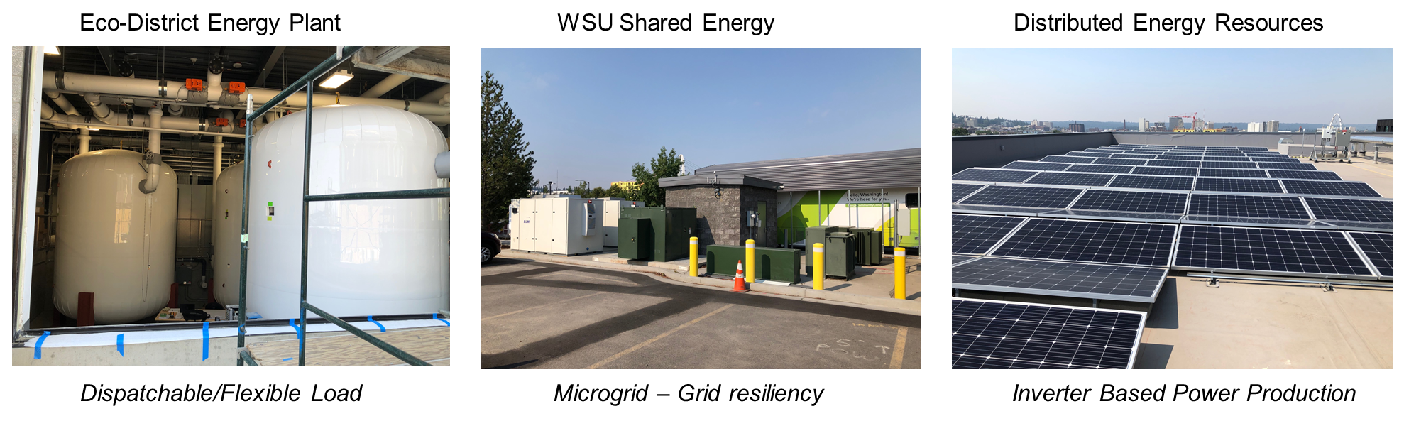
Avista’s Innovation Lab

Slide 11
The Role of Hydrogen and Renewably Generated E-Fuels
Blended in with traditional natural gas to reliably generate power and supply fuel to natural gas customers with a cleaner carbon footprint
Combine with renewable energy to produce hydrogen when grid has surplus electricity

Slide 12
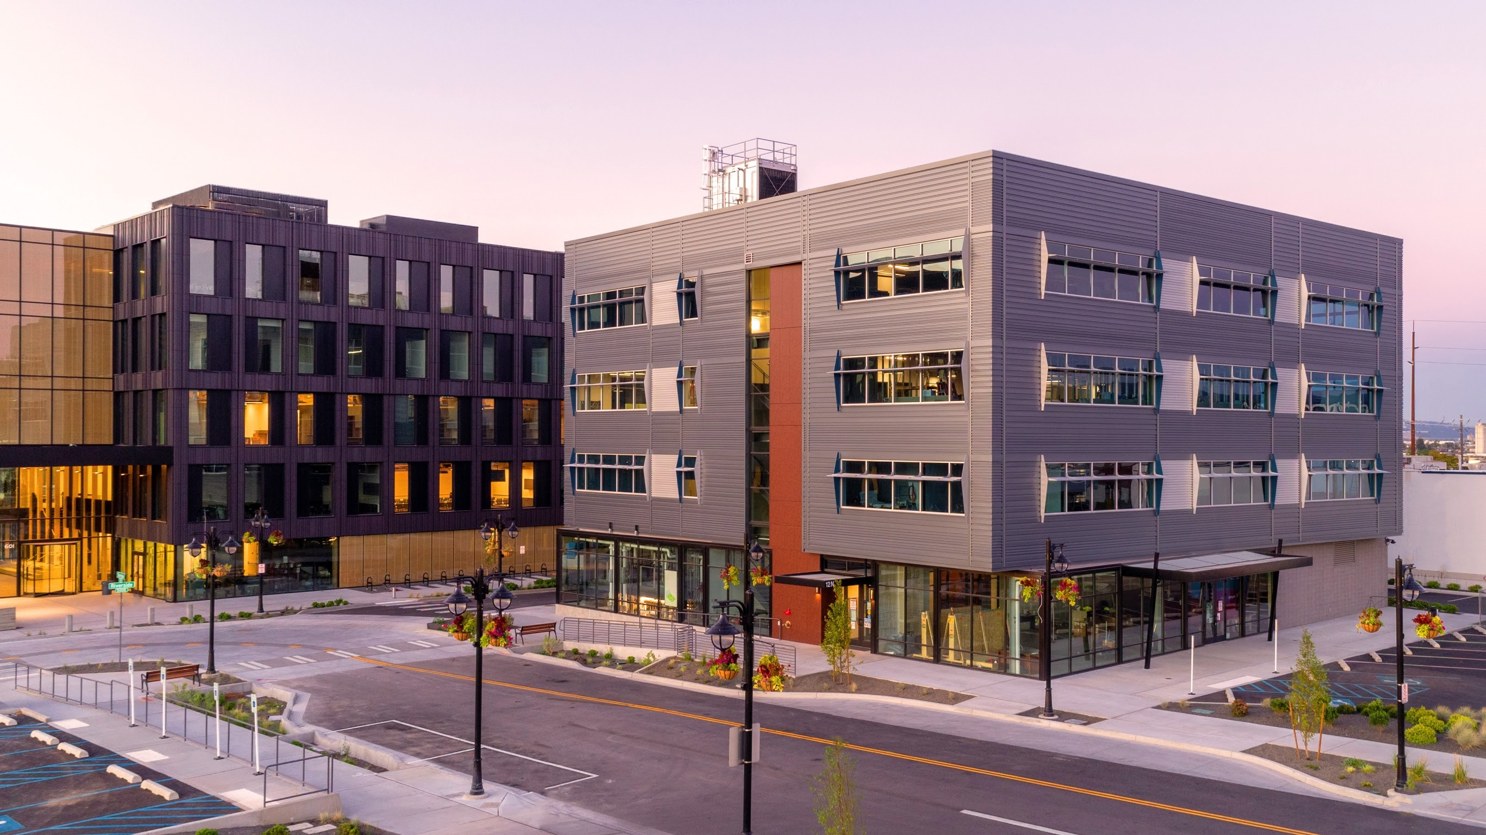
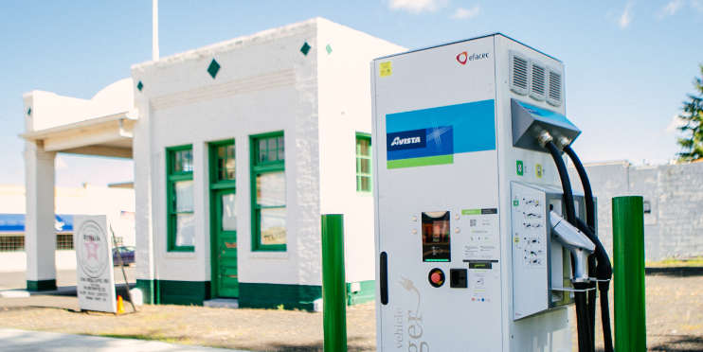
Serving our Customers into the Future
Additional clean generation
Dispatchable generation or renewables + storage
Ongoing energy efficiency programs
New ways to partner with customers
Electric transportation

Slide 13
Avista’s Cleaner Energy Future:
Solutions Beyond Wind and Solar
Jason Thackston, Senior Vice President, Energy Resources
August 17, 2021

Slide 14
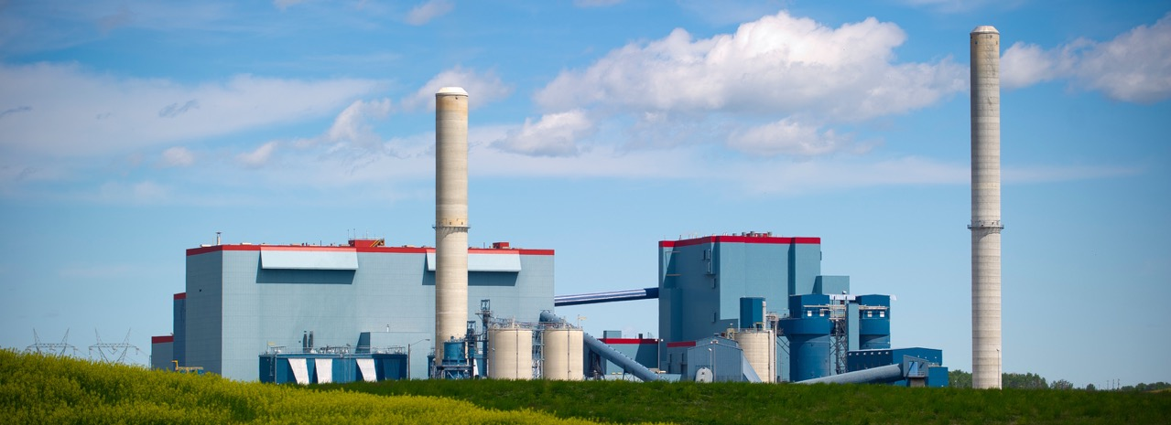

Decarbonization & CCUS
Presentation to PNWER Annual Summit
Kate Chisholm, Senior Vice President & Chief Sustainability Officer
August, 2021

Slide 15
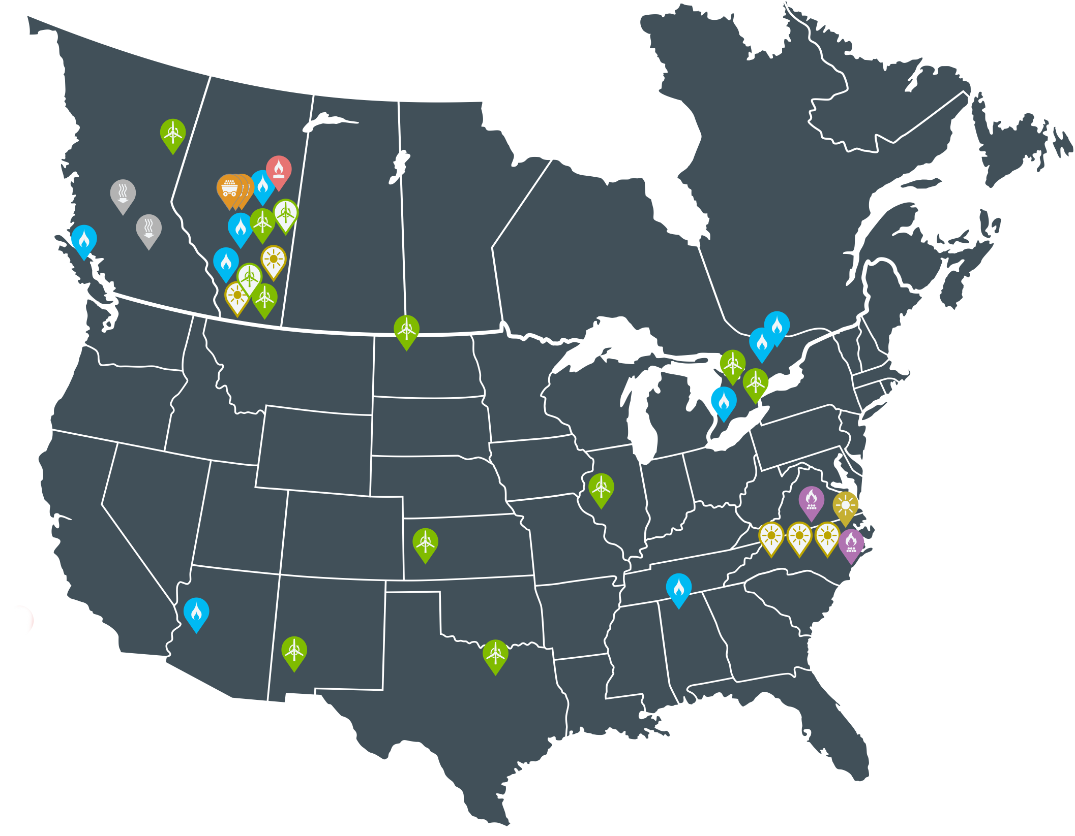





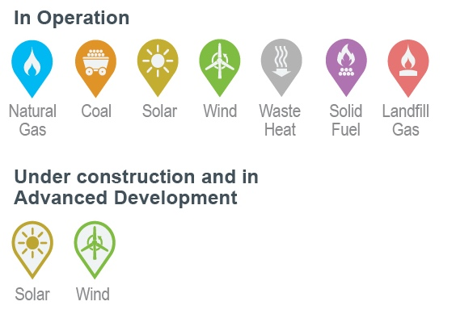
Growth-oriented North American Power Producer
Publicly-traded company headquartered in Edmonton, Alberta with a market cap of ~$3.8B
Owns ~6,500 megawatts of power generation capacity at 28 facilities in Canada and the U.S. Additional 985 MW in advanced development in Alberta and North Carolina.
A leading developer of carbon offset projects, with more than $100M invested
Named one of the World’s Most Ethical Companies® by the Ethisphere Institute (2019, 2020, 2021)
Recognized by Capital Finance International as Best ESG-Responsible Energy Producer (Canada) 2020
Named one of “Alberta’s Top Employers” for six years in a row
Notes:
Map of our operations
Somewhat unique in a world that rewards renewable pureplays insofar as we have based our sustainability strategy on what we believe will be the critically important role that thermal energy will play in energy transition as the world reduces its greenhouse gas emissions while still producing 100% reliable energy and reducing energy poverty.

Slide 16
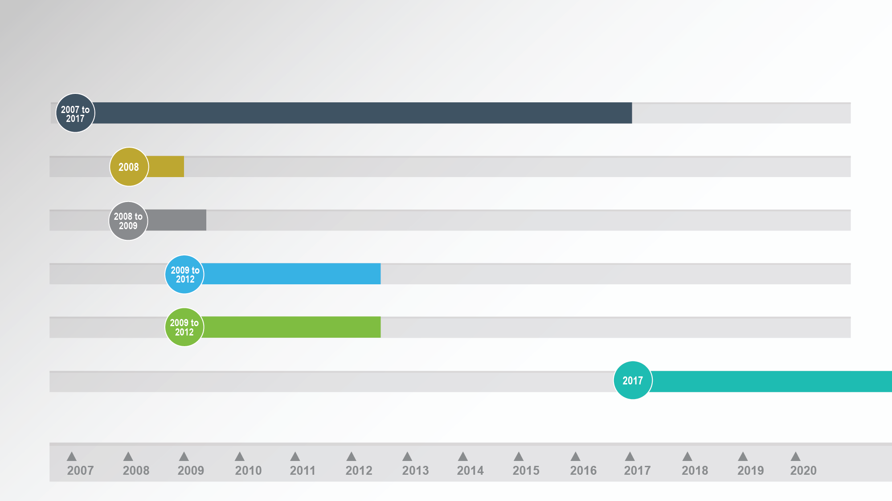
Capital Power major carbon capture initiatives
Participated with Canadian Clean Power Coalition (CCPC) studies on Carbon Capture Options
Confidential Project for Hydrogen/Power production from coal feed stock with Carbon Capture
Design, Engineering and Cost Estimate for Genesee 4; 200 MW coal-fired power plant with 90% carbon capture (1million ton). Subsequently Carbon Capture Facility was re-configured for Genesee 3 retrofit.
Front End Engineering and Design (FEED) using Integrated Gasification Combined Cycle (IGCC)
technology for Genesee expansion, 250 MW capacity and 1million ton capture
Partnered with Project Pioneer (1million ton) for CCS retrofit at Keephills 3 with Trans-Alta
Participating in Cosia Carbon X Prize for developing carbon
products from slip NGCC flue gas stream at Shepard Energy Center.
Participating in C2CNT Pilot Project for CO2 conversion to Carbon Nanotubes.

Slide 17


Capital Power’s Path to Net Carbon Neutral by 2050
2009 to Today
Today to 2024
2024 – 2030
2030 – 2050
2050 – 2070
Genesee efficiency program,12% decrease in GHG by 2021
Over $3B invested in/committed to renewables
C2CNT interest increased to 40%
Over $40M invested in carbon capture research
Completed two
CCUS FEED studies (2007/2011)
Complete repowering and off coal
Invest in renewables, strategic natural gas
CCU: C2CNT & Beyond
Invest in renewables + storage project
CCUS FEED study at Genesee
Assess hydrogen at Genesee
Explore commercial / physical Direct Air Capture (DAC) solutions
Expand CCU
Develop CCUS and/or hydrogen application at Genesee.
Add DAC to carbon compliance portfolio
Net carbon neutral via physical solutions on natural gas assets, DAC and “offsets”
Invest in DAC facility
Renewables + storage as baseload
Physical decarbonization

Slide 18
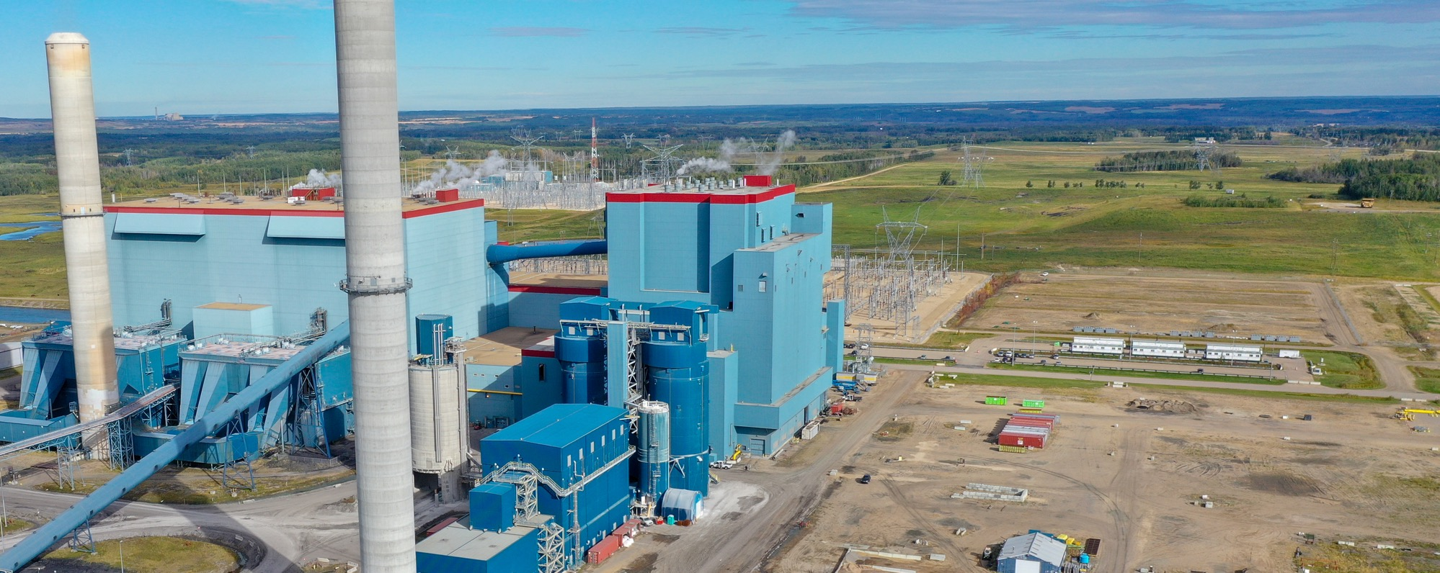
Decarbonization in action
Reducing CO₂ emissions by ~3.4 million tonnes per year
Over $1 billion invested
Genesee 1 & 2:
Repowering to best-in-class NGCC technology
CCS ready and hydrogen capable
Genesee 3:
Coal-to-gas conversion
Building the Genesee Carbon Conversion Centre (GC³) to transform emissions into carbon nanotubes (CNTs)
27%
Notes:
Each unit will increase its gross generation capacity from 430 megawatts (MW) to 732 MW
Utilizes latest technology; will be most efficient combined cycle plant in Canada
Approximately 900 people years of construction work with a peak forecast of 500 people required

Slide 19
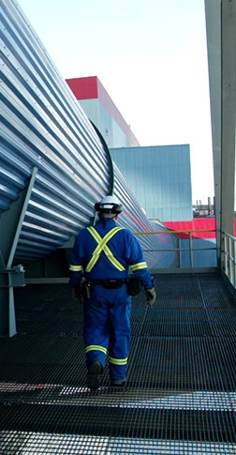

Why GC³
  Environmentally Friendly
    CCU process that captures CO₂ from flue gas and converts into a usable product
    Facility to utilize C2CNT technology – an NRG COSIA Carbon XPRIZE finalist and X-Factor award winner
  Creates a product that can be used across all industries
    Chemical & Polymers, Energy, Aerospace & Defense, Electronics, Batteries & Capacitors, Medical, Advanced Materials, Structural Materials
  Pathway to achieving net-zero emissions
    Material emissions reductions in heavy industrial processes
      Largest commercial-scale carbon nanotube production facility globally
        Opportunity to become primary supplier of CNTs to North America – Asia current world leader in CNT production (top 5 facilities = 400-700t/year)

Slide 20
Genesee CCUS Project Overview
3 MT per year of carbon capture by 2026 will materially advance decarbonization of Alberta's electricity grid while preserving system reliability and competitiveness
Project would deploy the latest post combustion carbon capture technology on the soon to be repowered GN 1&2.
The Project would capture 90% of the carbon emitted from GN 1&2; approximately 3M tonnes per year.
The Project leverages Capital Power’s 10+ years of experience in CCUS.
The Project is aligned with Capital Power’s 2030 and 2050 Sustainability Targets.
Shovel in the ground Q1’24.
First tonne of carbon in the ground Q3’26.
Pre-FEED
FEED
Construction
Complete Q4’21
Complete Q4’22
Q1’24 Start
COD
H2’26

Slide 21

Momentum for Carbon Conversion, CCUS
Significant increase recently in recognition by governments in Canada and U.S. of role of CCUS in achieving long-term decarbonization objectives.
In US, Senate just passed Bipartisan Infrastructure legislation including SCALE Act in its entirety to help finance the buildout of CO₂ transport and storage infrastructure.
In Canada, importance of CCUS acknowledged in Federal Government December 2020 Climate Plan Update, and in related “Net-Zero Pathways” report released by Canadian Institute for Climate Choices.
Alberta and Federal government CCUS Working Group to “explore opportunities with (CCUS) technology, and how Alberta can lead the way in setting up Canada to be a global leader in emissions-reducing technology.”
Federal Government commitment in Budget 2021 to develop Investment Tax Credit to support accelerated deployment of CCUS, and continue funding for CCUS R&D.
Alberta Government undertaking competitive “CCUS Hub” process to develop transportation and sequestration components of CCUS infrastructure
CCUS identified as an area for enhanced collaboration as part of June 2021 Canada/US MOU Concerning Cooperation on Energy
Notes:
Of specific interest to this audience is our focus on carbon. AS you’re all aware, policy is quickly evolving to be more CCUS and hydrogen friendly on both sides of the 49th parallel, likely because both federal governments have recognized NG’s importance to both economies and the need to take action now if the climate needle is going to be moved by 2030. Because the economics of widespread adoption of these new technologies would not occur in the short term without subsidy, these are positive developments.

Slide 22
Enabling Policy Framework
Resolution of current policy initiatives can provide certainty to support long-term investment decisions
Alberta CCUS Hub
  Competitive process execution timelines need to facilitate pre-2030 capture projects
  Evaluation criteria need to prioritize connection to projects with earliest in-service dates
  Multiple hubs would facilitate proximity and reasonable costs for capture regions
  Capture facilities most capital-intensive and cost challenged component of CCUS chain
CCUS ITC
  A “direct pay” option that provides value of credit immediately is essential to value of program to investors and to pace of CCUS deployment across all industry sectors
  A direct pay approach is “bankable” for investors and enables lower-cost financing
  Direct pay would align with key enhancement being pursued with U.S. 45Q
Carbon Policy & Markets
  Project economics reflect carbon price escalation to $170/t by 2030, and compliance costs and EPC value relative to current Alberta TIER stringency of 0.37 t//MWh.
  Potential for policy changes that affect core assumptions, including carbon market structure, creates significant investment risk and raises required investment returns
  Commercial agreements between governments and proponents to keep proponents whole in event of carbon policy-related changes would address “policy gap.”

Slide 23
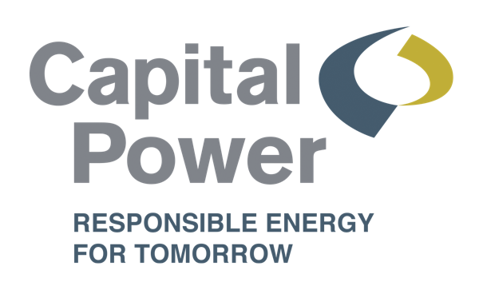



Keep the conversation going. Follow us at:
@capitalpower
@capital-power
@capitalpowercommunity
capitalpower.com

Slide 24
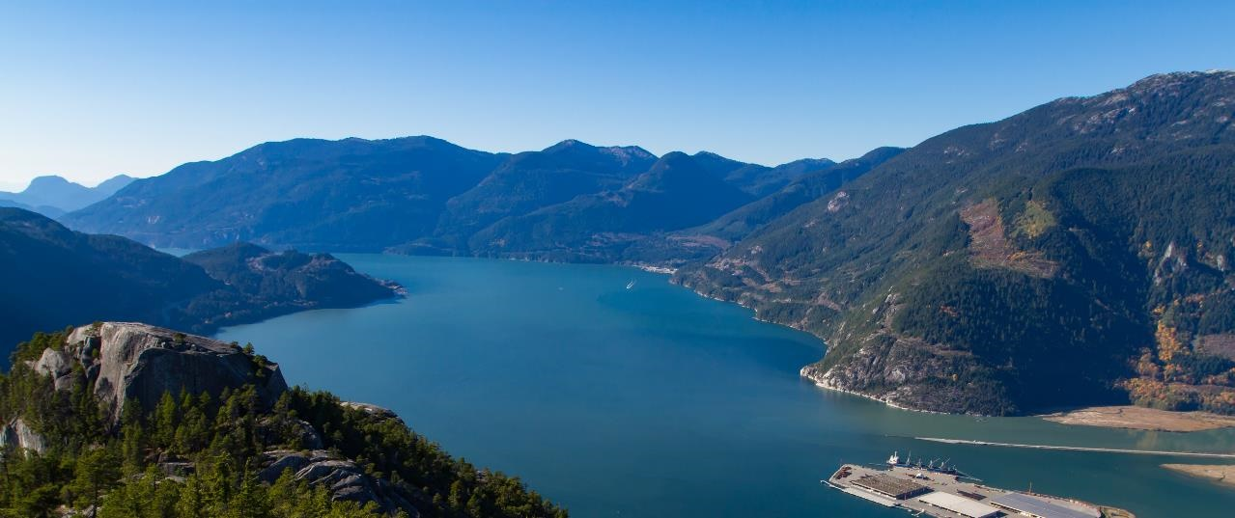


The Climate Revolution
………………………………………………………………………………………………………………
AUGUST, 2021
PNWER Annual Summit
Anna Stukas, P.Eng
VP Business Development
Carbon Engineering
AND HOW DIRECT AIR CAPTURE WILL ENABLE CLEAN INFRASTRUCTURE, MITIGATE RISK, AND PROVIDE AFFORDABLE NET-ZERO SOLUTIONS
Copyright © 2021 – Carbon Engineering Ltd.

Slide 25

Our climate bathtub is about to overflow
25 COPYRIGHT © 2021 - CARBON ENGINEERING
Fossil emissions
Loss of natural sinks through deforestation
Carbon Dioxide in the Atmosphere
LAND & OCEAN CARBON CYCLES
THE VOLUME OF CO₂ IN THE ATMOSPHERE DRIVES CLIMATE IMPACT

Slide 26


We Need a Variety of Tools to Reduce this CO₂ Volume
Permanent CO₂ removal is essential alongside fossil emissions reduction and reversing deforestation
26 COPYRIGHT © 2021 - CARBON ENGINEERING
Direct Air Capture
Decrease fossil emissions
Reforestation & Afforestation
LAND & OCEAN CARBON CYCLES
PERMANENT REMOVAL TO LONG LIVED GEOLOGIC STORAGE
REDUCE existing emissions
REMOVE equivalent for all remaining emissions
REMOVE legacy emissions for climate restoration
30-40 BILLION TONS/YR
10 -15 BILLION TONS/YR
ADDITIONAL 10-20 BILLION TONS/YR

Slide 27
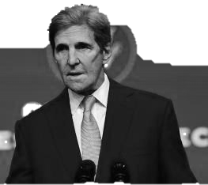


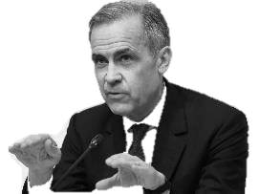


The Opportunity
The Net Zero revolution has started
There is a huge new market opening up. I think its very exciting and, in my judgement, its going to be the biggest market we’ve seen in the world since the industrial revolution.
“Even if we get to net zero, we still have to get carbon dioxide out of the atmosphere
“About half the emissions we have to reduce are going to be reduced by technologies that are not yet at scale in the market.” ¹
CO₂
27 COPYRIGHT © 2021 - CARBON ENGINEERING
Net Zero Revolution
John Kerry
US Special Presidential Envoy for Climate
2020
Innovation
Information Revolution
“
Industrial Revolution
Transition to net zero emissions is 'the greatest commercial opportunity of our age”^{2\}
Agricultural Revolution
Mark Carney
UN Special Envoy on Climate Action and Finance
1800
1900
2000
2100
John Kerry speaking at President Biden’s Leaders Summit on Climate, 2021/4/21
Mark Carney, speaking at the Green Horizon Summit. 2020/11
DO WE HAVE SOLUTIONS THAT COMBINE THE NEED FOR ACTION WITH ECONOMIC REALITY?

Slide 28
What Does This Mean?
Companies and governments will have to achieve net zero, operating with no net addition of CO₂ to the atmosphere (“a zero carbon footprint”)
  Catalyst may be shareholders, customers or government regulation
The cost of achieving net-zero will be significant and, for some, will threaten future viability
Carbon footprints will be able to be reduced initially with modest financial impact, however the complexity and impact will grow over time
The cost of compliance will start to feature as a key contingent liability on public accounts
28 COPYRIGHT © 2021 - CARBON ENGINEERING
Reduce emissions where possible
Remaining unavoidable emissions
=
Zero carbon footprint
+
Permanently remove the equivalent of remaining emissions
AN UNPRECEDENTED LEVEL OF IMPOSED DISRUPTION

Slide 29
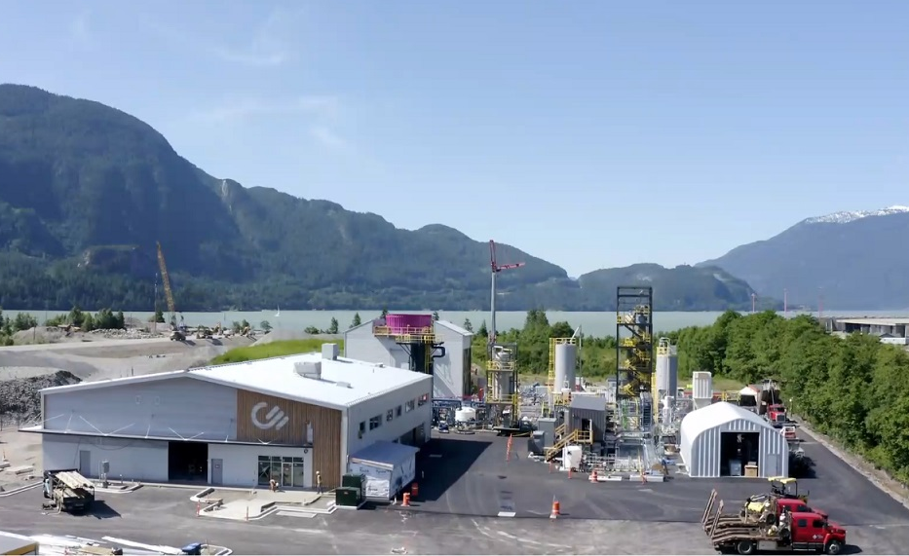
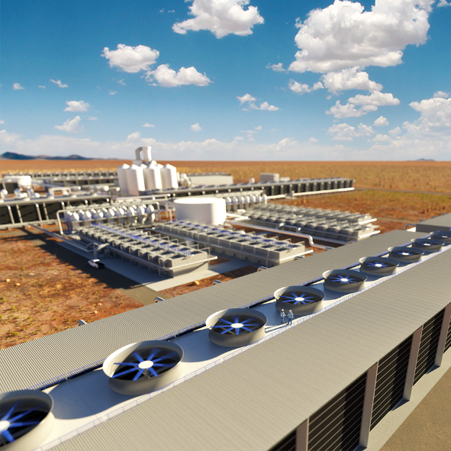
The Technological Missing Piece
Only one solution is available today that addresses the three key problems
CE’s Innovation Centre in British Columbia, Canada
29 COPYRIGHT © 2021 - CARBON ENGINEERING
COST
Is affordable compared to alternatives for many emissions
GROWTH IN EMISSIONS
“Has the potential to be almost infinitely scalable“ ¹
NON-DISRUPTIVE
Eliminates any emission or any type from anywhere and from any point in time, for a fixed cost
1
2
3
CE’s first large-scale plant
in the US will go operational
by 2025 and capture up to one million tonnes of atmospheric CO₂ per year
¹ Goldman Sachs – Carbonomics: The Future of Energy in the Age of Climate Change.
Proven technology now deploying at commercial scale

Slide 30
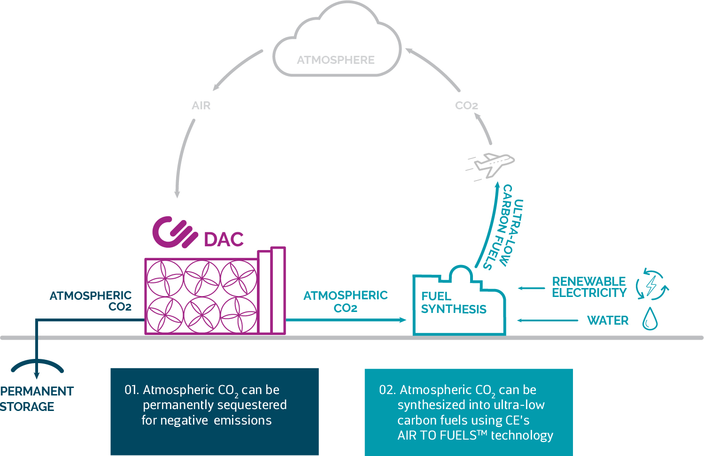
Carbon Engineering Brings Solutions at Climate-Relevant Scale
Direct Air Capture (DAC) & AIR TO FUELSTM technologies deliver:
30 COPYRIGHT © 2021 - CARBON ENGINEERING
Permanent, climate-relevant volumes¹ of carbon dioxide removal by capturing CO₂ from the atmosphere and safely sequestering it in the geosphere or durable carbon products
Drop-in compatible synthetic fuels that reduce the carbon intensity of transportation fuels by recycling atmospheric carbon
¹ Each standard, commercial CE DAC plant removes one million tonnes of atmospheric CO₂ per year, the equivalent of the work of 40 million trees.
ELIMINATION OF ANY EMISSION, OF ANY TYPE, FROM ANYWHERE AND ANY TIME

Slide 31
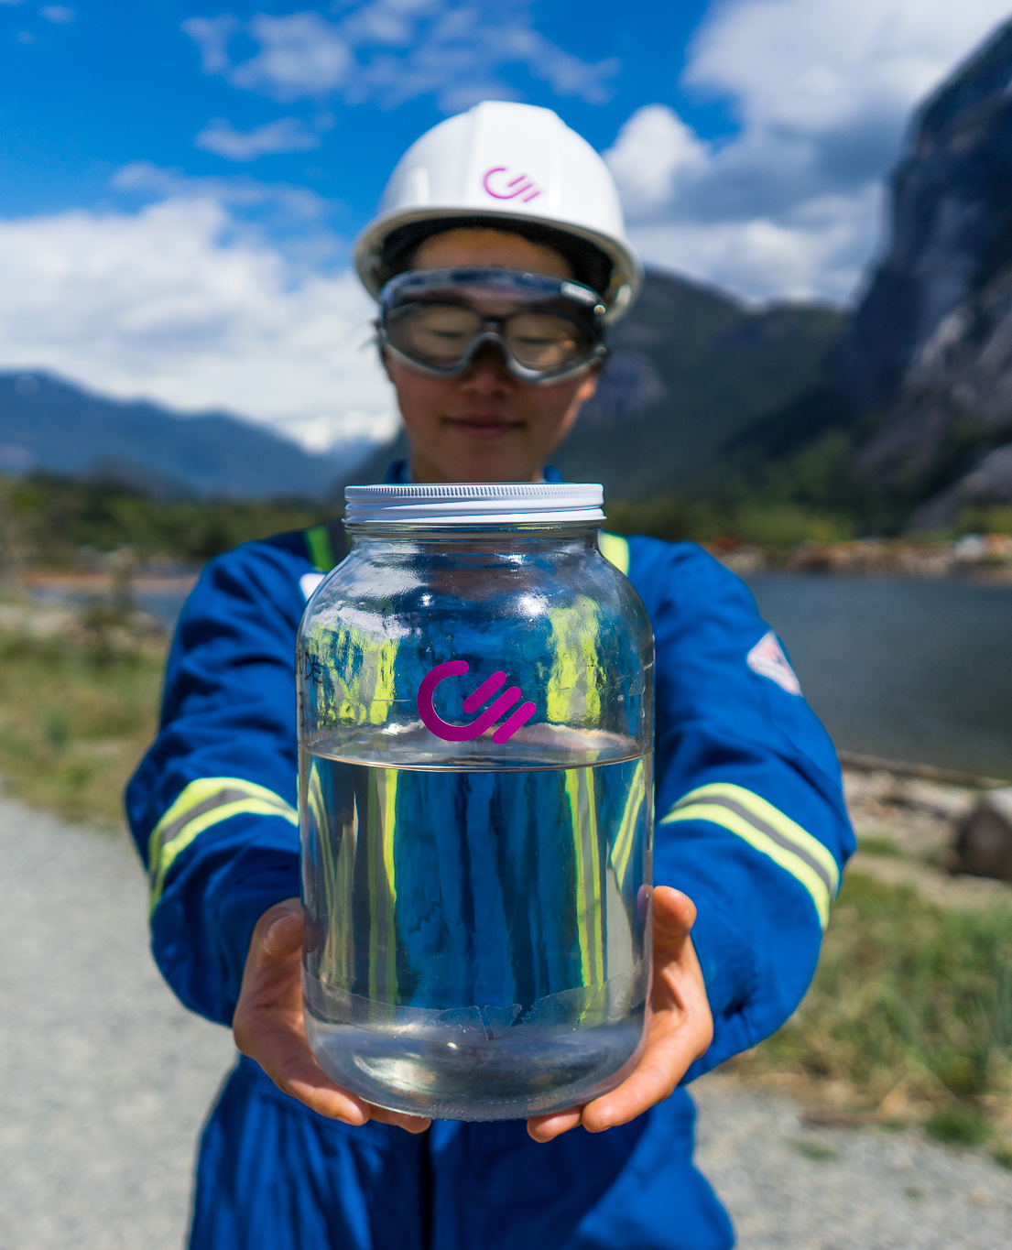

AIR TO FUELSTM Products
Use of captured atmospheric CO₂ and renewable electricity produces a near carbon neutral fuel
Refined into diesel, jet fuel or gasoline
No conflict with other feedstock needs
No sulfur, very low particulate matter and aromatic hydrocarbons
Wholly compatible with all existing vehicles, ships and airplanes without modification
31 COPYRIGHT © 2021 - CARBON ENGINEERING
CE’s fuel (right) compared to conventional diesel (left)
LOW CARBON, CLEAN BURNING

Slide 32
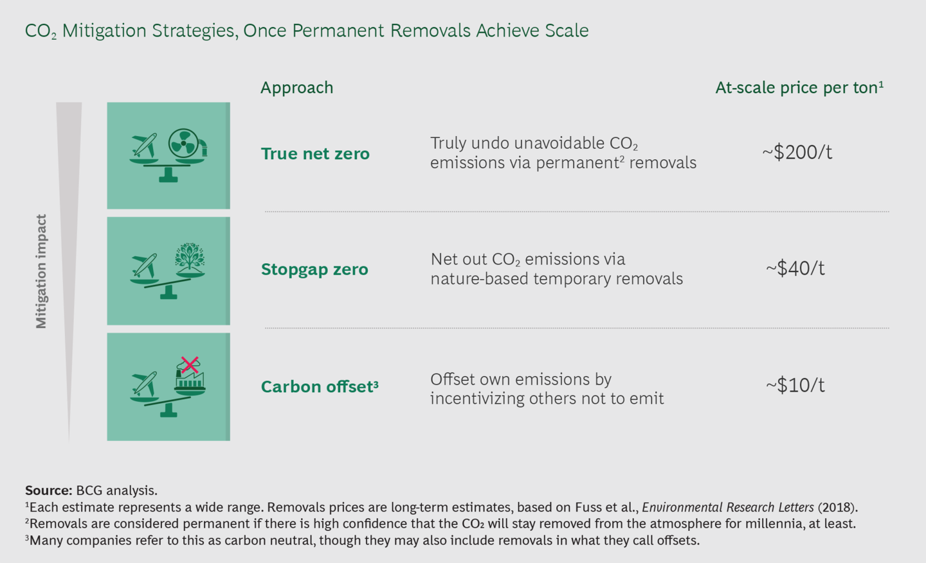
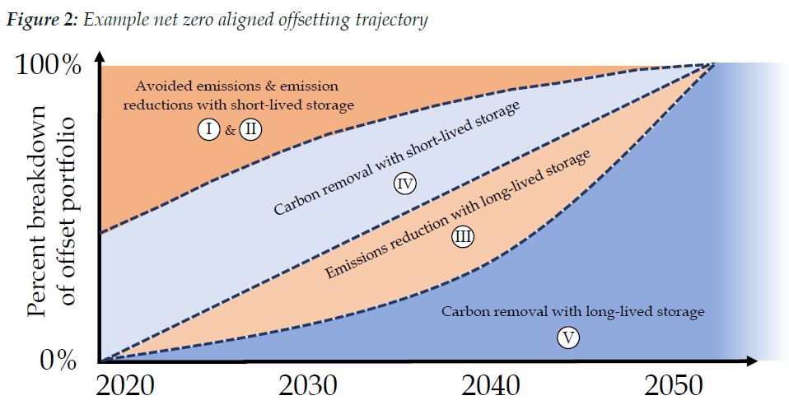
Why Permanent Carbon Removal?
450 ppm
2 degrees
In the past ~200 years, through the extraction and combustion of fossil fuels, the world has shifted over 1 trillion tonnes of CO₂ from underground (in the geosphere) up into the active biosphere (air, land, oceans), increasing the concentration of CO₂ in the atmosphere
Per climate experts around the world, and as highlighted by BCG and Oxford University below, we must reduce emissions where we can and then shift as quickly as we can to permanent carbon removal to offset unavoidable emissions
Nature-based carbon storage is an important “stopgap”¹ measure as we deploy permanent carbon removal solutions, but biological sinks are only temporary and indeed, can become sources as the world warms up
32 COPYRIGHT © 2021 - CARBON ENGINEERING
430 ppm
1.5 degrees
417 ppm (today)
350 ppm
(safe level)
280 ppm
(pre industrial)
We Need True Net Zero, and It Needs Early Adopters ¹ BCG
The Oxford Principles for Net Zero Aligned Carbon Offsetting, Oxford University
Atmospheric CO₂ concentration
WE MUST “TRULY UNDO UNAVOIDABLE CO₂ EMISSIONS VIA PERMANENT REMOVALS” ¹

Slide 33
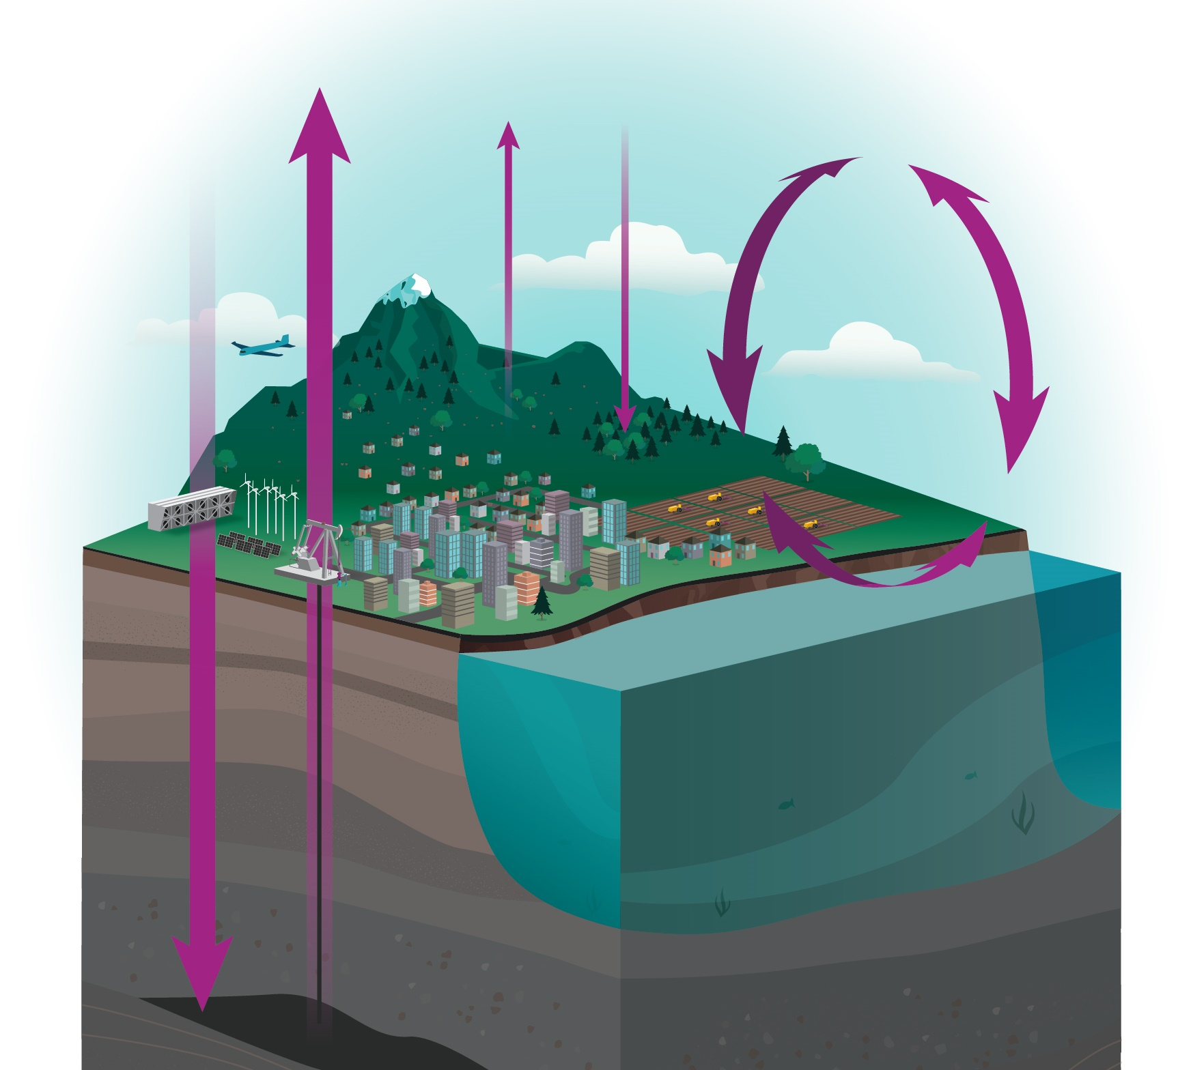
Restoring the Carbon Balance
DAC-based solutions will help bring the carbon cycle back into balance by safely removing and reusing atmospheric CO₂
In the short term, DAC and AIR TO FUELS™ products will help abate hard-to-avoid emissions as we achieve net zero
In the longer term, DAC will help to remove legacy CO₂ so that we can restore the climate
TOGETHER, WE CAN ACHIEVE net zero and beyond – TO CLIMATE RESTORATION

Slide 34
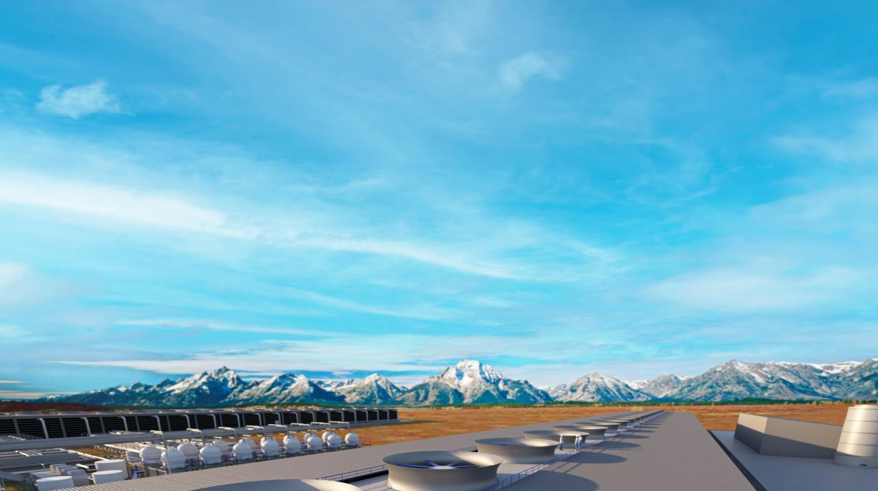
Achieving Net Zero could turn an existential risk into the greatest commercial opportunity of our time.
- Mark Carney, UN Special Envoy on Climate Change
Source: Chloe Farand, Climate Change News, 27/2/2020

Slide 35
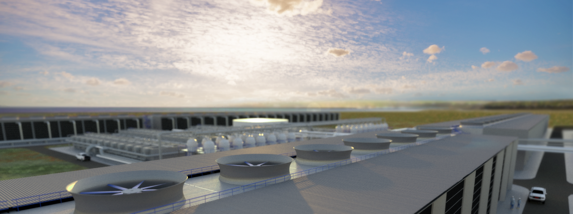
business@carbonengineering.com

Slide 36
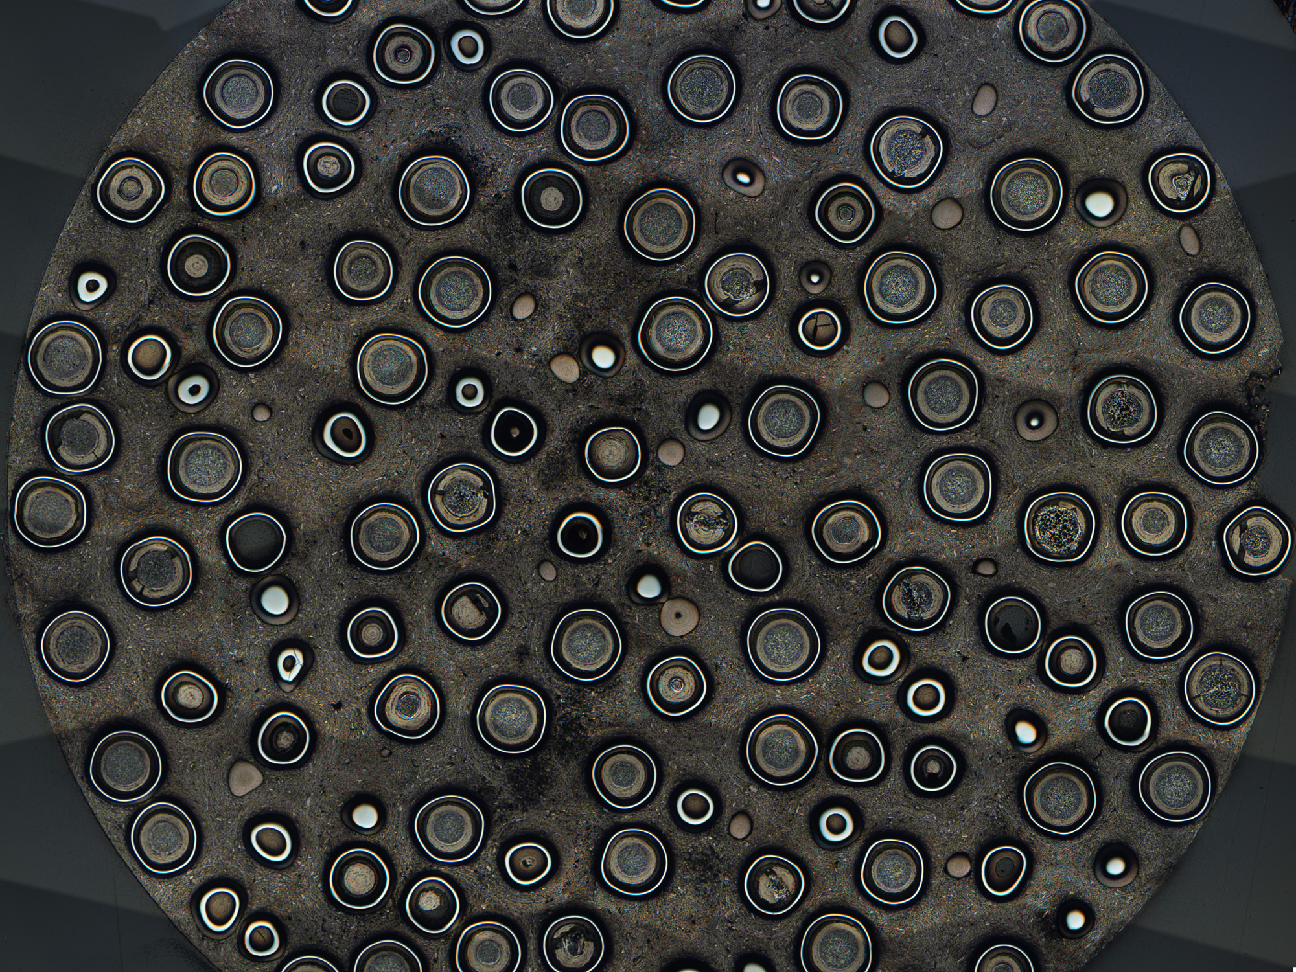
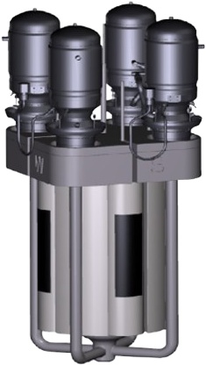
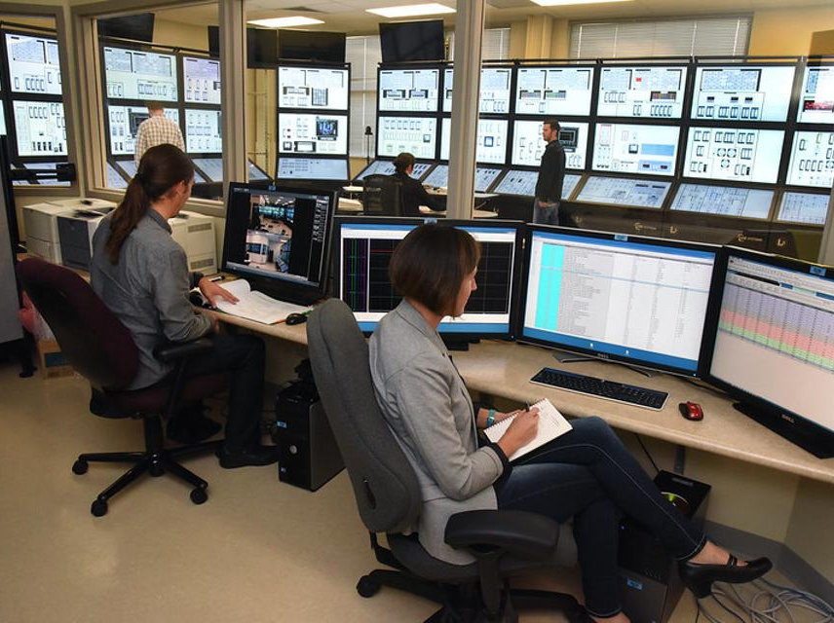
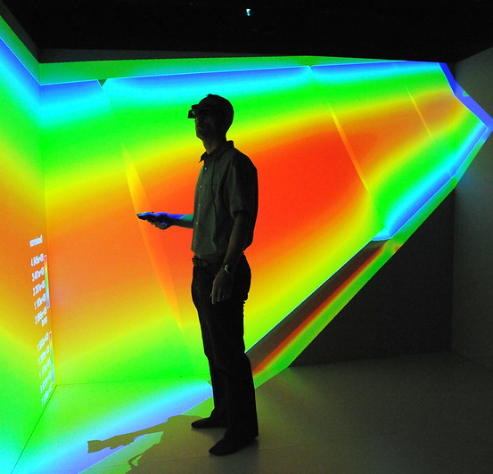
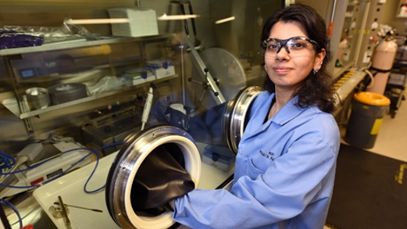
August 17, 2021
Dr. Richard Boardman
Light Water Reactor Sustainability Pathway Lead for Flexible Plant Operations and Generation
Dr. Shannon Bragg-Sitton
National Technical Director- NE Integrated Energy Systems
Innovations in Nuclear Supported Clean Energy Systems

Slide 37
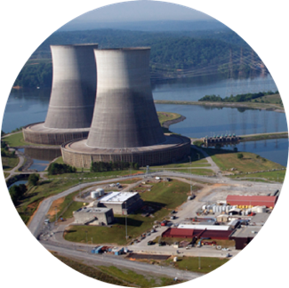
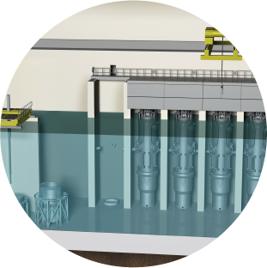
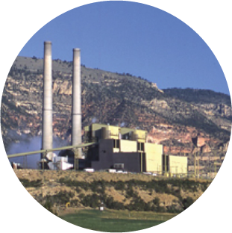

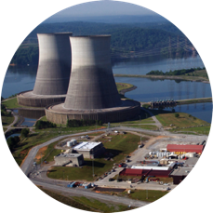
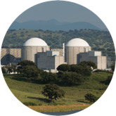
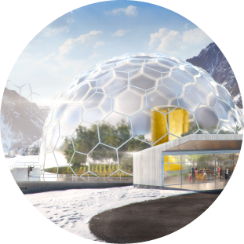

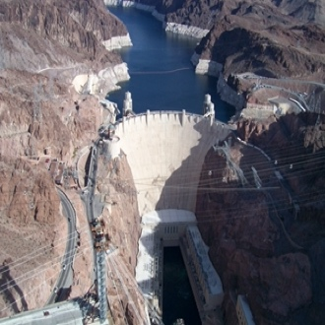

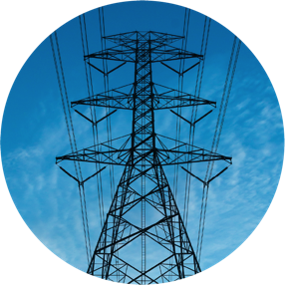



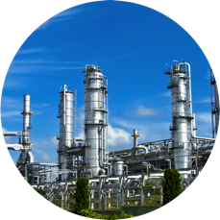
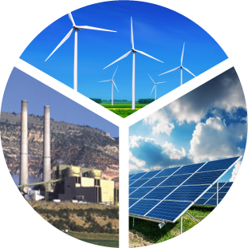




Transforming the energy paradigm
Today
Electricity-only focus
Future Energy System
Integrated grid system leverages contributions from nuclear fission beyond electricity
e⁻
Nuclear reactors from large light water reactors to microreactors
Other generation including intermittent renewables and municipal waste
Biofuel
Industry
Clean water
Hydrogen for
vehicles and industry
New chemical processes
Electricity
Notes:
Current state – energy to the grid. Intermediate future state – (near term) Rethinking how we use our current generators to do more than just put electrons on the grid. Transformative future state – (long term) Designing new systems, both small and large, to use heat, electricity and radiation to drive many other processes
Achieving this goal will require significant S&T advances in:
Enabling technology for flexible operation of existing and future nuclear power plants in integrated, hybrid configurations
Advanced industrial processes that utilize nuclear fission reactors as a primary energy source
Revolutionary concepts in materials design that incorporate new understanding of processes and enable the comprehensive use of nuclear energy in the form of radiation, heat, and electricity
Partnerships/Programs:
H2@Scale- DOE national laboratory initiative that continues to demonstrate at-scale hydrogen production, transport, and storage
INL collaboration with the NETL also introduces the use of nuclear energy to drive carbon conversion to higher-value products versus combustion of fossil fuels to produce heat and electricity
FlexPower project, in collaboration with NREL, will develop and validate control theory and demonstrate a flexible controller architecture for deployment of utility-scale hybrid generation
Tri-Lab initiative with NREL and NETL to develop and demonstrate novel ways diverse energy generators can provide power, heat, mobility, and other energy services.
DOE’s Battery500 program and the U.S. Advanced Battery Consortium rely on INL’s battery characterization and analysis research to support next-generation energy storage. Within work performed in the DOE Laboratory Complex we test 80-85% of all the deliverables being developed for electric vehicles and batteries to support vehicle applications. Over the next few years this percentage is likely to grow closer to 90+% as last year there was a shift from 2 labs to just INL doing testing.
INL Bioenergy: Municipal solid waste to carbon fiber materials: Explore pathways to generate coproducts that are paired with preprocessing methods tailored to the waste material’s carbon and material structure. For example, municipal solid waste feedstock could be targeted for torsion resistant carbon fiber composites or energy storage applications using electrospinning technology to create high surface area carbon-based material resulting in excellent capacitance making them suitable for supercapacitors. Biocomposite markets that will be explored for this project include renewable energy (flexible solar panels, wind turbine blades), medical (artificial limbs, dental composites), packaging materials, building (insulation, flame retardant paneling, compliant standing/walkway mats), and stealth technology due to light weight and improved properties.

Slide 38
A new Paradigm: Integrated Energy Systems with Nuclear
Industrial energy needs
  Electricity
  Steam
  Heat (Thermal Power)
Target Large Industries
  Transportation fuels
  Fired heaters / Steam boilers
  Polymers & Plastic
  Iron & Steel
  Fertilizers
  Minerals
Keys to success
  Hydrogen is key energy currency
  Flexible operations can support the grid
  Energy storage is imperative

Slide 39

Large-Scale Hydrogen Markets

Slide 40


Electrolysis while dispatching as spinning or non-spinning reserves

Slide 41


Market Arbitrage: Buy low, Sell high

Slide 42

Integrating systems for the nation’s net-zero future
Vehicles
Power Plant Operations
Hydrogen
Power Emulation
Power Systems
Wireless
Charging
Human Systems Simulation Lab
(out of picture)
High Temperature
Electrolysis
Digital, Real-Time Grid Simulation
Energy Storage
Battery Testing
(out of picture)
Fast
Charging
Thermal Energy Distribution System
Includes Thermal Energy Storage
MAGNET
Microreactor Agile Nonnuclear
Experimental Testbed
Distributed Energy
& Microgrid
42
Notes:
Energy Systems Integration Lab: INL has invested in new facilities and equipment to support further growth in this research area. Dynamic Energy Transport and Integration Laboratory (DETAIL) (DETAIL includes the High Temperature Electrolysis, TEDS, and MAGNET facilities) will emulate thermal energy generation from a nuclear source using controllable heaters and the Microreactor Agile Nonnuclear Test (MAGNET) facility and will transport that heat both to thermal energy storage and coupled energy users via the Thermal Energy Distribution System (TEDS). DETAIL will provide an opportunity to demonstrate systems integration components and will demonstrate integrated system operation and dynamic control. Preliminary design activities are also underway for the integration of high-grade heat exchangers in the MARVEL primary coolant system.
DETAIL, combines systems that represent energy generation sources, distribution systems, energy storage, and energy users to demonstrate how novel integrated energy systems might be operated within a microgrid under both nominal and off-nominal conditions. This allows researchers to show how a nuclear reactor would physically connect with renewable energy, energy storage, industrial plants, and within a microgrid, and also to demonstrate control systems for this new type of multi-input, multi-output energy system that can support multiple energy use sectors. DETAIL integrates real-world energy storage, electric vehicles, solar power and more using physical hardware, grid emulators, and modelling and simulation tools to form a working model of tomorrow’s electric grid.
The facility provides representation of energy input that might be provided by a nuclear microreactor, which is represented via a 250 kW electrical heater. This system will be coupled via heat exchanger to the thermal energy distribution system (TEDS) that will demonstrate how that thermal energy can be stored and conditioned using a thermal energy storage system, such that heat can be delivered at the right time and at the right quality needed by a range of energy users. TEDS is currently being integrated with a platform to demonstrate up to 250 kW of solid oxide electrolysis cells that will break down steam to produce hydrogen and oxygen. INL is working with a number of vendors to demonstrate different cell technologies to assess long duration performance, cyclic performance, and overall hydrogen production efficiency.
The Energy Systems Lab has also established connections to the INL Human System Simulation Laboratory, which represents a nuclear plant control room, allowing us to study the human component of operating complex integrated systems to support the electrical grid as well as direct users of heat and electricity.
Facility is also integrated with a microgrid that allows us to characterize energy system performance in the context of real power systems in the grid, using digital real time simulators (DRTS) to represent grid components and interactions..
FACILITY SUCCESS STORY: FY 21 INL ran a commercial hydrogen cell stack from an anonymous 3rd party for 4,000- double the planned 2,000 hours. The stack exceeded goals for performance and durability. This work demonstrated that the hydrogen fuel stacks are robust reducing the technical risk of commercialization. Excellent example of IES work in technology acceleration through de-risking. INL’s 25KW electrolysis stack in the ESL was able to reliably support this important work.

Slide 43







Tri-Lab Demonstration of Integrated Energy Systems
Human-in-the-Loop
Hydrogen and other Flexible
Industrial
Processes
Power Hardware and Grid-in-the-Loop
Thermal Energy Generation and Transport
Notes:
INL has established an Energy Systems Lab that is supporting the development of integrated systems that can produce hydrogen as centralized distributed plants. INL, NETL, and NREL are connected with internet data lines to demonstrate how clean energy can be generated and used in demand response. The capabilities at the three labs, with support from all DOE Offices, is proving rapid grid balancing and grid regulation with hydrogen production and combustion in fuel cells and vary soon will include gas turbines.

Slide 44




Joint EERE-NE H₂ Production Demonstration Projects
Three projects have been announced for demonstration of hydrogen production at nuclear power plants
Davis-Besse Nuclear Power Plant
LTE-PEM Vendor 1
Nine Mile Point
Nuclear Power Plant
LTE/PEM Vendor 2
  Demonstrate hydrogen production using direct electrical power offtake from a nuclear power plant
  Develop monitoring and controls procedures for scaleup to large commercial-scale hydrogen plants
  Evaluate power offtake dynamics on NPP power transmission stations to avoid NPP flexible operations
  Produce hydrogen for captive use by NPPs and first movers of clean hydrogen
Schedule:
Thermal & Electrical Integration at an Xcel Energy Nuclear Plant HTE/Vendor 1
  Exelon: Nine-Mile Point NPP; LTE/PEM Vendor 1; using “house load” power; PEM skid testing is underway at NREL; H2 production beginning ~Jan. 2022
  Energy Harbor; LTE/PEM Vendor 2; power provided by completing plant upgrade with new switch gear at the plant transmission station; installation to be made at next plant outage; contract start anticipate by Oct. 2022
  Xcel Energy: HTE/SOEC Vendor 1; Project negotiations are being finalized. Tie into plant thermal line engineering is being planned; Official project start anticipated around Jan. 2022.
Prairie Island
Monticello
Notes:
Four demonstration projects have been awarded under the joint NE-EERE call for proposals. These projects are helping nuclear plant owners/operators and electrolysis technology suppliers reduce the technical and economic risks of scaling up hydrogen production to full-scale commercial systems.
The TRI-Lab developed a set of scenarios for projects that could move the U.S. in the direction of clean energy systems. Hydrogen production with nuclear energy was one of the scenarios proposed by Tri-Lab.
The objectives of the demonstration is given by these bullets.
Two projects will demonstrate low-temperature electrolysis, which requires only an electricity connections (Energy Harbor Davis-Besse Plant in Ohio, and the Exelon Nine-Mile Point Plant in New York State).
Two projects will demonstration high-temperature steam electrolysis which adds a direct thermal connection to the plant. One project will be carried out a Xcel power plant in Minnesota. The second project will be carried out at the INL Energy Systems Laboratory using the newly commissioned Thermal Energy Distribution System that is supported by DOE-NE-IES (Shannon Bragg-Sitton as TIO).
The projects at the nuclear plant sites may be scaled to commercial scale projects. This will help support jobs in these regions- each of which may include social groups that have been impacted by the loss of manufacturing jobs in these areas.
Hydrogen markets provide a new mission for the existing fleet of nuclear reactors. This will ensure the clean energy produced by this plants continues to contribute to the nation’s clean energy goals.
Three demonstration projects have been awarded under the joint NE-EERE call for proposals. These projects are helping nuclear plant owners/operators and electrolysis technology suppliers reduce the technical and economic risks of scaling up hydrogen production to full-scale commercial systems.
Schedule
Exelon: LTE/PEM Vendor 1; Began Oct. 2020; Skid testing is now underway at NREL; H₂ production at plant beginning ~Jan. 2022 using “house load” at Nine-Mile Point NPP.
Energy Harbor; LTE/PEM Vendor 2; Project negotiations completed, plant upgrade with new switch gear at the plant transmission station; equipment purchases are now being made; official project start anticipated as Aug. 2021;
Xcel Energy: HTE/SOEC Vendor 1; Project negotiations are being finalized. Tie into plant thermal line engineering has been completed; official project start anticipated as Sept. 2021.
The TRI-Lab developed a set of scenarios for projects that could move the U.S. in the direction of clean energy systems. Hydrogen production with nuclear energy was one of the scenarios proposed by Tri-Lab.
The objectives of the demonstration is given by these bullets.
Two projects will demonstrate low-temperature electrolysis, which requires only an electricity connections (Energy Harbor Davis-Besse Plant in Ohio, and the Exelon Nine-Mile Point Plant in New York State).
Two projects will demonstration high-temperature steam electrolysis which adds a direct thermal connection to the plant. One project will be carried out a Xcel power plant in Minnesota. The second project will be carried out at the INL Energy Systems Laboratory using the newly commissioned Thermal Energy Distribution System that is supported by DOE-NE-IES (Shannon Bragg-Sitton as TIO).
The projects at the nuclear plant sites may be scaled to commercial scale projects. This will help support jobs in these regions- each of which may include social groups that have been impacted by the loss of manufacturing jobs in these areas.
Hydrogen markets provide a new mission for the existing fleet of nuclear reactors. This will ensure the clean energy produced by this plants continues to contribute to the nation’s clean energy goals.

Slide 45



Electrochemical Conversion of Natural Gas Condensates into Polymers & Hydrogen
INL – UWyo Process Development
Electrochemical Cell
H₃C
CH₃
H₂
H₂C
CH₂
Natural Gas Alkanes
Ethane
Propane
Butane
Heat
Electricity
Monomers
Ethylene
Propylene
Butene
Nuclear Reactor
High Value
Premium
Products

Slide 46
F.T. Carbon Conversion to Fuels and Chemicals (CCU)
Steam
Heat Exchanger
H2O
Nuclear Reactor Energy Source
Steam
Electrolysis
(800 °C)
Light Alkanes & Naptha
(to Chemicals)
H2
H2
Fischer-Tropsch
Fuels Synthesis
Fuel Distillates
CO
Paraffins
(crack or formulate Lubes)
CH4 (Methane)
Carbon Source
(CO2)
Water-Gas Shift or CO2 electrolysis
(850 °C)
Fired Heater
O2
CO2

Slide 47

Iron and Steel Making
Flash-Iron Technology
Direct reduced iron with hydrogen
Scalable to mini-mills
Fed directly to electric-arc furnace
Pilot plant at University of Utah:
Professor HY Sohn

Slide 48

Advanced reactor future state:
One size does not fit all

Slide 49

Advanced Reactor Design Concepts
Benefits:
Enhanced safety
Versatile applications
Reduce waste
Use advanced manufacturing to save money
60+ private sector projects under development
Notes:
Jon – advanced reactor concepts and why they matter

Slide 50




















Accelerating advanced reactor demonstration and deployment
2030
Natrium Reactor
TerraPower & General Electric
2028
SMR
UAMPS &
NuScale
2029
Hermes
Kairos
2026
MCRE
Southern Co. & TerraPower
2025
Xe-100
X-energy
2027
Project Pele Microreactor
DoD
2023-2024
Aurora
Oklo Inc.
TBD
LOTUS Test Bed
NRIC
2024
MARVEL
DOE
2022-2023
DOME Test Bed
NRIC
2023-2024
Notes:
DOE-ID recommends highlighting both MARVEL and Pele
Timeline includes all planned demonstrations and first of a kind reactors, regardless of site location (for example, Natrium is possible for WA or ID).
Oklo’s Aurora and X-energy’s Xe-100 are not yet included because they lack firm dates.
MARVEL:
DOME:
Pele:
Oklo: Licensing 2023
LOTUS:
MCRE:
Hermes: Kairos is siting Hermes at the East Tennessee Technology Park (site K-33). INL has some involvement (investigating tritium transport phenomena, behavior of materials under irradiation, and assisting with siting support for Hermes, and some licensing and code interpretation). INL can also take credit for TRISO work over the years, which is an important enabler for Kairos.
Natrium:
Xe-100:
SMR:

Slide 51



