Slide 1


Slide 2


Slide 3


Slide 4
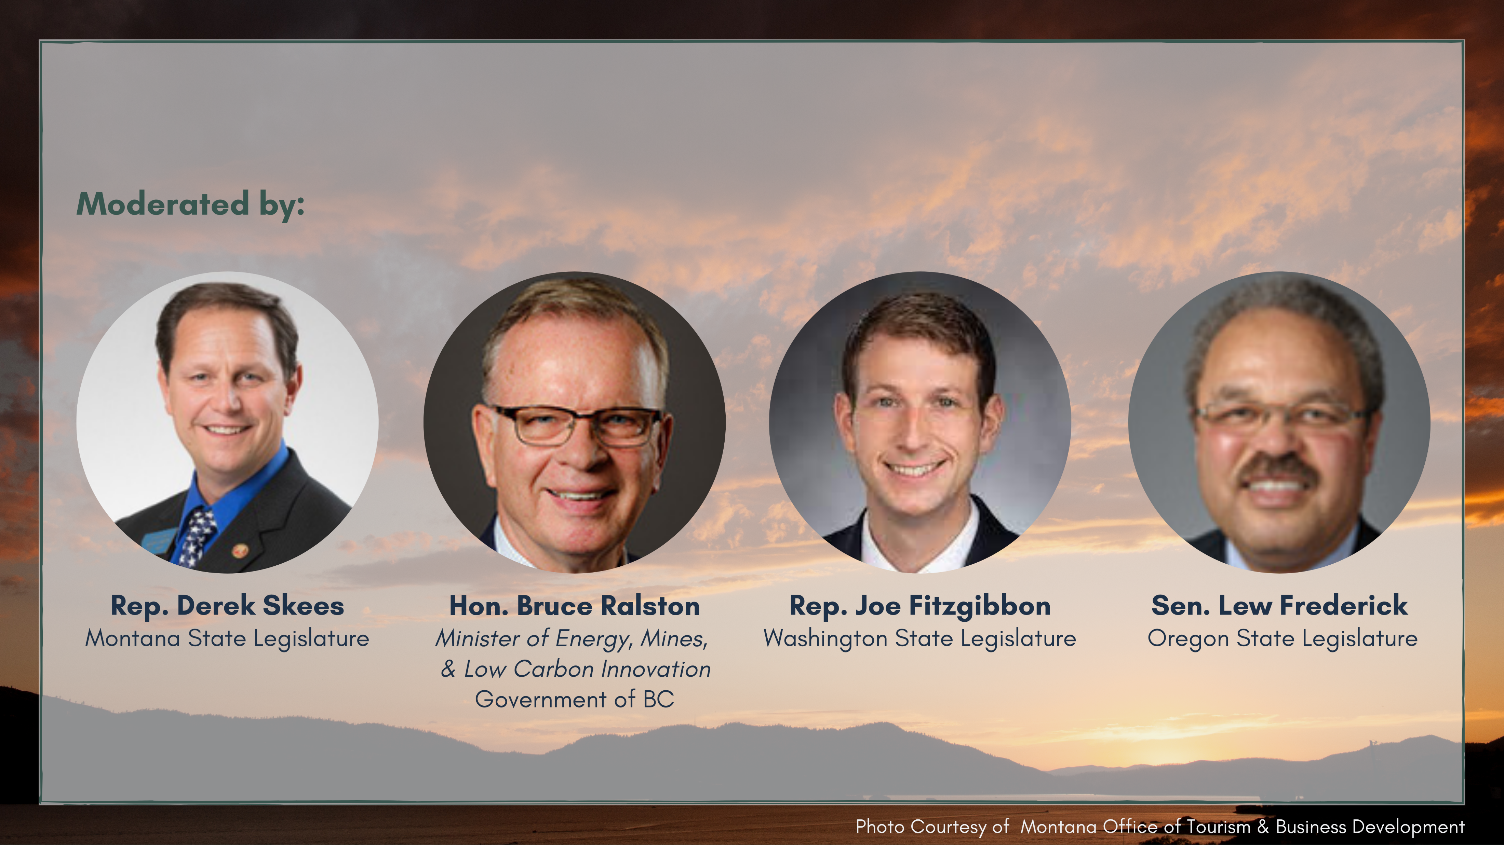

Slide 5
Natural Gas By the Numbers
State/Province | Households / Businesses | Pipeline (miles / km)
British Columbia | 955,626 / 98,476 | 35,000 / 58,500
Idaho | 433,237 / 44,420 | 17,500 / 29,000
Montana | 279,987 / 38,099 | 16,250 / 27,000
Oregon | 783,100 / 85,081 | 30,000 / 50,000
Washington | 1,234,324 / 109,451 | 45,000 / 75,000
TOTAL | 3,686,274 / 375,527 | 143,750 / 239,500

Slide 6
Recent Gas Demand

Slide 7
System Supply Demand Balance

Slide 8
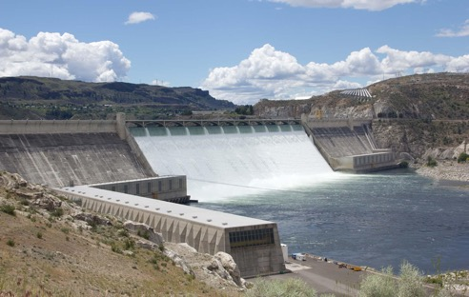
Peak Energy
January 5, 2017, 7am-8am:
  ~30 GWh delivered via electric system
    = 1,000,000 therms
  ~1,800,000 therms delivered via gas system
    = 53 GWh
8 x

Slide 9
2021 NWPP overview
Resources & Transmission
Tuesday, August 17, 2021, at the PNWER Annual Summit during our Energy session
Frank Afranji
NWPP, President

Slide 10
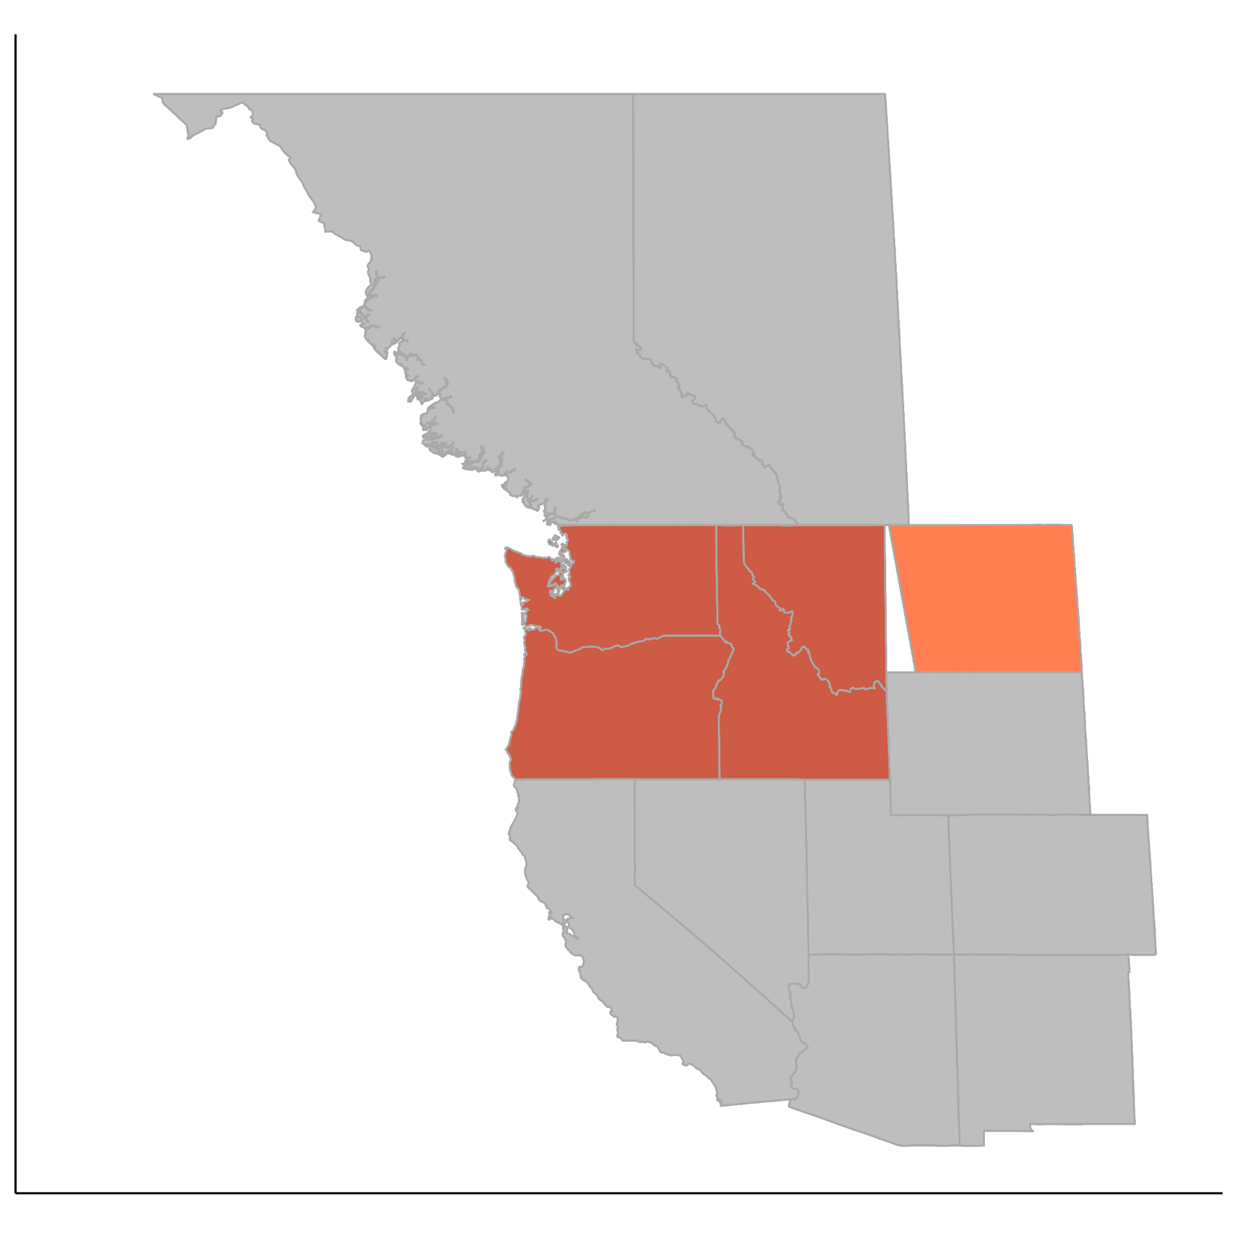
2021 Northwest Regional Forecast
Aggregates utility data in Power Act footprint
  Over 100 utilities
Requirements
  1-in-2 loads after energy efficiency, firm exports, a 16% planning margin for peak
Resources
  Expected generation from utility owned/contracted resources, long-term imports, hydro under critical water conditions (8% for peak), no short-term market transactions
A power system barometer
  Does not provide an exact need for power

Slide 11
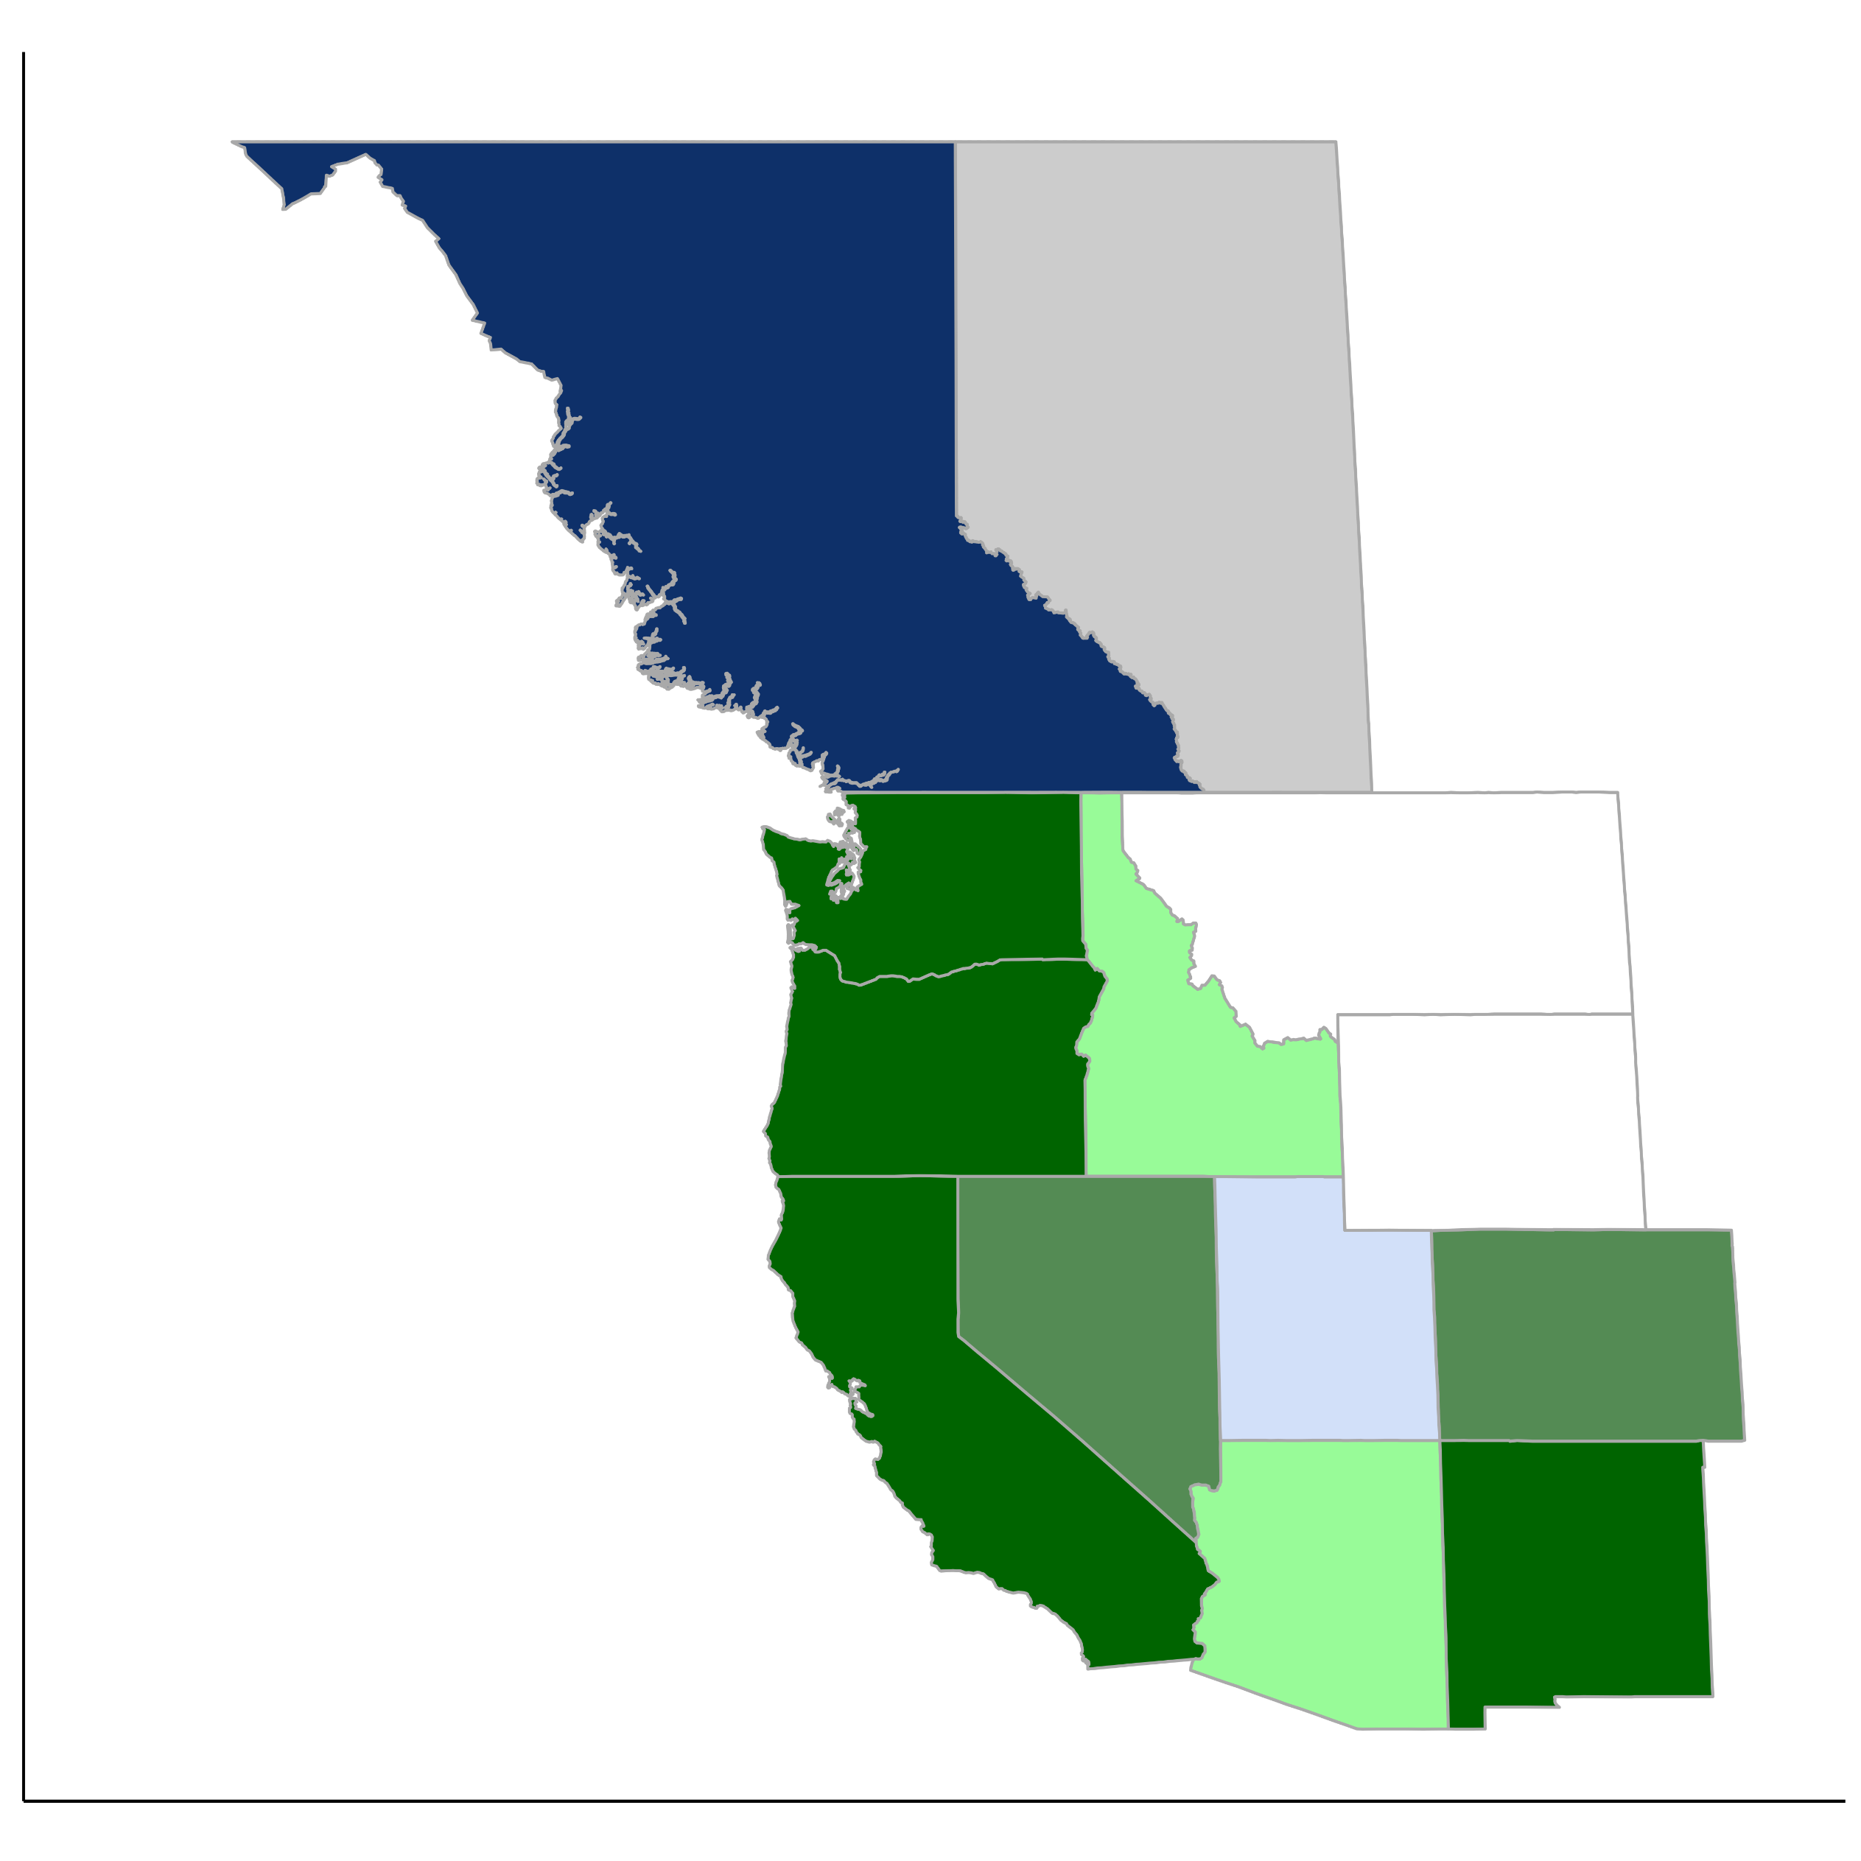
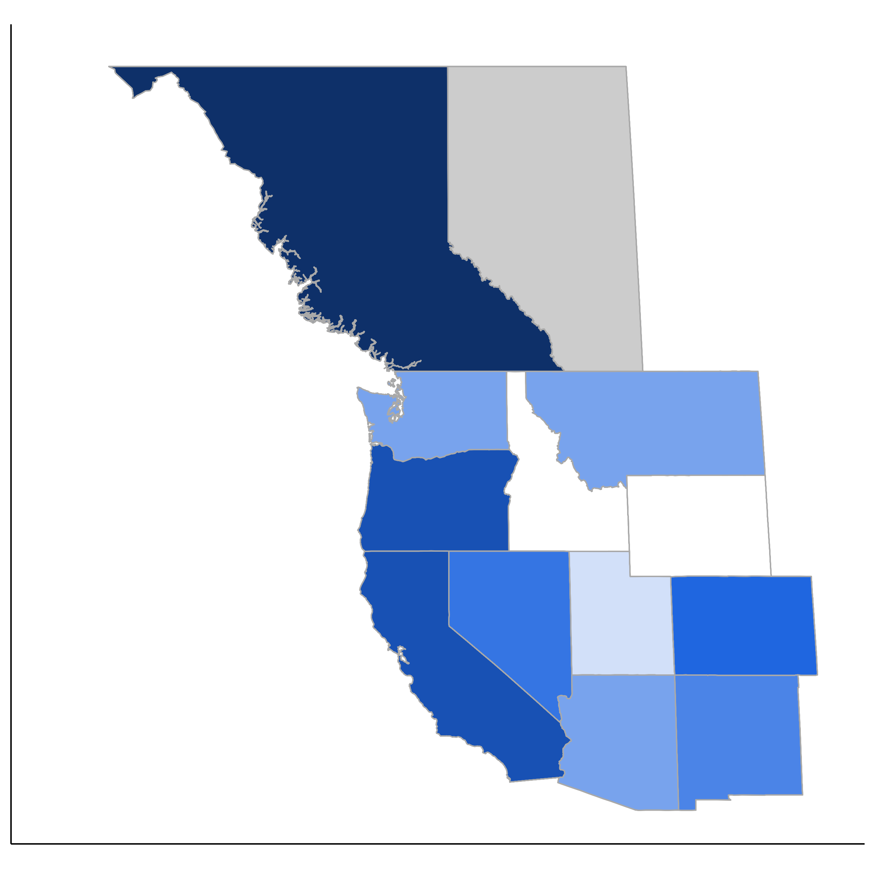
Major shifts in western carbon policies
2017
Summer 2021
Has CO₂ pricing
Has CO₂ pricing
CO₂ free by 2040/2045 via state policy; also has RPS
Nearly CO₂ free by 2045/2050 via state goals; also has RPS
Nearly CO₂ free by 2045/2050 via utility/city goals
RPS only (darker equates to higher standard; BC (93%) includes hydro
Mandated coal retirements by 2030
No policy
Has CO₂ pricing
Has CO₂ pricing

Slide 12
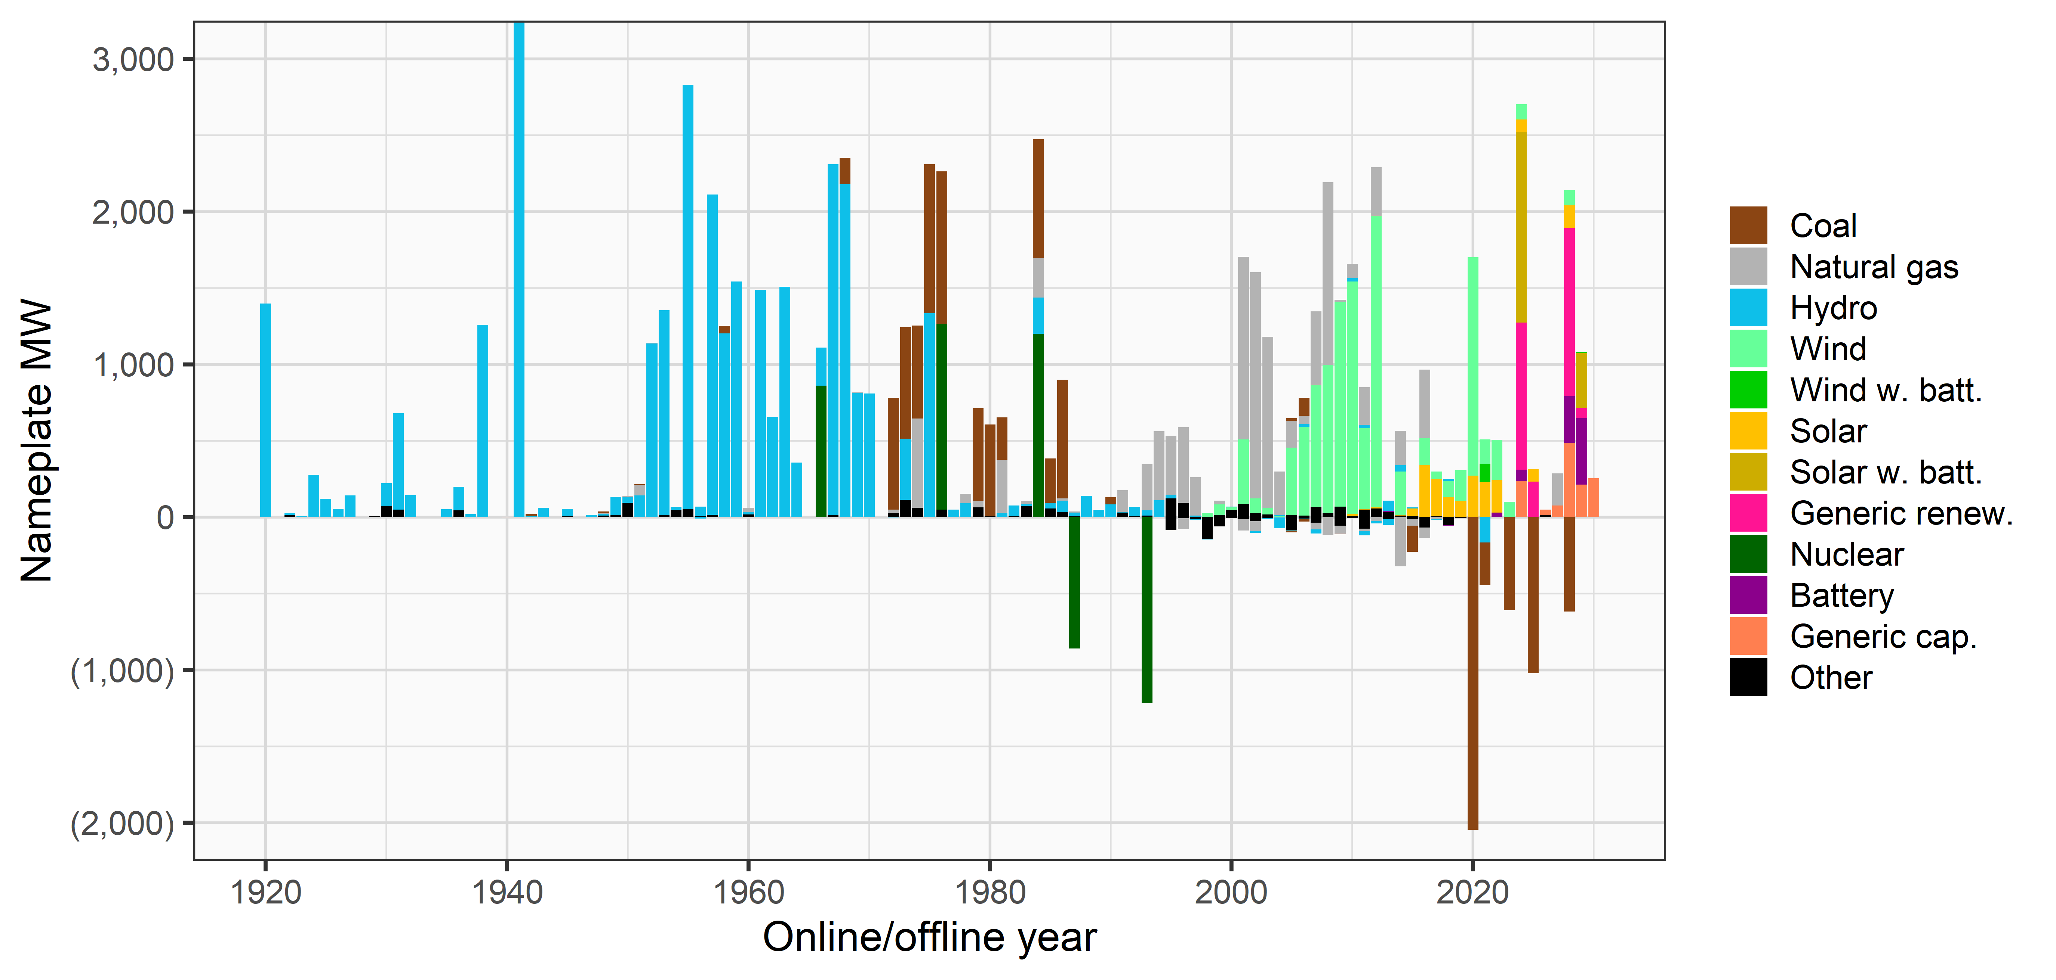
Historical NW resource development
Extends to 6,800 MW
1920 and earlier combined

Slide 13
Utilities exiting Northwest coal units

Slide 14
A barometer for need
Northwest peak load/resource balance
January
August

Slide 15
NWPP Bulk Transmission
Members 500 kV OR-WA-ID-WY-UT
  Miles >2,000
  Segments: B2H, Hem-Midpoint-Populas-Aeolus-Clover
    Hermiston,OR – Boise,ID – Casper,WY – Salt Lake City,UT
Members <500 kV
  Miles ~200
  Segments Cascade Renewable (400 kV HVDC)
    The Dallas,OR – W. Portland, OR
ITP Projects under review
  SWIP-N (AC) ~275 miles 500 kV
  TWE (AC/DC) ~400 miles 500kV HVDC, ~320 Miles 500kV
  Cross-Tie (AC) ~210 miles 500 kV

Slide 16
TransWest Express / SWIP-N / CrossTie / GW-W / GW-S
B2H
TWE Loop-in on GW-South&West
GW-West
Segments
SWIP-N
GW-South
CrossTie

Slide 17
NorthWestern Energy Infrastructure Overview
NorthWestern plans for extreme weather events;
Events are becoming more extreme
Market unreliability at crisis level
  Leads to incredible price volatility
  Transmission constraints limit ability to import supply
  Supply upgrades and capacity resources take years to accomplish; Requires urgent action
Regional Resource Adequacy plays critical role in Montana challenges during weather events

Slide 18
Big Picture - Electric Transmission System Challenges
The NorthWestern system is generation resource deficient.
  Flexible generation not only needed for energy and capacity, but is also critical for support of the transmission system and for the provision of ancillary services
The system is transmission constrained.
  Generation and transmission system were developed together
  Loss of generation in balancing authority is a significant concern and causing high imports from market
  Transmission to import energy is constrained on peak hours when supply need is greatest
  There is competition for transmission capacity
Current situation has been described for several years
The region is also constrained and recognizes a Resource Adequacy issue

Slide 19
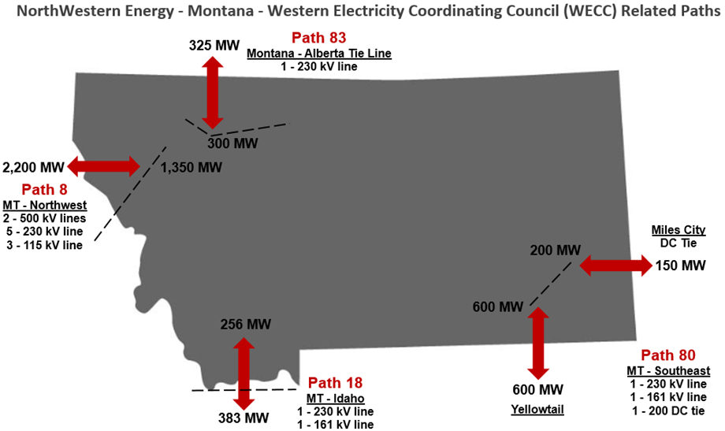
Increasing Risk – Access to Market
Very few trading partners on Path 80; Very unreliable and often gets cut

Slide 21
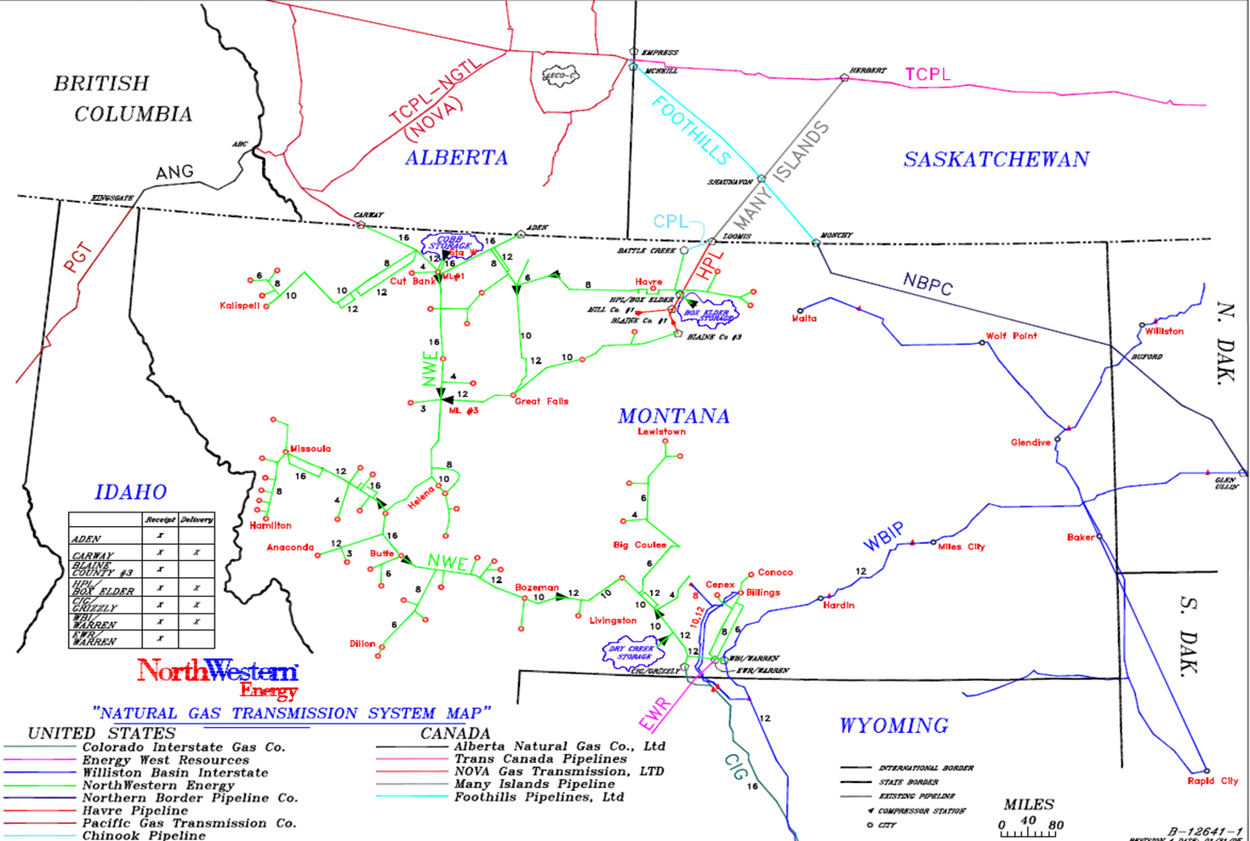
Gas Transmission System
Notes:
GTS operates/maintains approximately 2150 miles of gas transmission pipeline, from 1” thru 24”, almost 1600 miles of gathering pipeline and 114 individual compression units totaling almost 90,000 horsepower in Montana and South Dakota.
In Montana, GTS provides service to about 190,000 natural gas customers in the western 2/3 of Montana (~70,000 square miles of service territory). We have about 50 receipt points where gas enters our system and 150 delivery locations. We have 3 active storage reservoirs that we cycle about 13 Bcf annually through.
Our system is designed to deliver about 336 MMcfd (design day) with a little more than half of that deliverability available from our storage reservoirs.
On an annual basis, we deliver about 44 Bcf. Half of our delivered volume goes to the core customer and the other half to the on-system non-core customer.

Slide 22
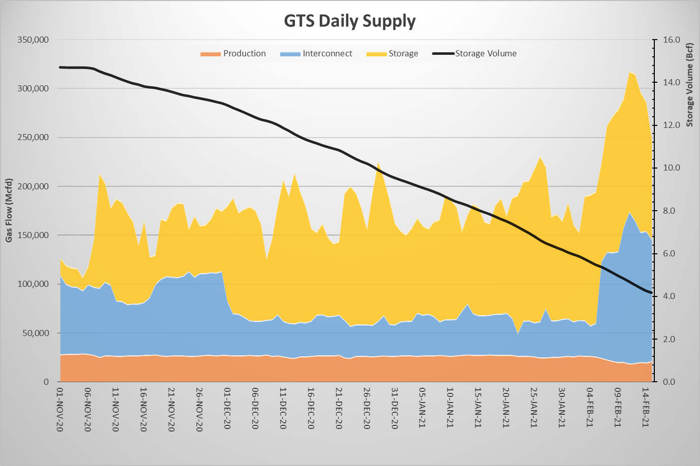
Heating Season Gas Supply & Storage Volume
Storage Seasonal Cycle – 11/1/20 = 14.4 BCF, 2/17/2021 = 3.9 BCF

Slide 23
Gas Transmission Important Takeaways
The Gas Transmission System operated well and as designed during cold weather event
The system operated at or above its design limits at times
  When above design limits, system is losing pressure
  There were challenges, as there always are during peak period operations
  Significant customer growth on gas transmission system, especially in certain areas
Planning for major upgrades takes significant lead time including permitting, engineering and construction
We are interconnected with others with operational dependence on other systems, markets and market pricing
We continue to plan for the future growth for our gas transmission and distribution customers

