Slide 1


Slide 2


Slide 3
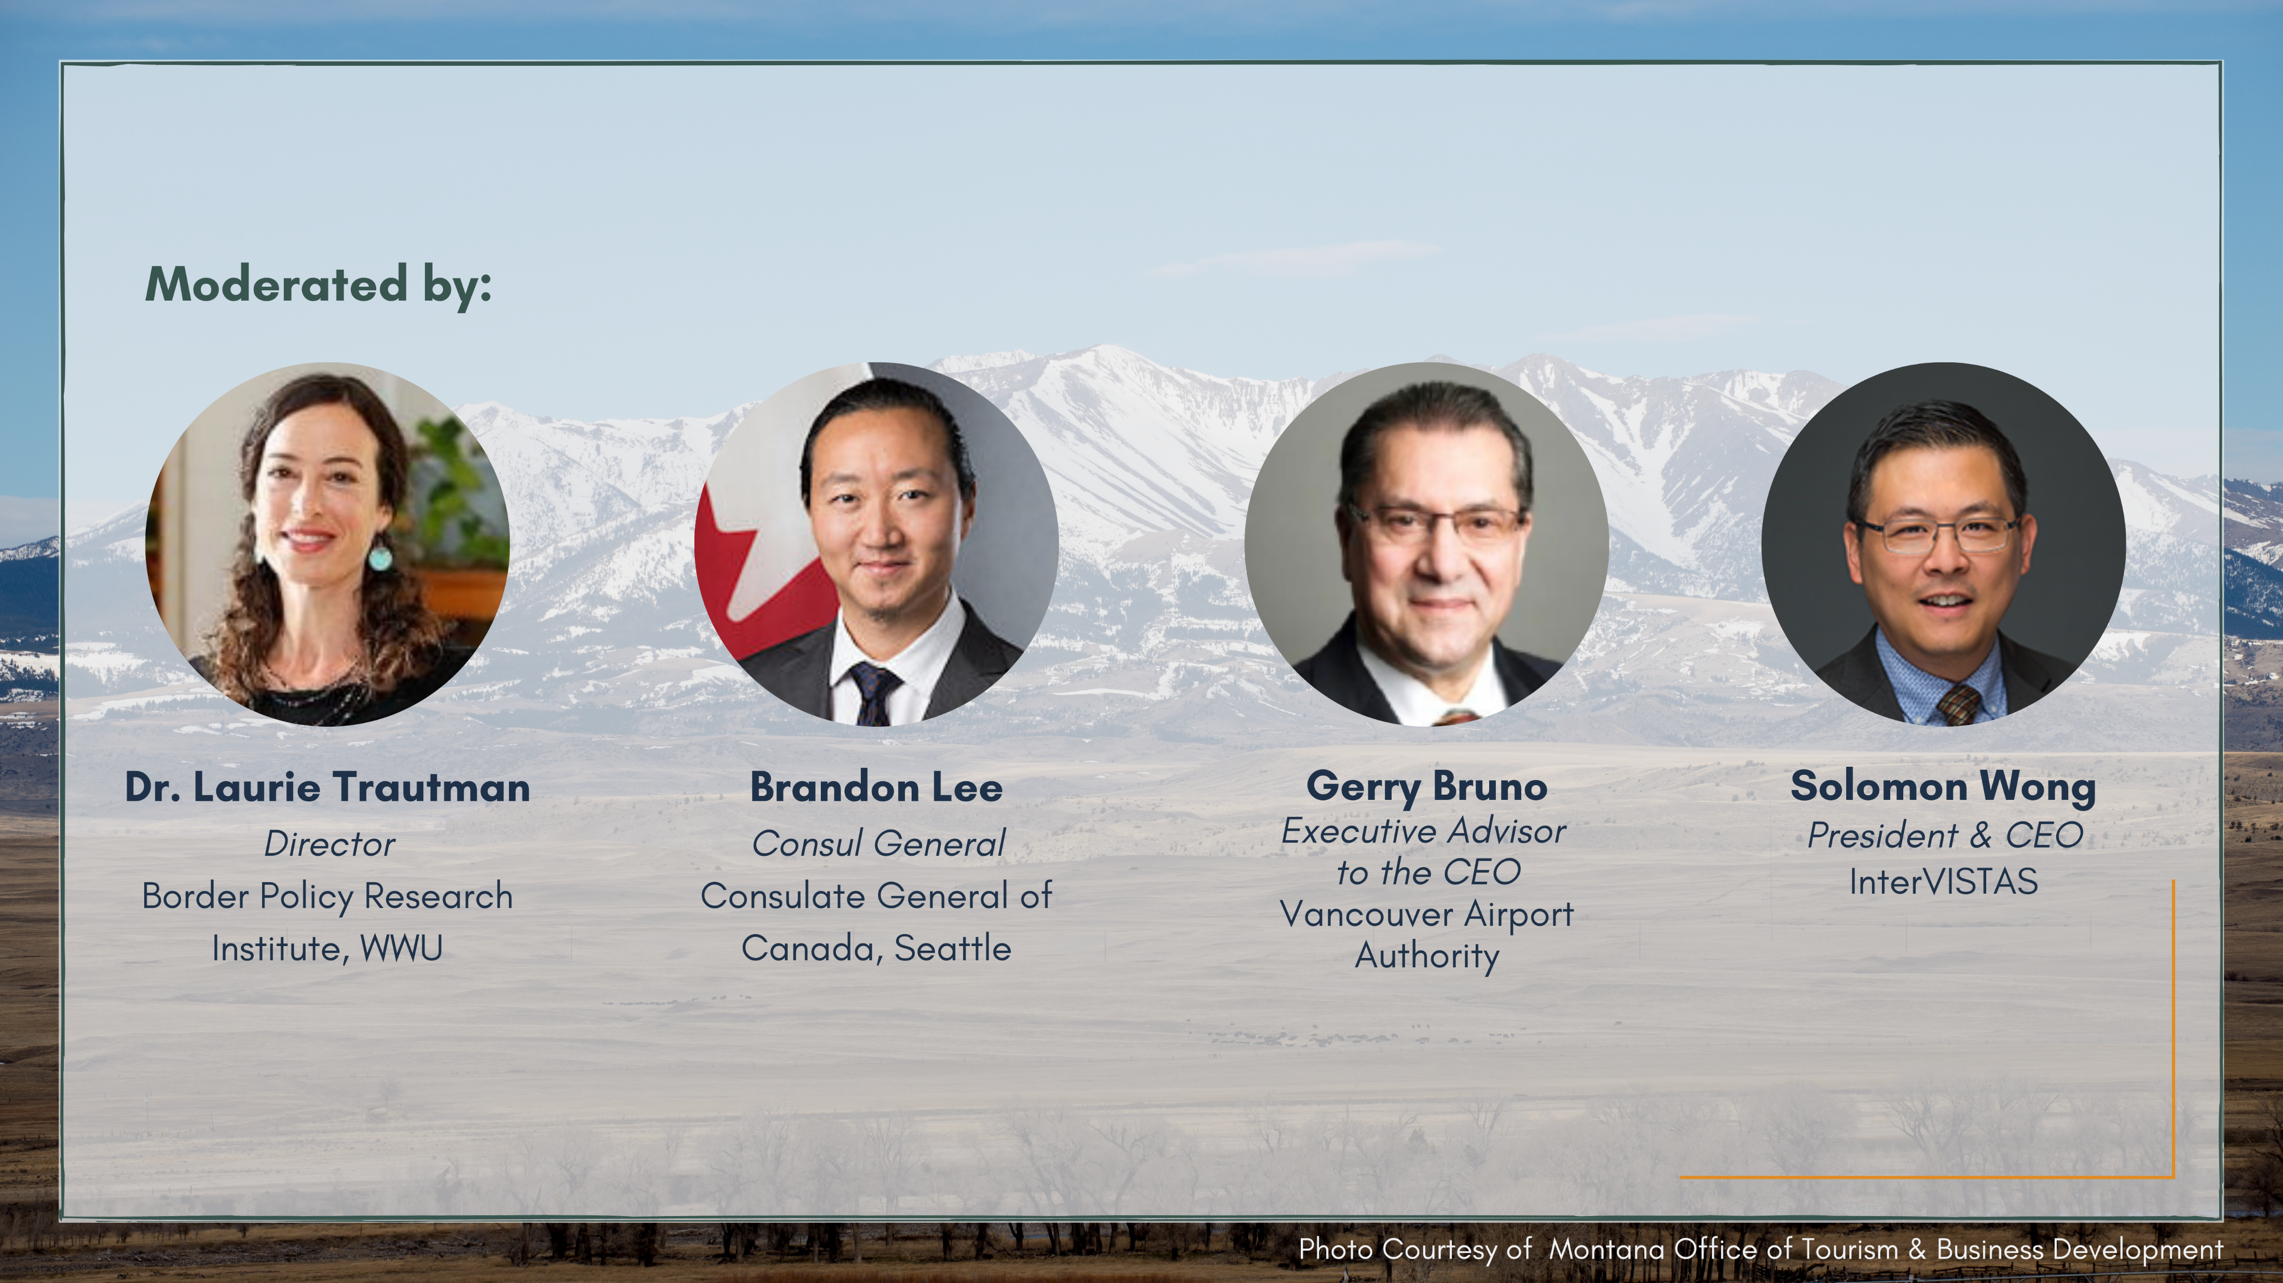

Slide 4


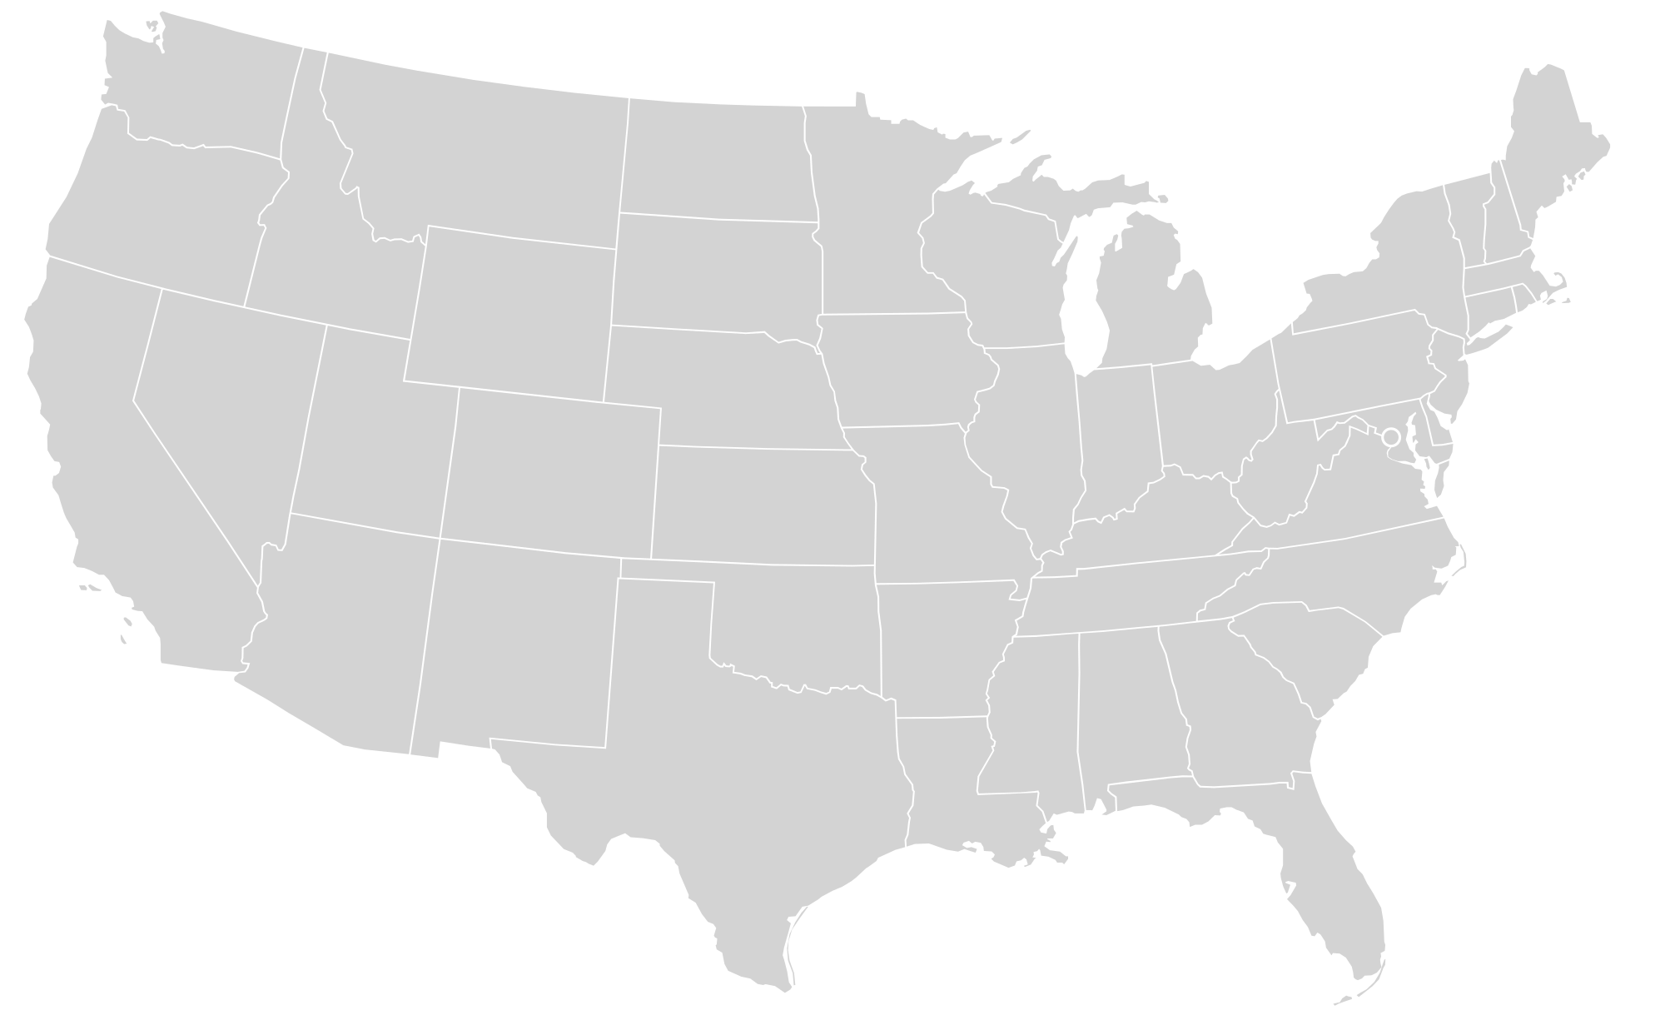
Overview of FBC Strategy
Reimagining the next-generation
U.S.-Canada Border
Launch: August 2021
Target Completion: Q1 2022
Notes:
Applied research, stakeholder engagement, and integration of climate change and public health considerations by leveraging the latest border technologies

Slide 5

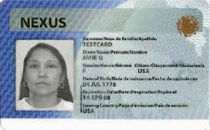
Major Successes in the Past 25 Years
Common framework for border management
Inter-agency cooperation (policy & technical)
Clarity of rules and processes
Actual gains in border efficiency and security
Support of cross-border trade and travel

Slide 6
Since March 2020
Uncoordinated Border Policies
Increase in processing times
Complexity of rules across modes
Duplication of efforts (public & private)
Confusion and uncertainty for users
Added administrative burden
We are ill-prepared to take full
advantage of USMCA and
coordinate our pandemic recovery.
This ultimately affects our overall
global competitiveness.

Slide 7

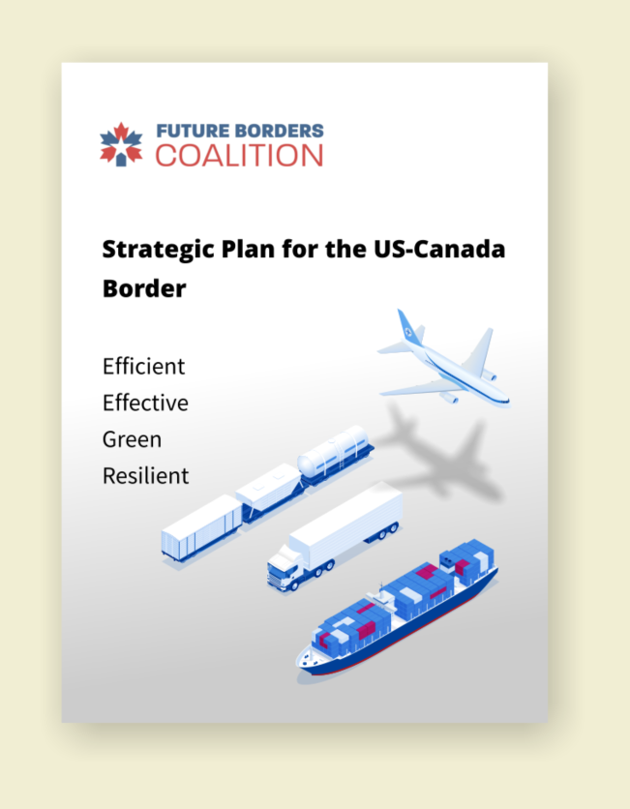

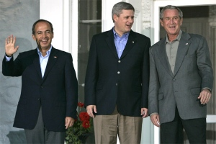

Opportunity: A Renewed Border Vision
1995
2001
2004
2011

Slide 8
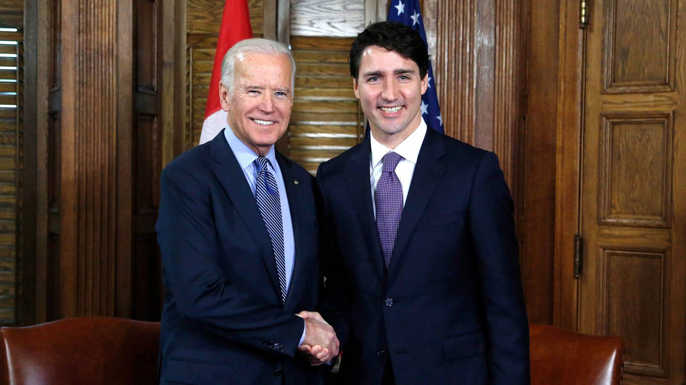
1995
Opportunity: A Renewed Border Vision
Future Borders Coalition is
launching a major applied research project to input into a future border US-Canada border vision.
2001
2004
2011
2022?

Slide 9

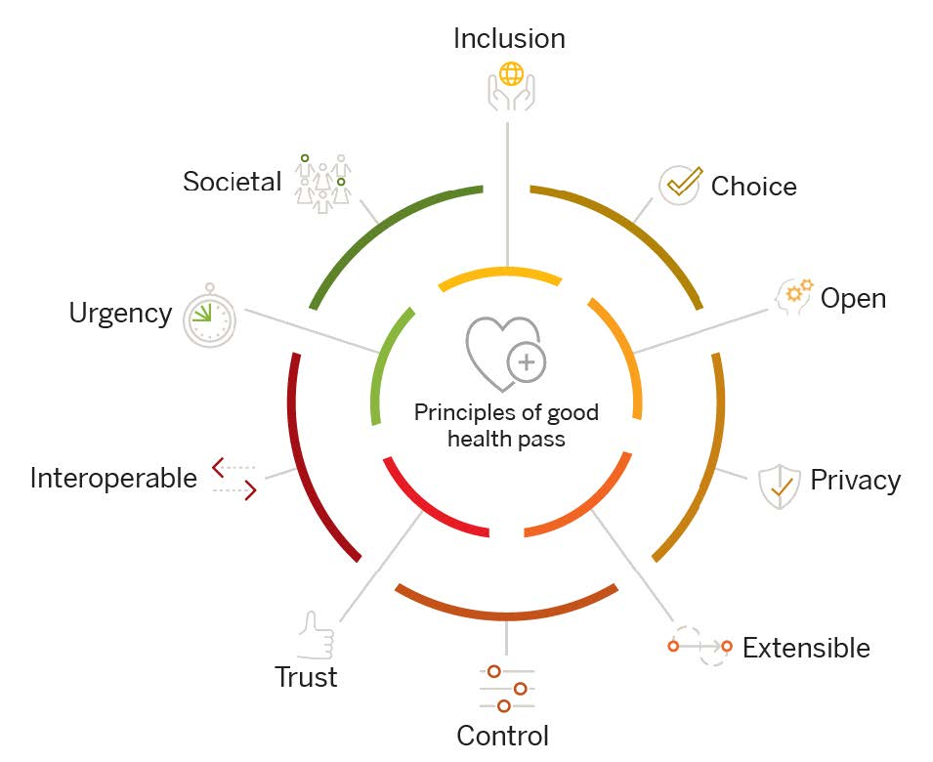
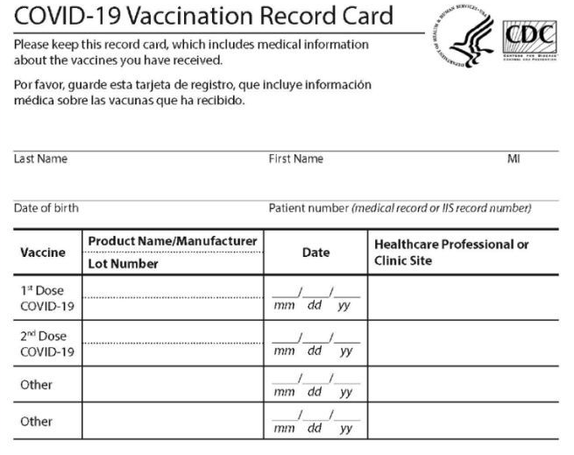
Theme 1: Digital Trust for Efficient/Effective Borders
Paper-based approaches
used since 18th Century
Great Plague to Now
Interoperable digital credentials, built off of
privacy, equity and user-control
(e.g. adhering to Global Health Pass Collaborative)

Slide 10
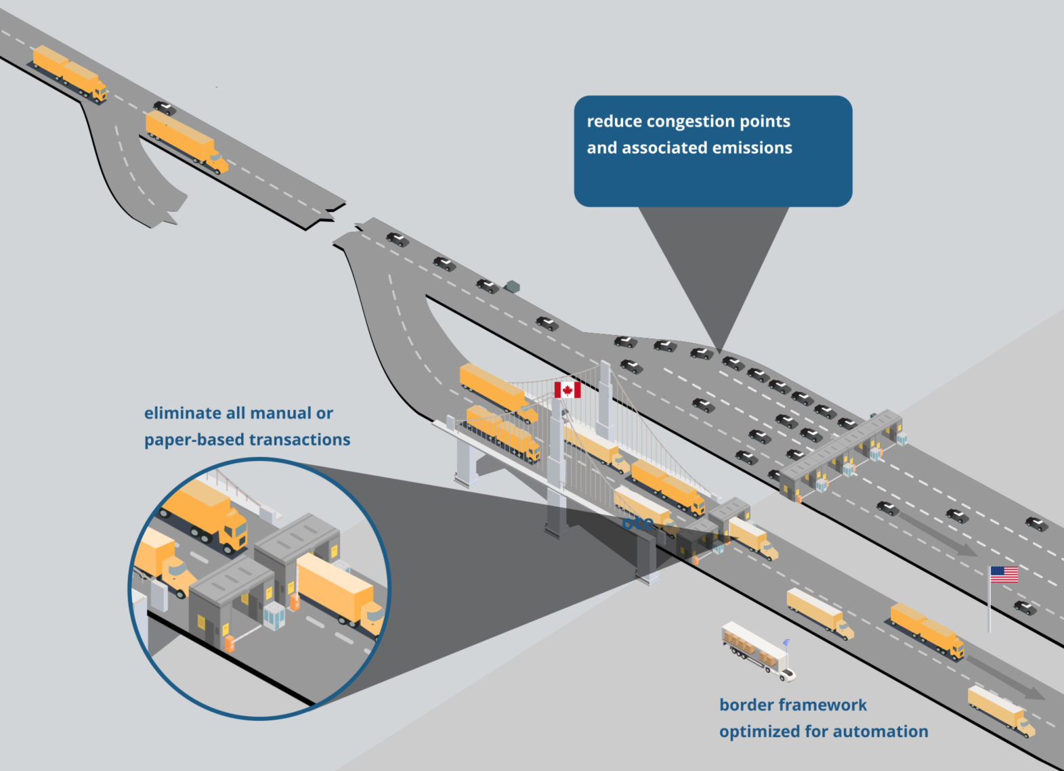
Theme 2
Greening
Our
Borders

Slide 11
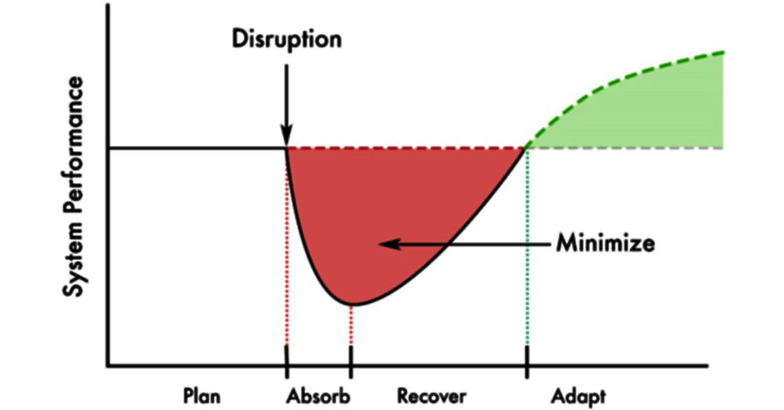
Theme 3: Resilient Borders
Source: OECD, A systemic resilience approach to dealing with Covid-19 and future shock, 2020

Slide 12
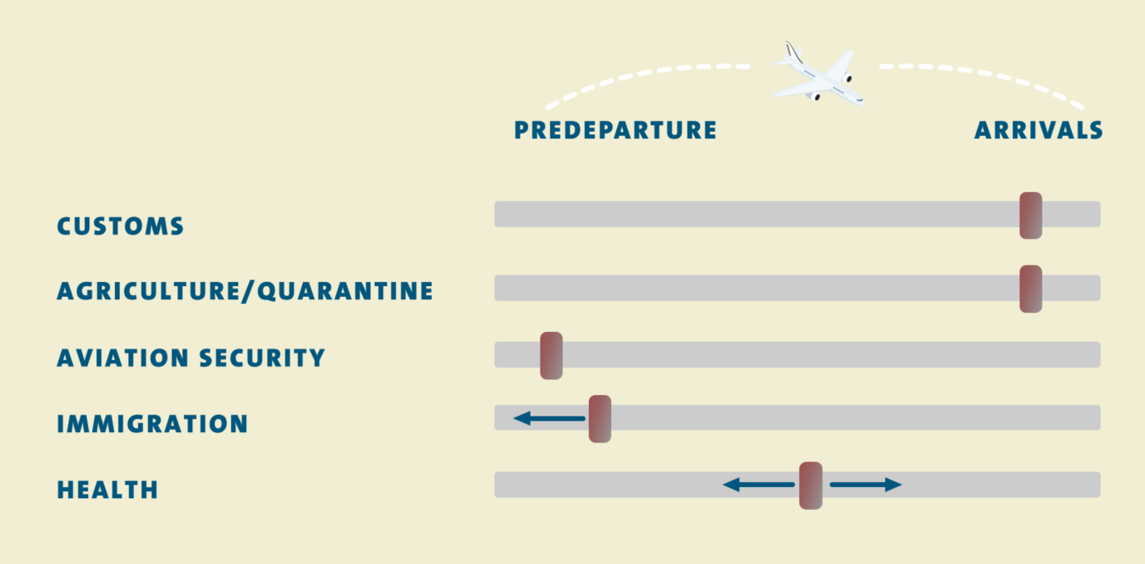
Theme 3: Resilient Borders: When Do We Address Risk?

Slide 13
Call To Action: Where Do You See Future US-Canada Borders?
www.futureborderscoalition.org

Slide 14
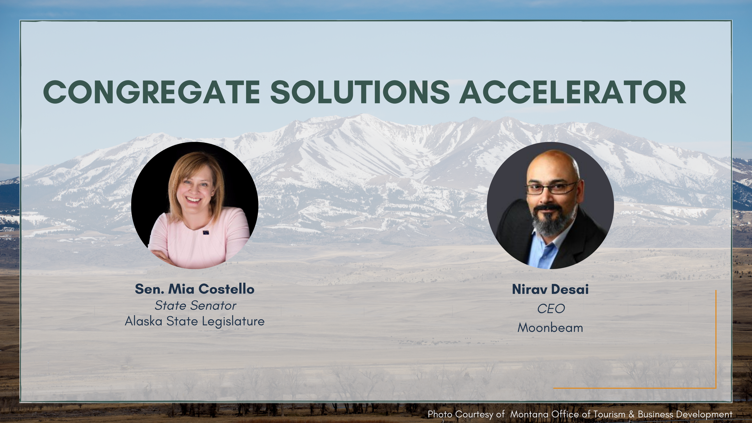

Slide 15




PNWER Congregate: A Solution Accelerator to Reopen
Tourism, Performing Arts, Travel, and Hospitality (TPATH)

Slide 16














Congregate is a solutions accelerator to reopen the Tourism, Performing Arts, Travel, and Hospitality (TPATH) sectors with broad support from government and industry.
Regional Government Support for U.S. EDA Funded Grant
Private Sector Partners
Alaska and Washington State
Alaska Lt. Gov. Kevin Meyer
AK Department of Health and Social Services
WA Department of Commerce
6 Members of the U.S. Congress
21 – Washington State Legislators
Notes:
Mitacs
Destination Greater Victoria
Creativity Disruption Labs
BC Provincial Government
BC Tourism Industry Association
Ports and Airports
Rocky Mountaineer
0ther Vancouver Incubators
Launch Ventures
Business Council of British Columbia/Co-Chair, Cascadia Innovation Corridor

Slide 17
Congregate’s “Challenge-Driven” approach engages and supports the innovation ecosystem to address societal and industry challenges.
Convene
Gather experts from industry and government and identify
Prove
Engage innovators to address public health needs and support the evaluation and refinement of their solutions
Scale
Offer resources and connections to help solutions achieve rapid adoption in other regions and congregation venues.
Critical impediments to reopening TPATH sectors
Technology areas of need
Public health requirements
Test these solutions through pilots in coordination with industry
Scout
Leverage data science tools networks to identify game changing technology solutions to address challenges such as:
Immunity tracking
Touchless surfaces
Hybrid congregation solutions
IOT public health monitoring and reporting
Key Objectives
We are looking to the innovation economy for solutions – collaboration between industry, regulators, and innovators is key.
Members of the innovation economy accepted into the program includes startups, corporate innovation labs, or academic research teams looking to spin out companies.
We want member with capabilities to address a need – not technology solutions looking to find a market.
Find 16-24 startups – accelerate their product development to successfully scale 6-10 solutions for resilience in the Tourism sector

Slide 18
Congregate is a solutions accelerator to reopen the Tourism, Performing Arts, Travel, and Hospitality (TPATH) sectors with broad support from government and industry.
Convene
Prove
Scout
Scale
Cohort 1.1: 5/1/21 – 8/31/21
Cohort 2.1: 2/1/2022 – 3/30/2022
Convene Stakeholders
Program setup
Challenge Development
Mentor & Advisor Recruiting
Cohort 1: 9/1/21 – 9/31/21
Cohort 2: 4/1/22 – 4/30/22
Scout for Potential Solutions
Invite companies to apply for accelerator
Evaluate applicants
Engage investors
Cohort 1: 10/1/21 – 12/31/21
Cohort 2: 5/1/22 – 7/31/22
Prove Solutions and Accelerate Adoption
Industry Training
Mentorship
Accelerator Programming
Cohort 1: 1/1/22 – 9/30/22
Cohort 2: 8/1/22 – 9/30/22
Scale Proven Solutions Globally
Help companies fundraise
Customer introductions
On-going mentorship and support
Notes:
Mitacs
Destination Greater Victoria
Creativity Disruption Labs
BC Provincial Government
BC Tourism Industry Association
Ports and Airports
Rocky Mountaineer
0ther Vancouver Incubators
Launch Ventures
Business Council of British Columbia/Co-Chair, Cascadia Innovation Corridor

Slide 19




Congregate: A Solutions Accelerator to Safely Re-Open
Tourism and Transportation Economy
Expected Outcomes
Reopen
Re-opening the TPATH sectors will return millions to the state and provincial budgets and billions to GDP – including addressing a disproportionate impact on minority jobs
Export
By creating the technology for reopening venues, we will create an exportable capability rooted in the PNW
Innovate
This will help the Pacific Northwest retain and grow its position as a global innovation hub and a leader in the future economy. Establish as a model for other sectors, states, provinces, e.g., green tech, broadband, etc.

Slide 20



Ways to partner
Help identify industry challenges and secure industry engagement
Help recruit mentors
Help diversify representation in the Industry Advisory Council
What we are looking for: Companies with a critical need and willingness to work with external innovators to pilot solutions
What we are looking for: Industry experts with deep domain knowledge and understanding of what it takes to implement technology in an enterprise
What we are looking for: Executives that will identify challenges, evaluate candidate companies, and help scale solutions

