Slide 3
Interjurisdictional water resources: is conflict inevitable?
Reed D. Benson
University of New Mexico School of Law

Slide 4
“Interjurisdictional water”?
Transboundary waters are rivers, aquifers or lakes that span a border between sovereigns
sovereigns include nations, Indigenous tribes/First Nations, and states/provinces
Transboundary or not, a water body may be governed by law from multiple levels/sources
state/provincial, federal, tribal/First Nation, international

Slide 5
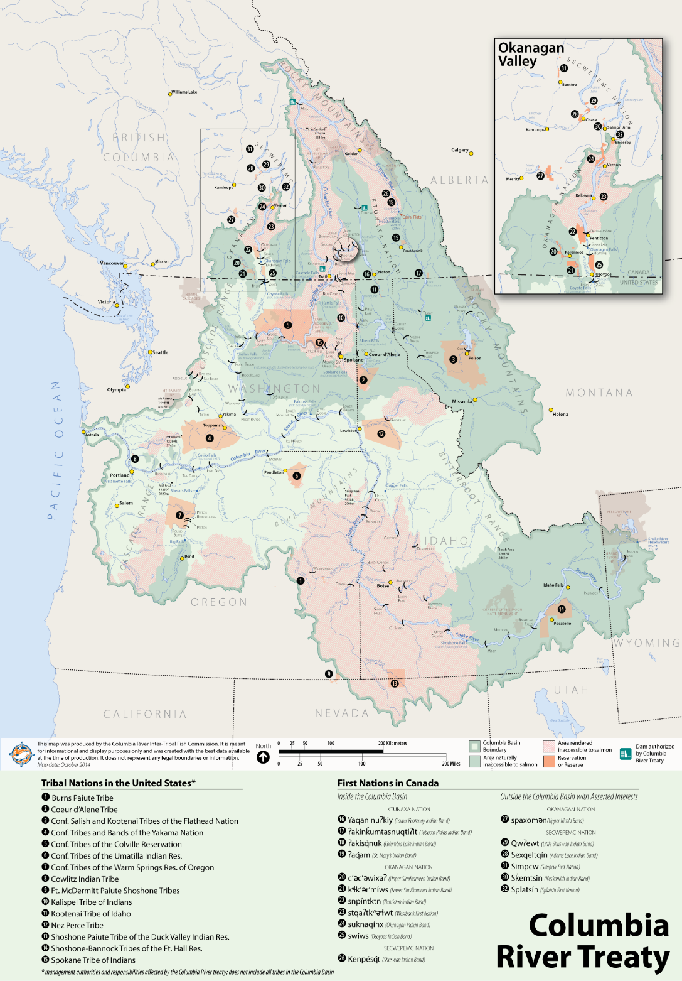

Slide 6
Interjurisdictional arrangements
For international waters:
treaties, e.g. 1909 Boundary Waters Treaty
For interstate/interprovincial waters
apportionment agreements are preferred
For waters claimed by tribes/First Nations, establishing/confirming their legal rights
For federalized waters, clarifying and sharing powers and responsibilities among levels

Slide 7
In U.S., water conflict is common
Between states: Supreme Court litigation, esp. to enforce interstate water compacts
Between states and tribes: litigation (which may take decades) over tribal water claims
Between states and feds: legal/political fights over dam operations, endangered species
Plus a few international disputes ….
Such conflicts appear less common in Canada

Slide 8
Why do “we” fight over water?
Interjurisdictional water conflicts tend to have one or more of the following features:
sovereigns have different goals for resource
zero-sum games
antipathy toward the “other side”
politics favor fighting
Such factors can make fighting the “easy way”

Slide 9
Florida v. Georgia: a huge water battle, too

Slide 10
Is conflict inevitable?
Though fighting over interjurisdictional water may be the easy way, there is another way
interstate/interprovincial problem-solving
water settlements with tribes/First Nations
multilateral fish/wildlife recovery efforts
As water problems get more complex and difficult, sovereigns should try the hard way

Slide 11
Thanks! benson@law.unm.edu

