Slide 1


Slide 2


Slide 3


Slide 4
Antimicrobial resistance in food animal production…missed opportunities and unintended consequences?
Douglas R. Call, Regents Professor
Paul G. Allen School for Global Health
Washington State University, Pullman, WA
drcall@wsu.edu

Slide 5
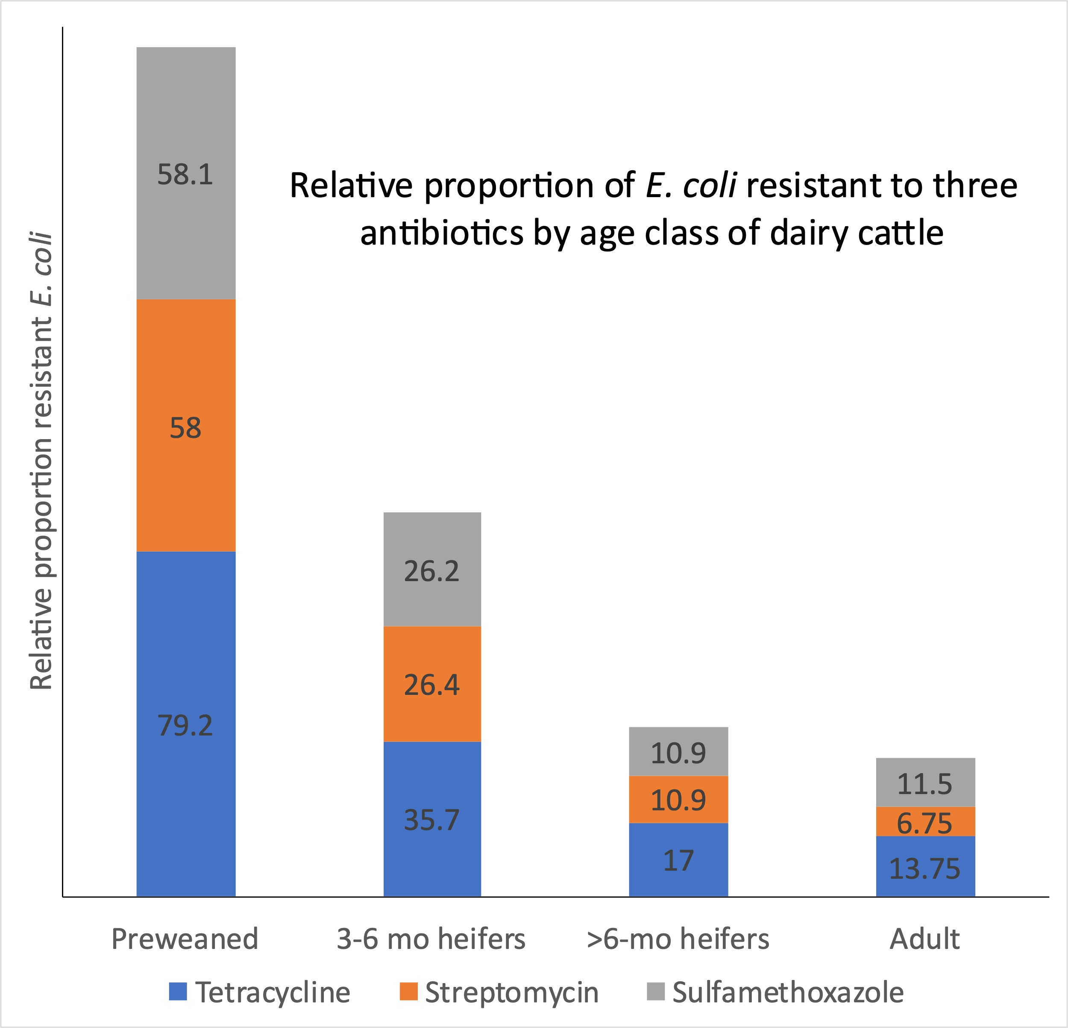
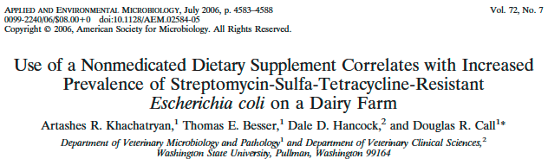
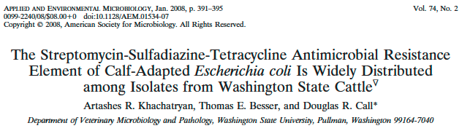
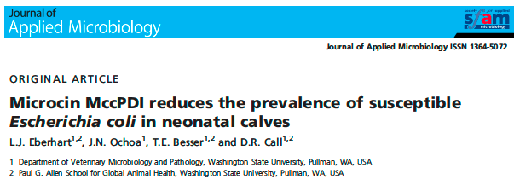
Take-home messages
ABR bacteria can persist for reasons other than selection from antibiotics
Younger animals are a primary source of resistant bacteria

Slide 6
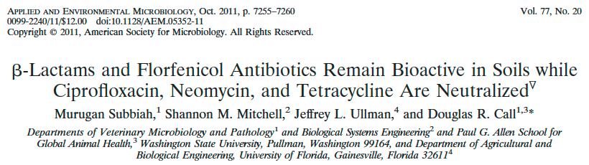
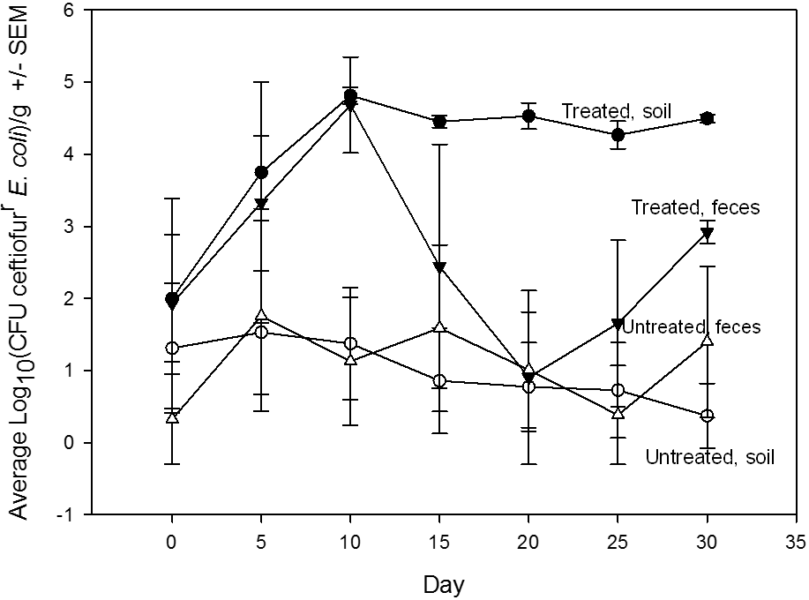
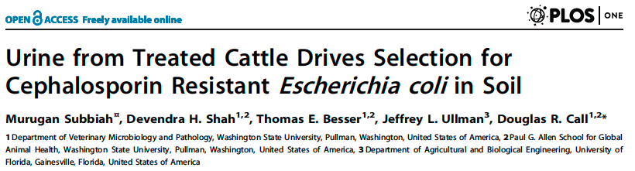
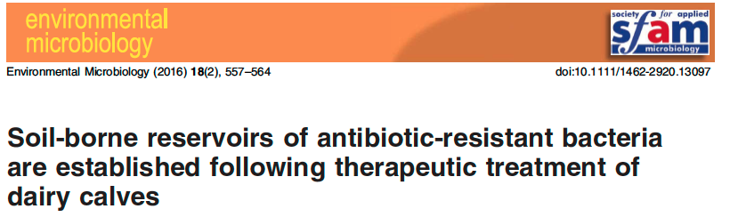
100,000 E. coli/g
100 E. coli/g

Slide 7
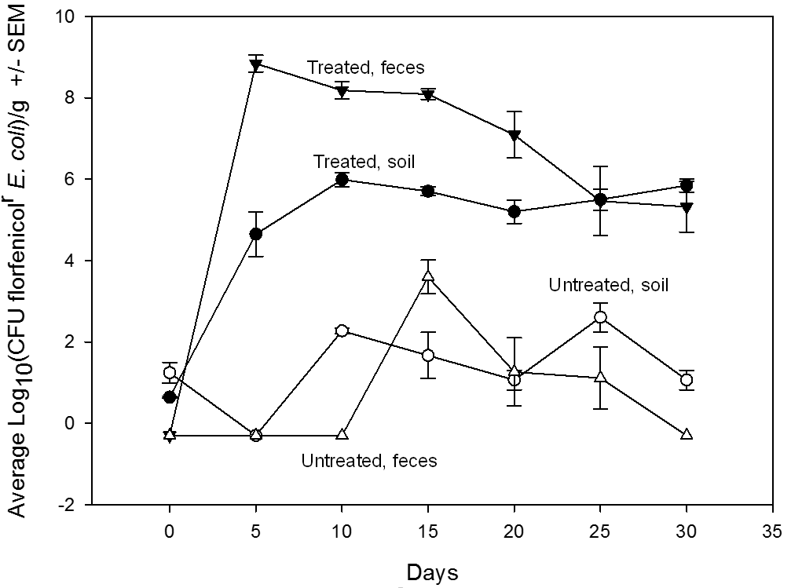
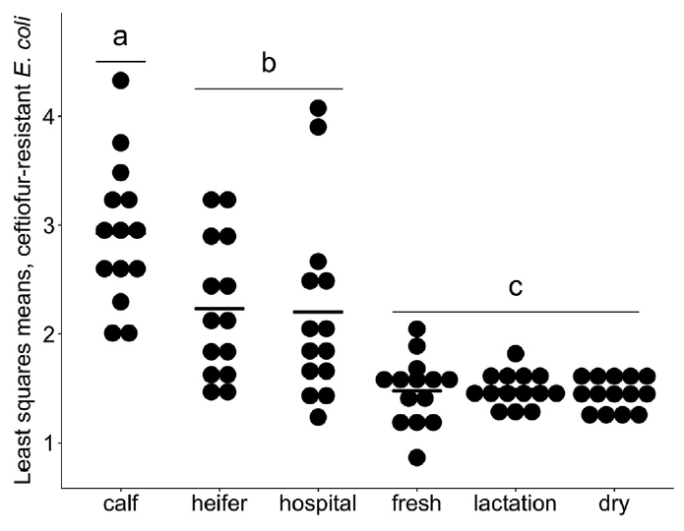
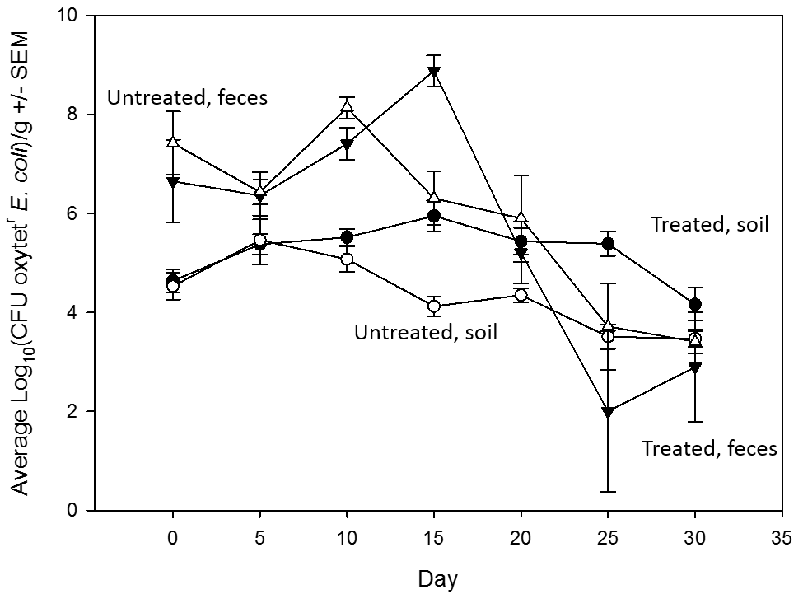
Take-home messages:
Not all antibiotics present the same magnitude of risk
Environmental reservoirs can become established quickly and they are predictable

Slide 8
In feed chlortetracycline prophylaxis of beef cattle
300 calves arrived 9 Feb 2015; on 14 Feb, 150 calves received 5-day in-feed CTC prophylaxis treatment; 150 untreated control calves.
25% of control calves developed illness requiring treatment with a macrolide (tildipirosin).
Only 2 animals in CTC group required treatment
No difference in prevalence of AMR after 27 days.
Highest AMR shedding rate for both groups was 75 and 117 days post treatment.
Agga et al. 2016. AEM

Slide 9
Summary
We will always find antimicrobial resistant bacteria on farms. The key is to reduce the total numbers to reduce transmission.
Younger animals and their housing locations are “hotspots” for antimicrobial-resistant bacteria. Different strategies can be used for different age groups.
When they work, some antibiotics will have less effect on AMR than others.
Regulations designed to stop preventative use of antibiotics will likely have unintended consequences.

Slide 10
Agriculture and Cross-border Livestock Health
Richard Rusk, DVM, MD, MPH
Associate Professor
Community Health Sciences
University of Manitoba
August 18th 2021

Slide 11
Presenter Disclosure
CFPC CoI Templates: Slide 1
Speaker: Dr Richard Rusk
Relationships with commercial interests:
  Grants/Research Support: PHAC grant – Lyme Disease
  Speakers Bureau/Honoraria: MCFP, University of Manitoba
  Consulting Fees: HyLife Foods Ltd., Maple Leaf Foods.
Notes:
This slide must be visually presented to the audience AND verbalized by the speaker.

Slide 12
Objectives
Overview of Human Health Antimicrobial Stewardship (AMS) programs in Canada
AMS Interventions in Human Health
Influencers to progress with AMS in north America
Re-addressing AMS After COVID

Slide 13
AMS Overview
Chief Public Health Officer of Canada’s 2019 Spotlight Report: “Handle with Care: Preserving Antibiotics Now and into the Future”
  Big picture focus
Canadian Integrated Program for Antimicrobial Resistance Surveillance (CIPARS) Annual Reports
  Antimicrobial Use data
https://www.canada.ca/en/public-health/corporate/publications/chief-public-health-officer-reports-state-public-health-canada/preserving-antibiotics/message.html

Slide 14
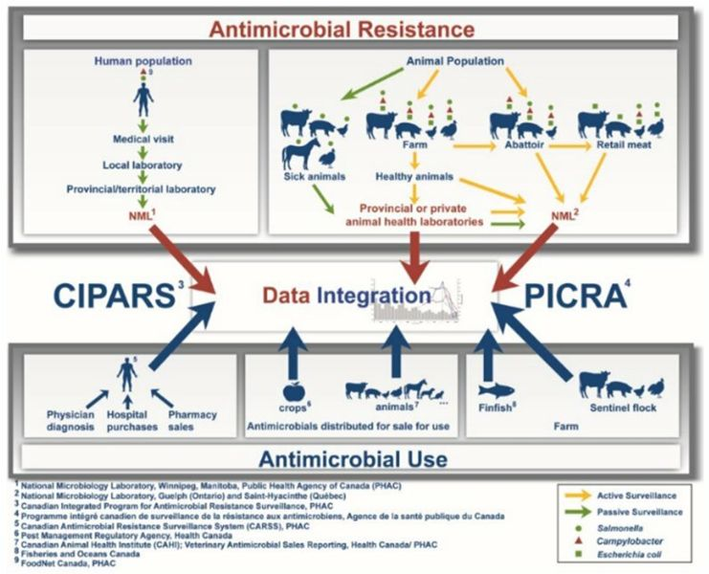
https://www.canada.ca/en/public-health/services/surveillance/canadian-integrated-program-antimicrobial-resistance-surveillance-cipars/cipars-reports/2018-annual-report-integrated-findings.html

Slide 15
AMS INTERVENTIONS
Community-based interventions
  Public awareness, community education and stewardship, National AMS Strategy
Primary-care interventions
  Educational programs, feedback to physicians, shared decision making, Electronic health records (EHR) surveillance
Health system interventions
  Guidelines, vaccinations, Point-of-care testing, Restricted reimbursement
https://www.canada.ca/en/public-health/services/publications/drugs-health-products/interventions-address-antimicrobial-use.html

Slide 16
SOCIAL DETERMINANTS of AMS
Organization and health system-related
  Availability and access to diagnostic tools and guidelines, peer influence, systems for self-monitoring (EHR), OTC sales, economic incentives from pharma, malpractice laws, sick leave policies, daycare policies, vaccination campaigns
Practitioner-related
  Knowledge, beliefs, and attitudes towards antibiotics, perceived expectations, shared decision making, patient-practitioner relationships, practice volume, medical training
Patient-related
  Attitudes, knowledge, or beliefs about antibiotics, illness and health behaviours, expectation of a prescription, previous experience, demographics and social determinants of health
Sociocultural factors
  Power distance, uncertainty avoidance, cultural perceptions, income inequality
https://www.canada.ca/en/public-health/services/publications/drugs-health-products/social-cultural-drivers-antimicrobial-use.html

Slide 17
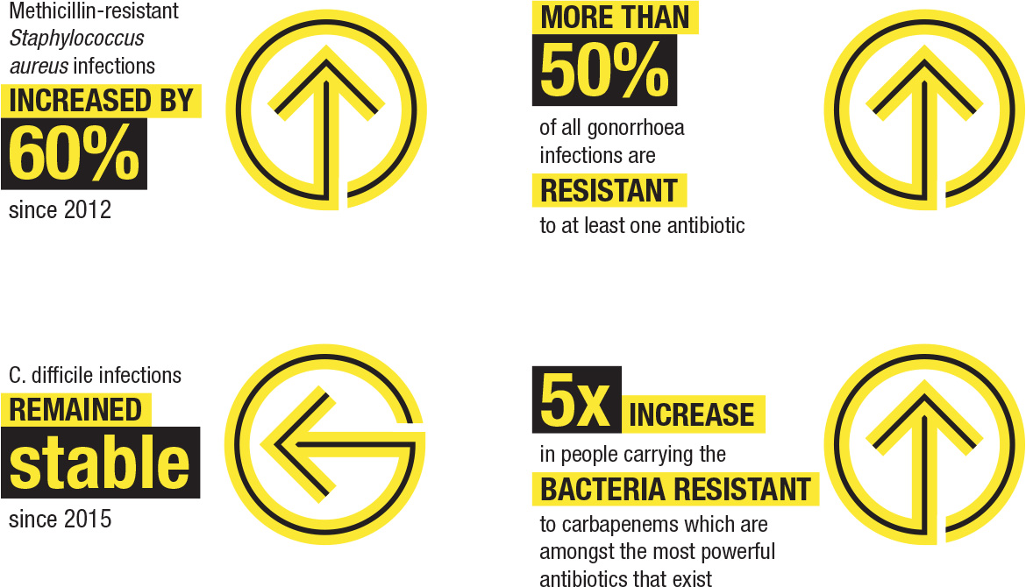
AMR Priorities

Slide 18
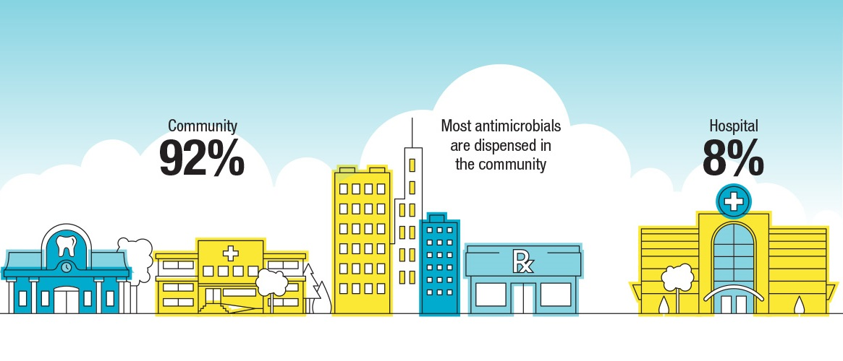
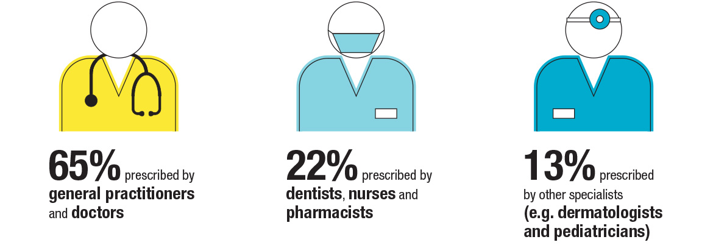

Slide 19
AMS Progress Concerns
COVID 19 pandemic
Influence of Covid on AMS
  Diverted funding
  Diverted personnel
  Diverted research focus
  Lower risk tolerance by clinicians in community who then increase the use of antibiotics
Less educational and promotional information available

Slide 20
Re-addressing AMS After COVID
Require a mosaic of actions
Division of actions into “segments”
  Primary care, acute care, ICU, long-term care, transplant patients, infectious diseases
Focus on actions that impact and resonate the most for the physicians in that segment
Use a broader team to create a safety net for the clinicians - check lab results and medical orders

Slide 21
CONCLUSION
Addressing AMS and AMR is a WICKED problem
Human Health and Animal Health have overlaps but also very different issues to address and focus on
COVID 19 pandemic has had a negative effect on progress
Sub-divide efforts into specific sections moving forward

Slide 22
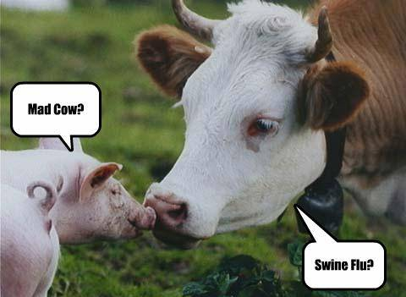
QUESTIONS

Slide 23

Intersection of Trade and Antimicrobial Resistance and Use Policies
Rachel Cumberbatch, DVM
Animal Health Institute
PNWER 30th Annual Summit 2021

Slide 24




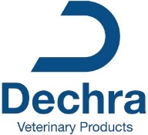













Animal Health Institute (AHI): Who are we?
Notes:
18 animal health companies and affiliate members of the Animal Health Institute (AHI)
Some major animal health companies are subsidiaries of human health/pharmaceutical companies
Majority are global/multinational companies
Local/regional players in regions/geographies

Slide 25
  The animal health industry is heavily regulated.
Safe
Safe
Human Food Safety
Target Animal Safety
Environment Safety
Product Safety
  Chemistry, Manufacturing and Control
Effective
Target Animal
Notes:
All animal drugs are required to demonstrate both safety and effectiveness through extensive data packages. This process can take up to 10 years in food producing animals.

Slide 26
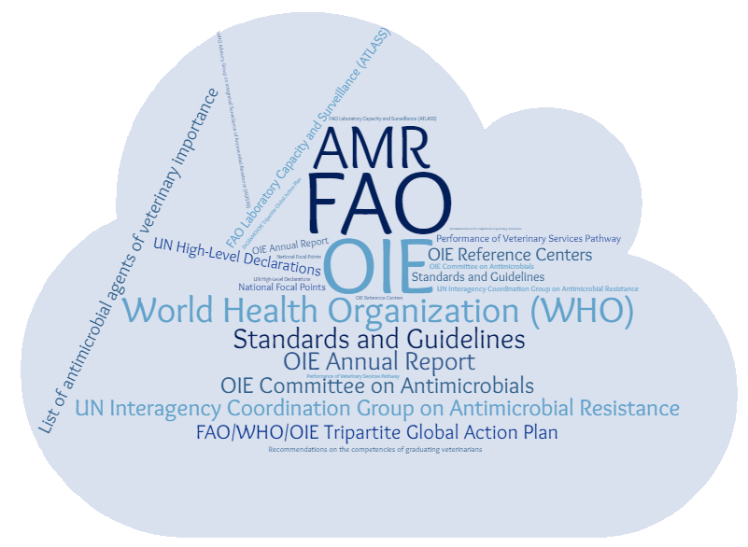
Flurry of International Activity Related to AMR

Slide 27
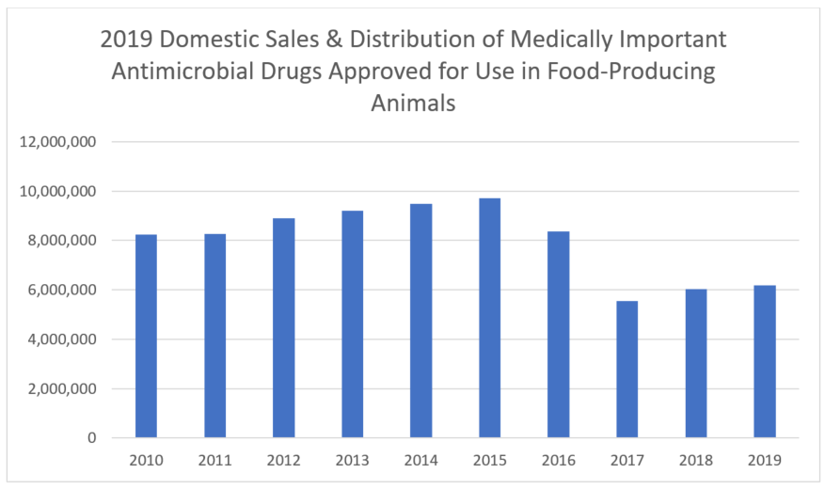
Significant Domestic Progress on AMR
Medically Important Antimicrobials Under Veterinary Oversight
Elimination of Growth Promotion Indications
National Surveillance through NARMS
FDA Antimicrobial Sales Reporting
National Action Plan
AVMA Judicious Use Principles
Species Specific Guidelines

Slide 28

Codex Task Force on AMR
OIE & Codex are Referenced Standards at the World Trade Organization
Influence direction of development funding
Serve as starting point for domestic policies
Terms of Reference:
  Revise the Code of Practice to Minimize and Contain Antimicrobial Resistance to address the entire food chain, in line with the mandate of Codex.
  Consider the development of Guidance on Integrated Surveillance of Antimicrobial Resistance

Slide 29

Article 118
Article 118, a section in the EU vet medicines legislation, prohibits the use of certain antimicrobials in food animal production exported to the EU. The EU legislation would effectively impose EU hazard-based antibiotic use measures on meat, milk, egg, and fish producers in countries that export to the EU, including the United States. Policy is set to take force January 2022.
Reasons for Concern:
Reduce food/meal/milk/fish/egg exports to the EU
Threaten animal health and animal welfare by limiting animal disease control options and increased cost to third countries
Hinder access to medicine by preventing veterinarians using products approved by the FDA
Sets a negative precedence
Not WTO Compliant and under WTO rules unnecessary
Notes:
The European Union has proposed addressing AMR in the context of trade agreements. AHI believes that AMR-specific provisions in trade agreements are unnecessary and inappropriate. Any country that identifies a legitimate AMR-related food safety risk already has the right under the WTO Agreement on the Application of Sanitary and Phytosanitary Measures to restrict imports from the country or the operator that is the source of that risk. Regulatory standards that are not risk-based and trade-related have no place in a trade agreement.

Slide 30

AMR-specific provisions in trade agreements are unnecessary and inappropriate
Any country that identifies a legitimate AMR-related food safety risk already has the right under the WTO Agreement on the Application of Sanitary and Phytosanitary Measures to restrict imports from the country or the operator that is the source of that risk.

Slide 31
Summary
Animal medicines are heavily regulated. Veterinarians are central to judicious use programs that slow the development and spread of AMR bacteria.
There is significant activity underway domestically and internationally.
Activity internationally affects domestic policy. Therefore, engagement is important.
EU legislation to take effect in Jan 2022 aims to dictate antimicrobial use in third countries.
AMR-specific provisions in trade agreements are unnecessary and inappropriate.

Slide 32
Thank you

Slide 33
Ultimately the goal is to maintain or return an animal to health.
There are currently no approved alternatives to antibiotics for the treatment of bacterial infections in animals.
Removing traditional antibiotics prematurely can have negative consequences.
  A 2018 study found that 65% of veterinarians, producers and other animal health stakeholders felt that rearing animals in a 'Raised Without Antibiotics' system slightly or significantly worsens animal health and welfare.
How does AHI view AMR?
Managing AMR and preserving the effectiveness of antibiotics is a core goal. Industry is an important collaborator in the fight to reduce the development and spread of AMR. The goal is to reduce the need for traditional antibiotics while protecting the health and welfare of our animal patients.
Notes:
To prevent and manage infectious diseases, it is sometimes necessary for veterinarians and farmers to turn to antibiotics. Research has shown the proper use of antibiotics can keep food animals healthy and reduce the potential for harmful bacterial contamination of finished meat products.

Slide 36
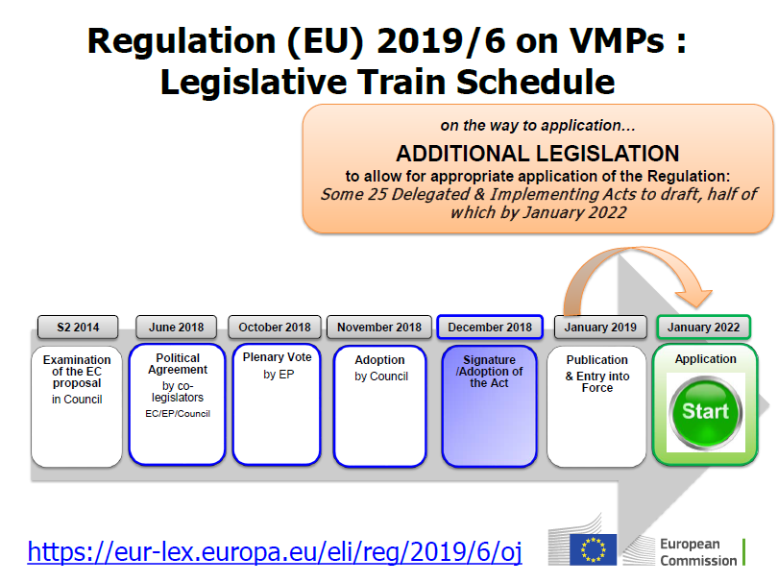
Timeline for Article 118 Implementation

Slide 37
Relevant WTO Rules:
Agreement on the Application of Sanitary and Phytosanitary Measures
Article 4
Equivalence
1. Members shall accept the sanitary or phytosanitary measures of other Members as equivalent, even if these measures differ from their own or from those used by other Members trading in the same product, if the exporting Member objectively demonstrates to the importing Member that its measures achieve the importing Member's appropriate level of sanitary or phytosanitary protection. For this purpose, reasonable access shall be given, upon request, to the importing Member for inspection, testing and other relevant procedures.

Slide 38
Relevant WTO Rules:
SPS Agreement
Articles 2.2 and 5.1 require Members to base measures on scientific principles, sufficient scientific evidence and a risk assessment
Articles 2.2 and 5.6 require Members to ensure that measures are no more trade restrictive that necessary to protect health

Slide 39
Relevant WTO Rules:
SPS Agreement
Article 3 requires Members to base measures on international standards unless they can justify scientifically a stricter standard
  World Organization for Animal Health (OIE)
    OIE Terrestrial Animal Health Code
    OIE Aquatic Animal Health Code
    OIE List of Antimicrobial Agents of Veterinary Importance
    Resolution No. 36 – Combating Antimicrobial Resistance through a One Health Approach: Actions and OIE Strategy
  Codex Alimentarius
    Guidelines for Risk Analysis of Foodborne Antimicrobial Resistance
    Code of Practice to Minimize and Contain Antimicrobial Resistance

Slide 40


