Slide 1
Lending to people, Investing for resilience
Throughout Oregon and Washington

Slide 2
Craft3 is a nonprofit that provides loans to entrepreneurs and individuals
Since 1994, Craft3 has invested over $423 million in entrepreneurs, nonprofits and individuals.
Craft3 loans align with our mission of strengthening economic, ecological and family resilience.
Loans are available in the urban and rural communities of Oregon and Washington.
60 employees are located in 7 regional offices.

Slide 3
Craft3 delivers on a “Capital Plus” regional lending strategy
Craft3 makes long-term commitments to regional economic centers.
Focusing loans in these centers allows the impact to amplify throughout the surrounding regions.
These create jobs, other measurable outcomes and build durable links between urban and rural communities.
Craft3 provides more than just capital, brokering relationships, knowledge and networks to support our clients.

Slide 4
Craft3 works with businesses, nonprofits and individuals in a variety of sectors
Clean energy and energy-efficiency
Manufacturing and value-added processing
Agriculture and food systems
Land and water conservation
Essential services/community facilities
Small retail and hospitality

Slide 5
Annual lending 2012-2016

Slide 6
$423 million in Craft3 loans support resilience outcomes
503 | Loans to entrepreneurs of color, women- and veteran-owned businesses
12,004 | Jobs created or retained
92,865 | Low-income families assisted
$1 billion | Owner equity and other funds leveraged
17,306 | Acres conserved
2.3 million | MBTUs of energy conserved
858,005 | Metric tons of greenhouse gases averted
993 million | Cumulative gallons of water treated
$1.4 billion | Real estate value maintained
Notes:
http://www.census.gov/popest/data/state/totals/2015/index.html

Slide 7
Craft3’s mission-aligned investors are essential to delivering capital and impact
More than 120 investors trust Craft3 with over $137 million in capital grants and loans.
Since inception, Craft3 has maintained a 100% investor repayment record.
Notes:
http://www.census.gov/popest/data/state/totals/2015/index.html

Slide 8
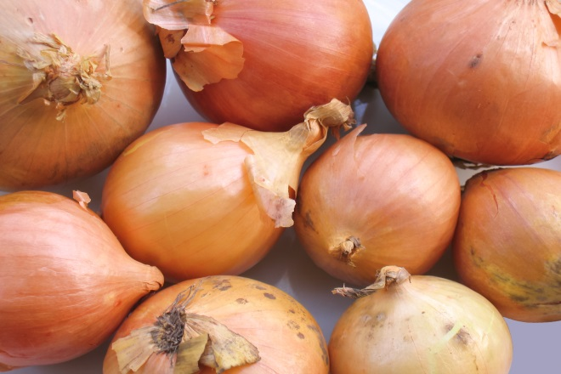
Craft3 business loan
FRY FOODS
Ontario, Oregon
Fry Foods is family-owned and operated, with a 75-year history in the food industry. When its West Coast processing facility in Weiser, Idaho reached capacity, Fry Foods sought a larger location. It found the former Select Onion process facility. This 302,000 square foot facility was used to process onions until its close in 2012. The facility is five times larger and located just 20 miles away in Ontario, Oregon, one of the largest onion producing regions in the country.
With Ontario’s personal income levels trailing the state average by 31% and more than a quarter of the population living below the poverty line, bringing 180 existing employees to the area and creating 124 new jobs for locals will be a huge boost to Ontario’s economy.
In partnership U.S. Department of Agriculture, Craft3 provided Fry Foods with a $10,000,000 loan to finance the purchase of the existing Select Onion facility.
MEETING OUR MISSION
$1.4 million of funds leveraged
$10 million value-added processing
304 jobs in a high-poverty area
$15.5 million real estate value maintained
Minimizes environmental impact

Slide 9
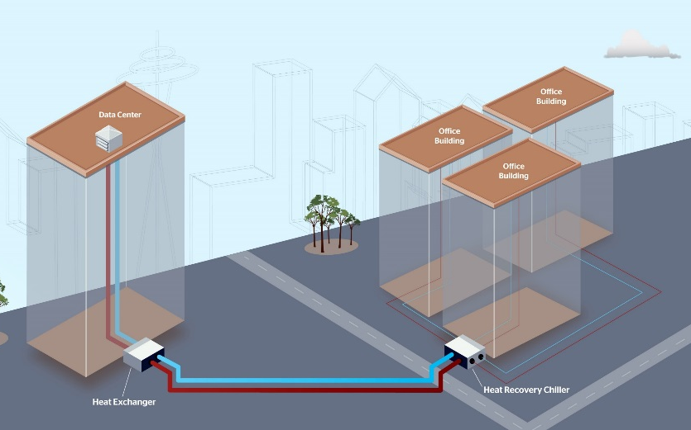
Craft3 clean energy loan
McKINSTRY
Seattle, Washington
McKinstry is a 54-year old full-service design, build, operate and maintenance firm. It is a national leader in energy-efficiency design and build for the commercial, municipal and industrial sectors. McKinstry has developed specialized expertise in data center energy management.
McKinstry and its partner, Clise Properties, are participating in a ground breaking project that transfers waste heat from the Westin Building data center to the new headquarters of a large online retailer based in Seattle. The waste heat exchange system will provide hot water and space heating in the building, allowing the retailer to save three-quarters of the electricity it would bought for it otherwise.
Craft3 provided McKinstry with a Clean Energy Loan to supplement contributions to the project.
MEETING OUR MISSION
19 construction jobs created
$2.4 of other funds leveraged
5,516 metric tons of greenhouse gasses averted

Slide 10
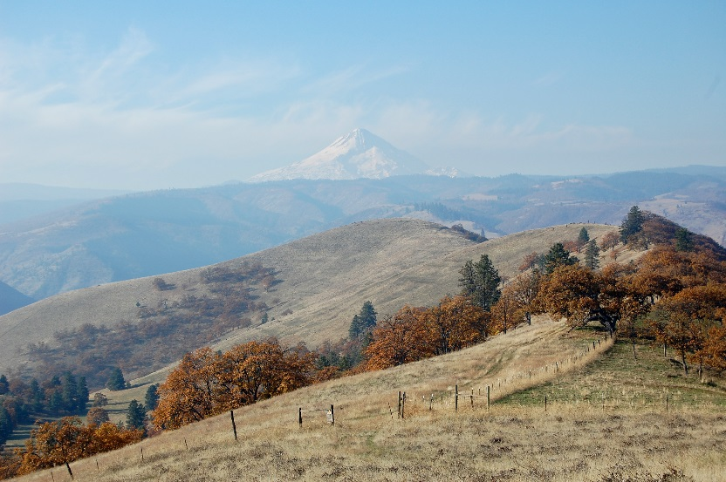
Craft3 conservation loan
COLUMBIA LAND TRUST
The Dalles, Oregon
Columbia Land Trust is a 24-year-old nonprofit focusing on land conservation, land stewardship and public outreach in the Columbia River region. It has conserved more than 24,000 acres across 175 different sites.
Craft3 provided the Trust with bridge financing to purchase 110 acres within the Mill Creek Ridge, connecting it with existing Trust land to protect rare white-oak Ponderosa pine habitat. Columbia Land Trust needed to move quickly to meet the seller’s timeline. Craft3’s Conservation Bridge Loan allowed the Trust to acquire the property ahead of grant funding, preventing the land from being sold for residential development. In addition to the loan, Craft3 provided a grant to Columbia Land Trust to help cover loan fees and closing costs.
MEETING OUR MISSION
$25,000 of other funds leveraged
Green Production Business
110 acres of conservation lands
$315,000 real estate value maintained

Slide 11
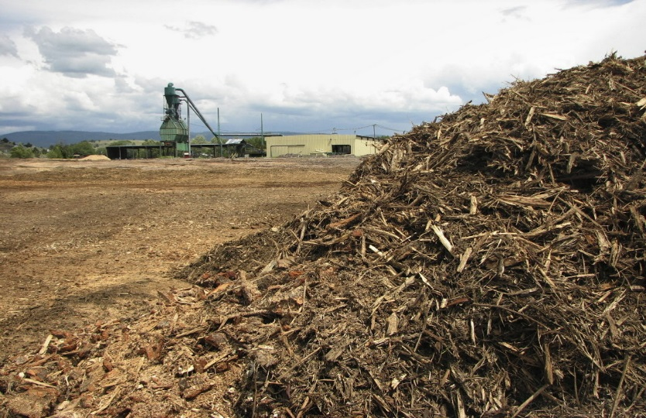
Craft3 clean energy loan
INTEGRATED BIOMASS RESOURCES
Wallowa, Oregon
David and Jesse Schmidt started Integrated Biomass Resources (IBR) in 2009 to transform the low-value woody biomass left over from timber harvesting into thermal energy products. For several years, IBR concentrated on producing bundled firewood, wood chips, post and poles.
Then in 2012, IBR moved to the former Wallowa Forest Products mill site and transformed it into an integrated log yard.
Craft3 provided Integrated Biomass Resources with a loan to install the new equipment and implement site upgrades. These upgrades will increase efficiency and throughput by about 200 percent. It will also allow IBR to produce a broader range of products and lower its cost of raw materials.
MEETING OUR MISSION
21 jobs created or retained
$525,000 leveraged for the project
395,000 in value-added processing

Slide 12
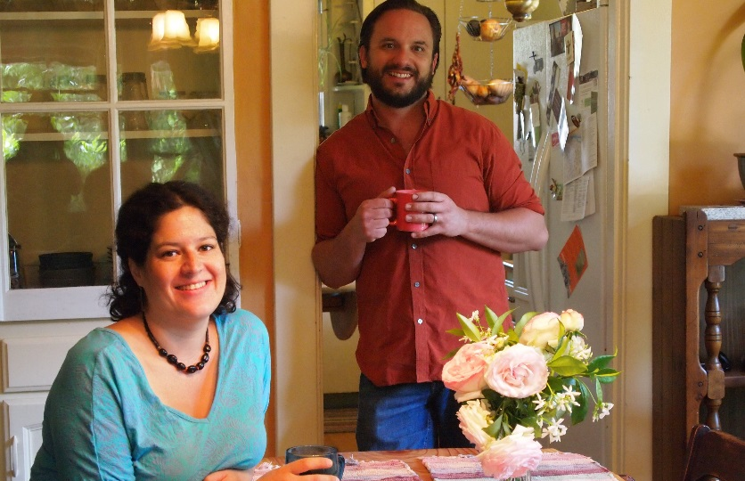
Craft3 home energy loan
SHADIA DUERY
Portland, Oregon
Shadia Duery knew that buying a 1913 Portland home would mean taking on a laundry list of home improvements. After experiencing the first winter in her house, Shadia realized she needed to do something to keep energy bills down and comfort level up.
She learned about Enhabit from a friend. Shadia found the application process fast and simple. Her contractor provided her with a menu of improvements and helped her select the right ones for her home. The upgrades Shadia chose gave her an estimated total of 30 percent energy savings.
Craft3 provided Shadia with a Home Energy Efficiency Loan to seal the basement and attic, insulate the walls and install a new water heater and two heat pumps. After applying rebates and incentives of $2,000, Shadia’s project totaled $14,800. Her Craft3 loan is repaid through her regular utility bill.
MEETING OUR MISSION
$2,000 of other funds leveraged
2.97 tons of greenhouse gases averted
56.22 BTUs of energy conserved
$276,120 real estate value maintained

Slide 13
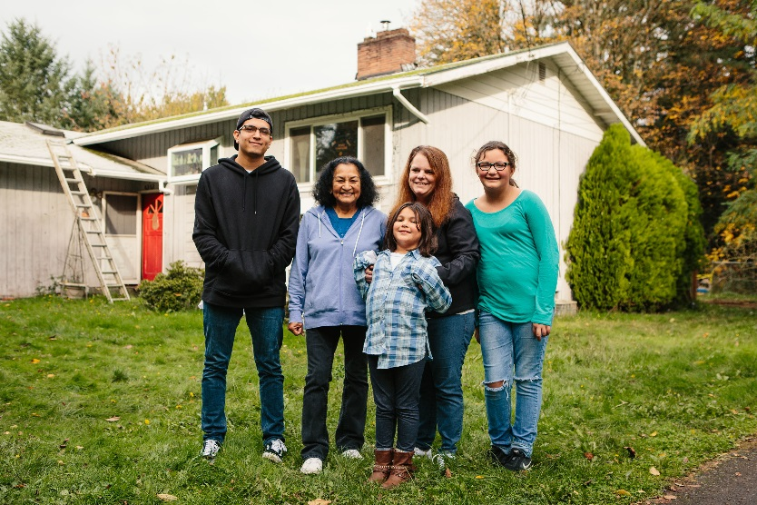
Craft3 clean water loan
FLORIDALMA TORRES & SHAWNA HAGER-CRASE
Portland, Oregon
Floridalma Torres has lived in her East Portland home for 13 years. She shares it with her son Anthony, his fiancé Shawna and their three children. They first found out there was a problem when the plumbing started backing up.
Shawna contacted a local septic professional and received an estimate for replacement, about $19,000. A web search revealed a few options. They could take out a second mortgage, but payments would have been about $500 per month—more than they could afford. Then she found Craft3.
Knowing how important running water and flushing toilets are to a family of six, Craft3 worked quickly to get loan documents signed and the contractor replacing the septic.
MEETING OUR MISSION
175,200 gallons wastewater treated
$348,170 real estate assets preserved

Slide 14
Rural – urban linkages
Historic statewide nature of the economies of the PNW
The linkages have frayed, but they are not gone
Intentional networks and knowledge sharing are critical
Parochialism and turf does not win the day
Public resource should be a “starter” to bring leveraged investment

Slide 15
Learn more about Craft3, our work or apply for a loan
Adam Zimmerman
azimmerman@craft3.org
888-231-2170 ext 500
www.Craft3.org
www.Craft3.org/About/Videos
www.Craft3.org/Borrow

